Slide 1
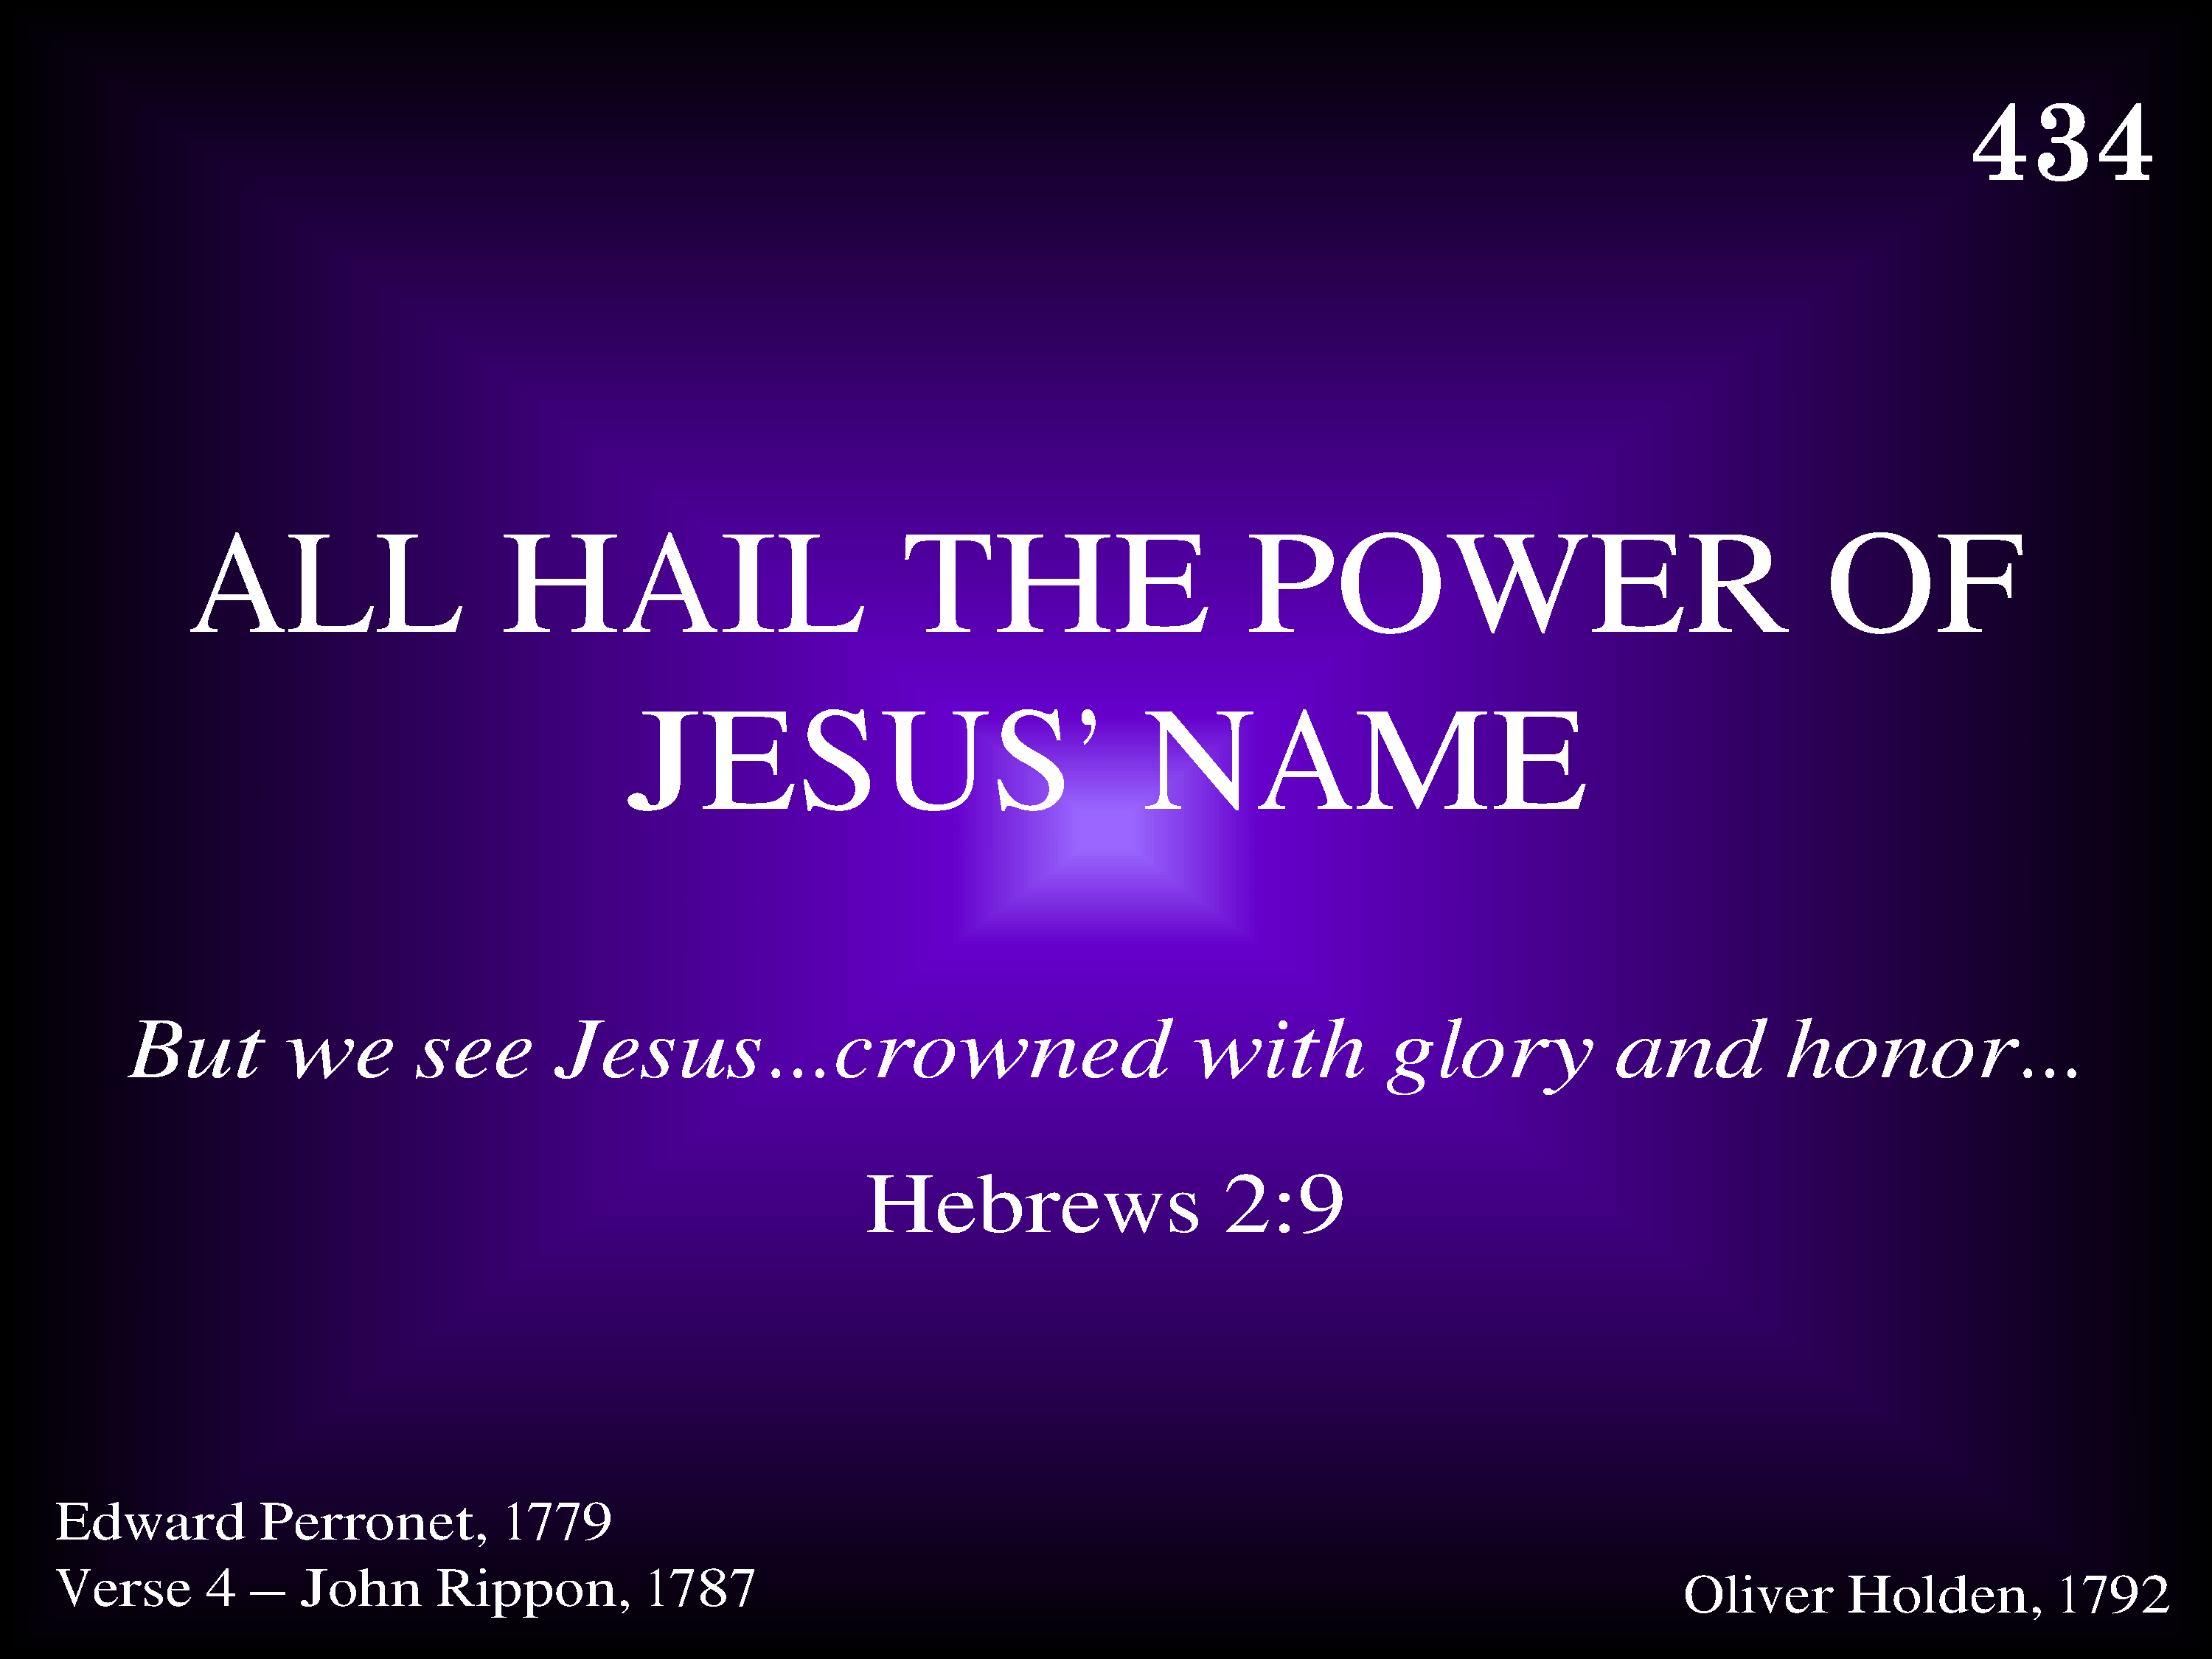
434 - All Hail The Power Of Jesus' Name - Title

Slide 2
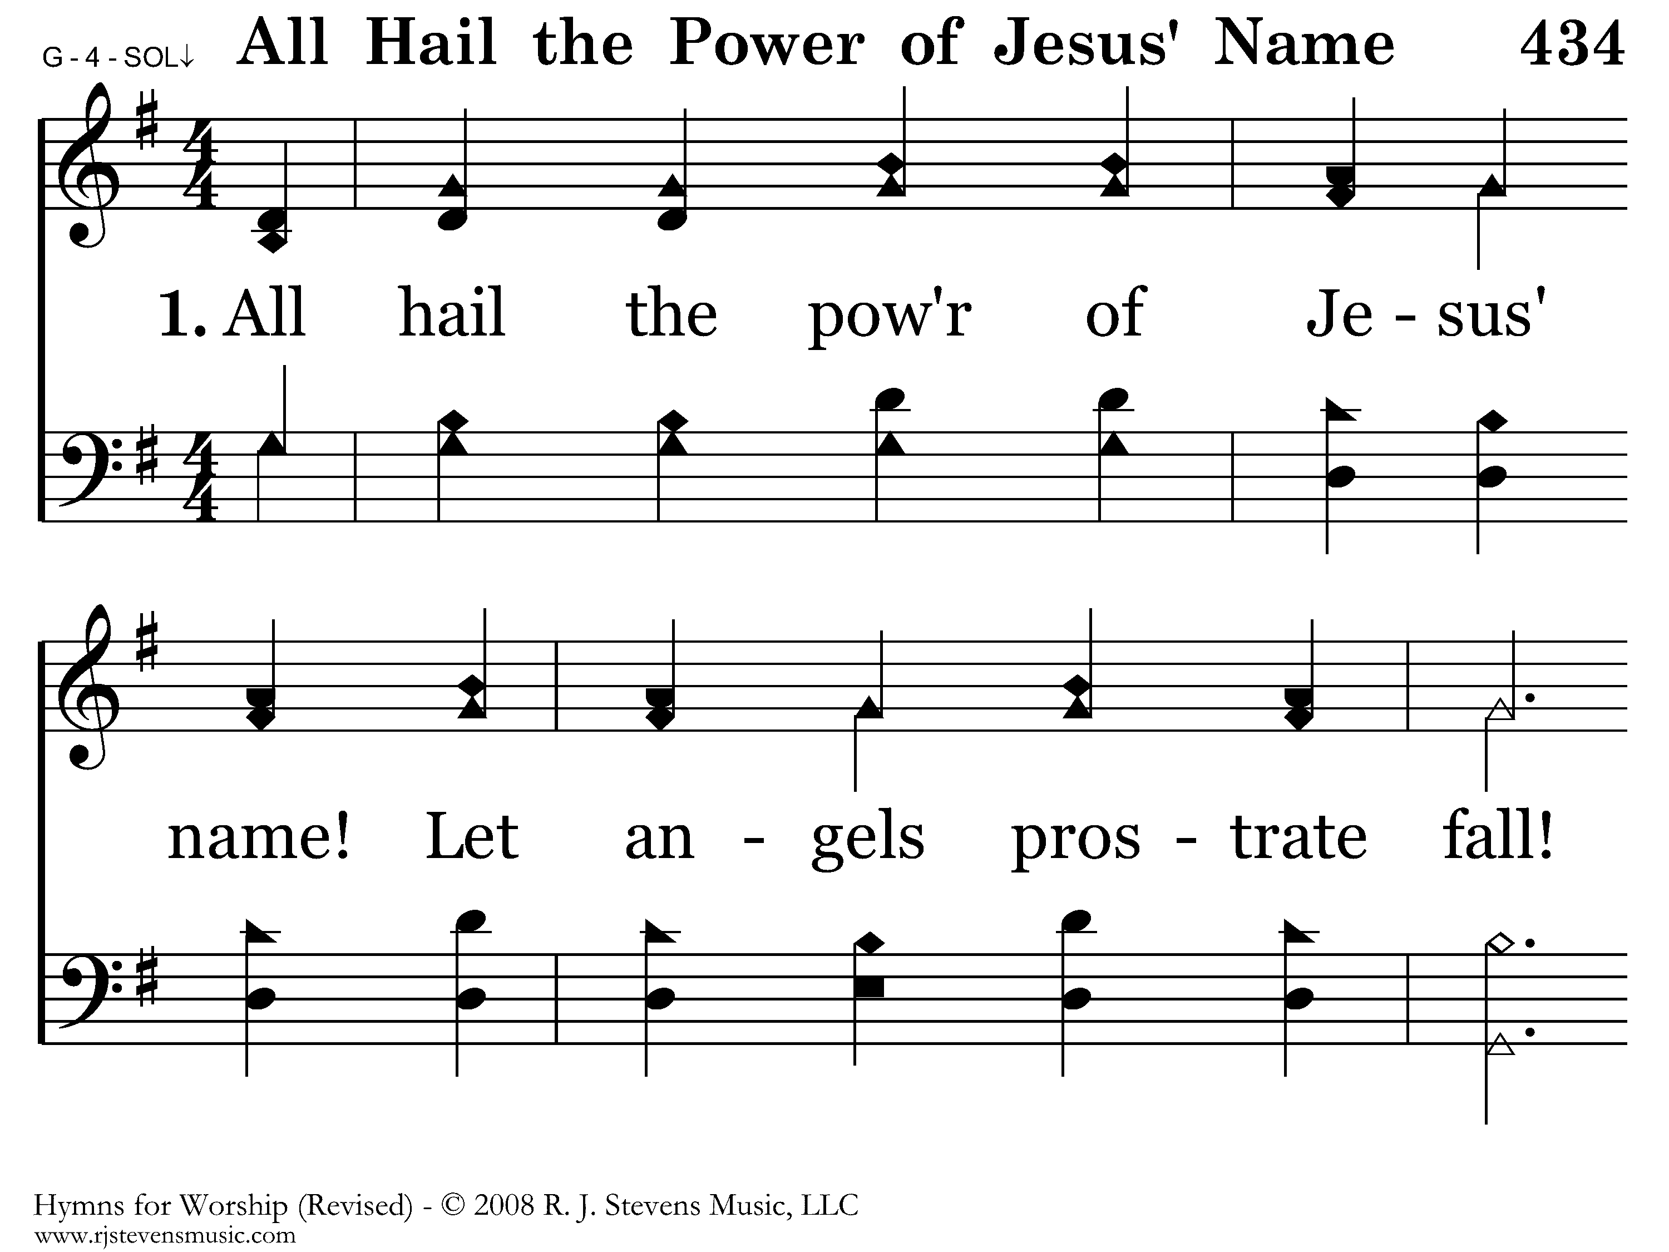
434 - All Hail The Power Of Jesus' Name - 1.1

Slide 3
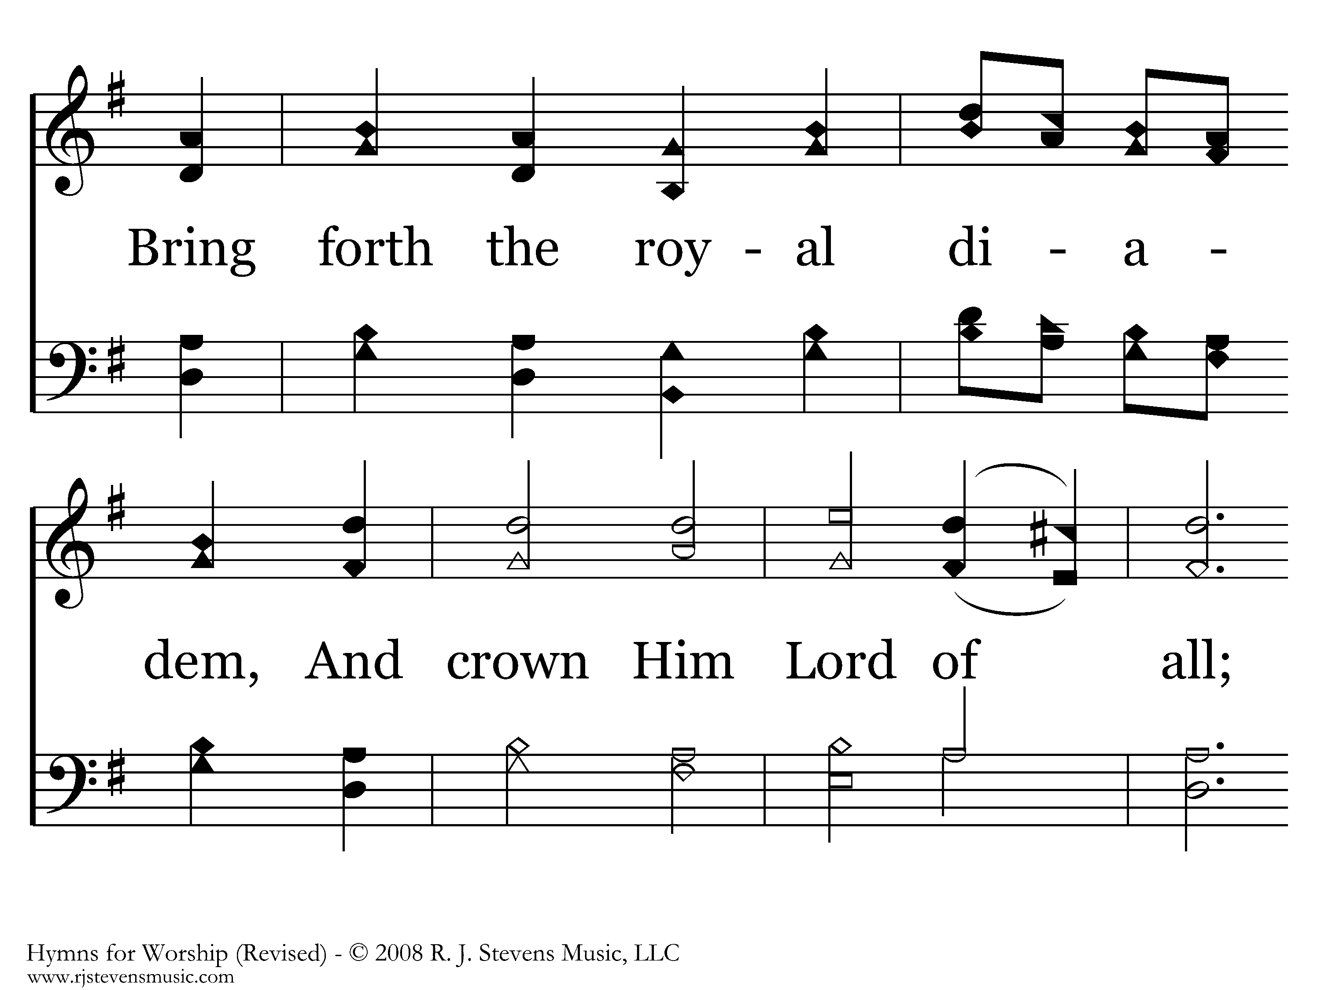
434 - All Hail The Power Of Jesus' Name - 1.2

Slide 4
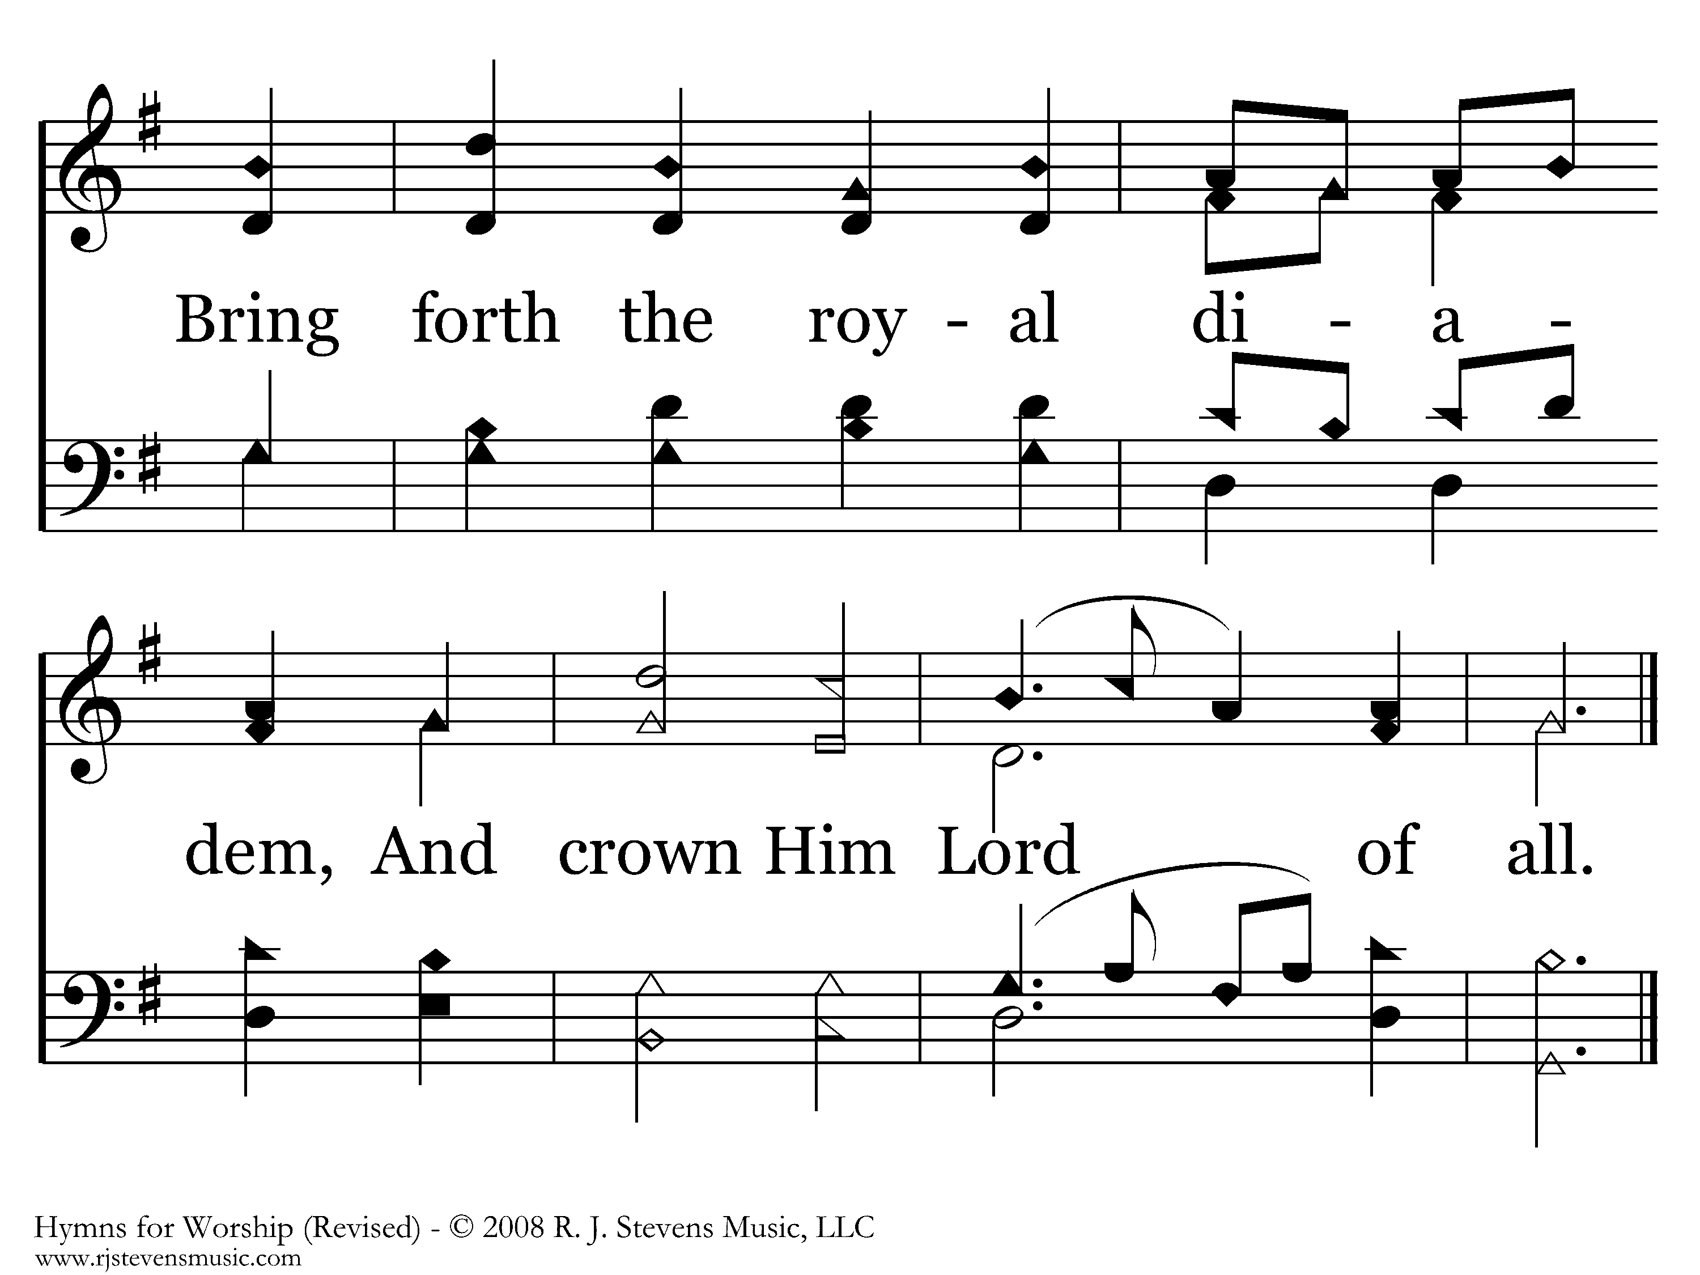
434 - All Hail The Power Of Jesus' Name - 1.3
End of Verse 1

Slide 5
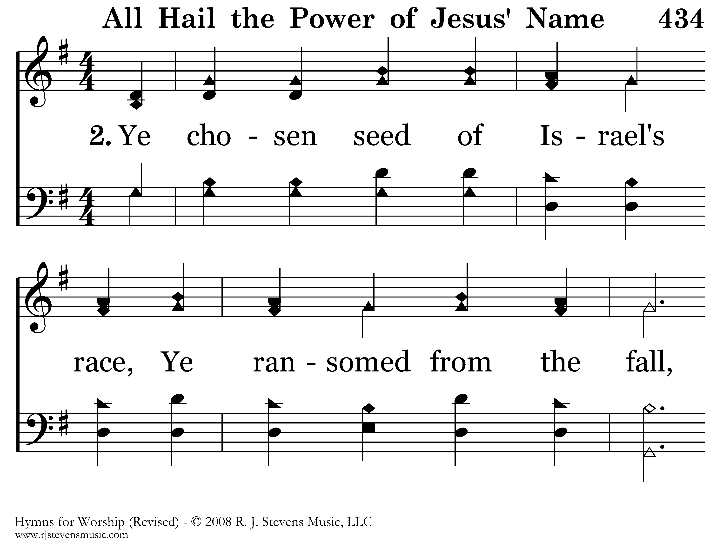
434 - All Hail The Power Of Jesus' Name - 2.1

Slide 6
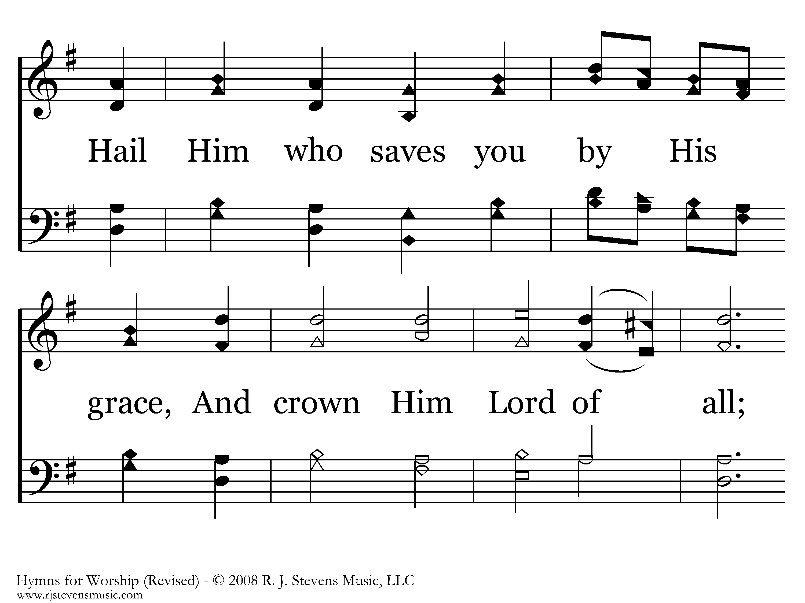
434 - All Hail The Power Of Jesus' Name - 2.2

Slide 7
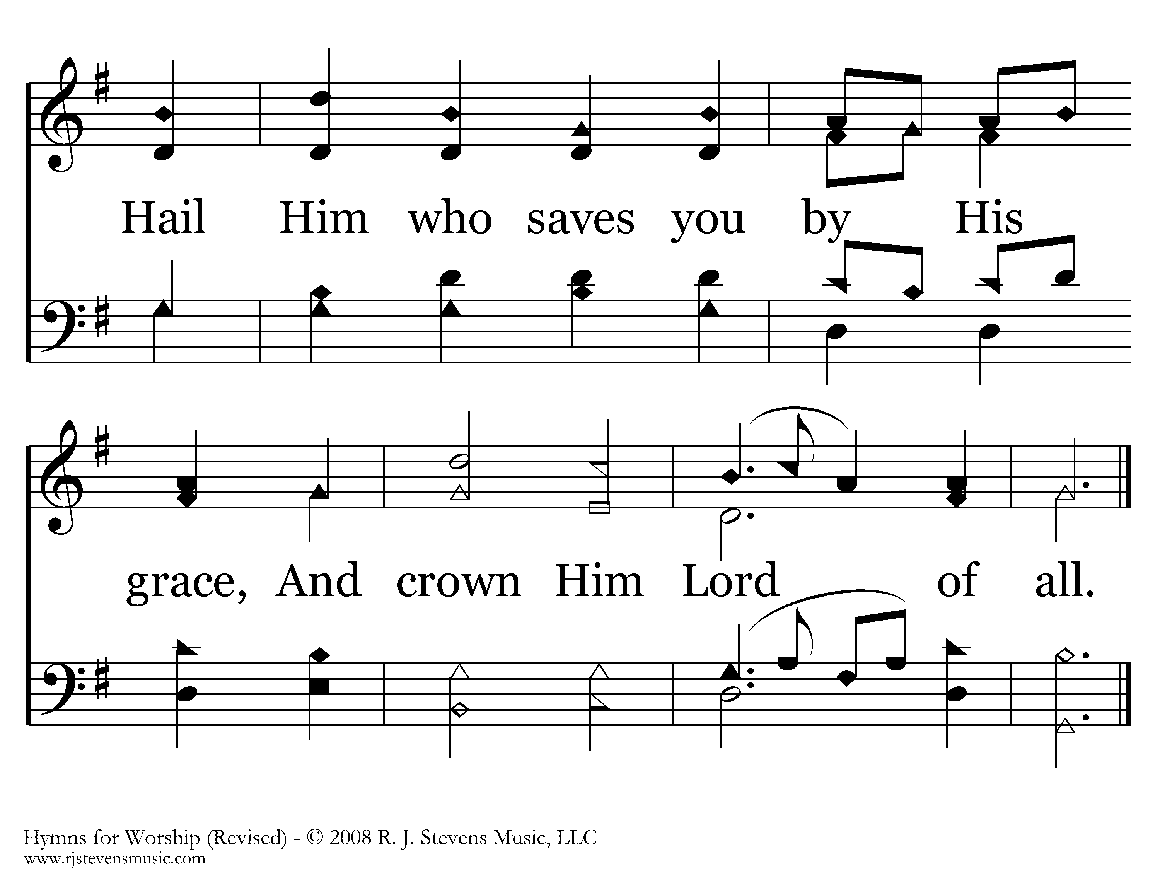
434 - All Hail The Power Of Jesus' Name - 2.3
End of Verse 2

Slide 8
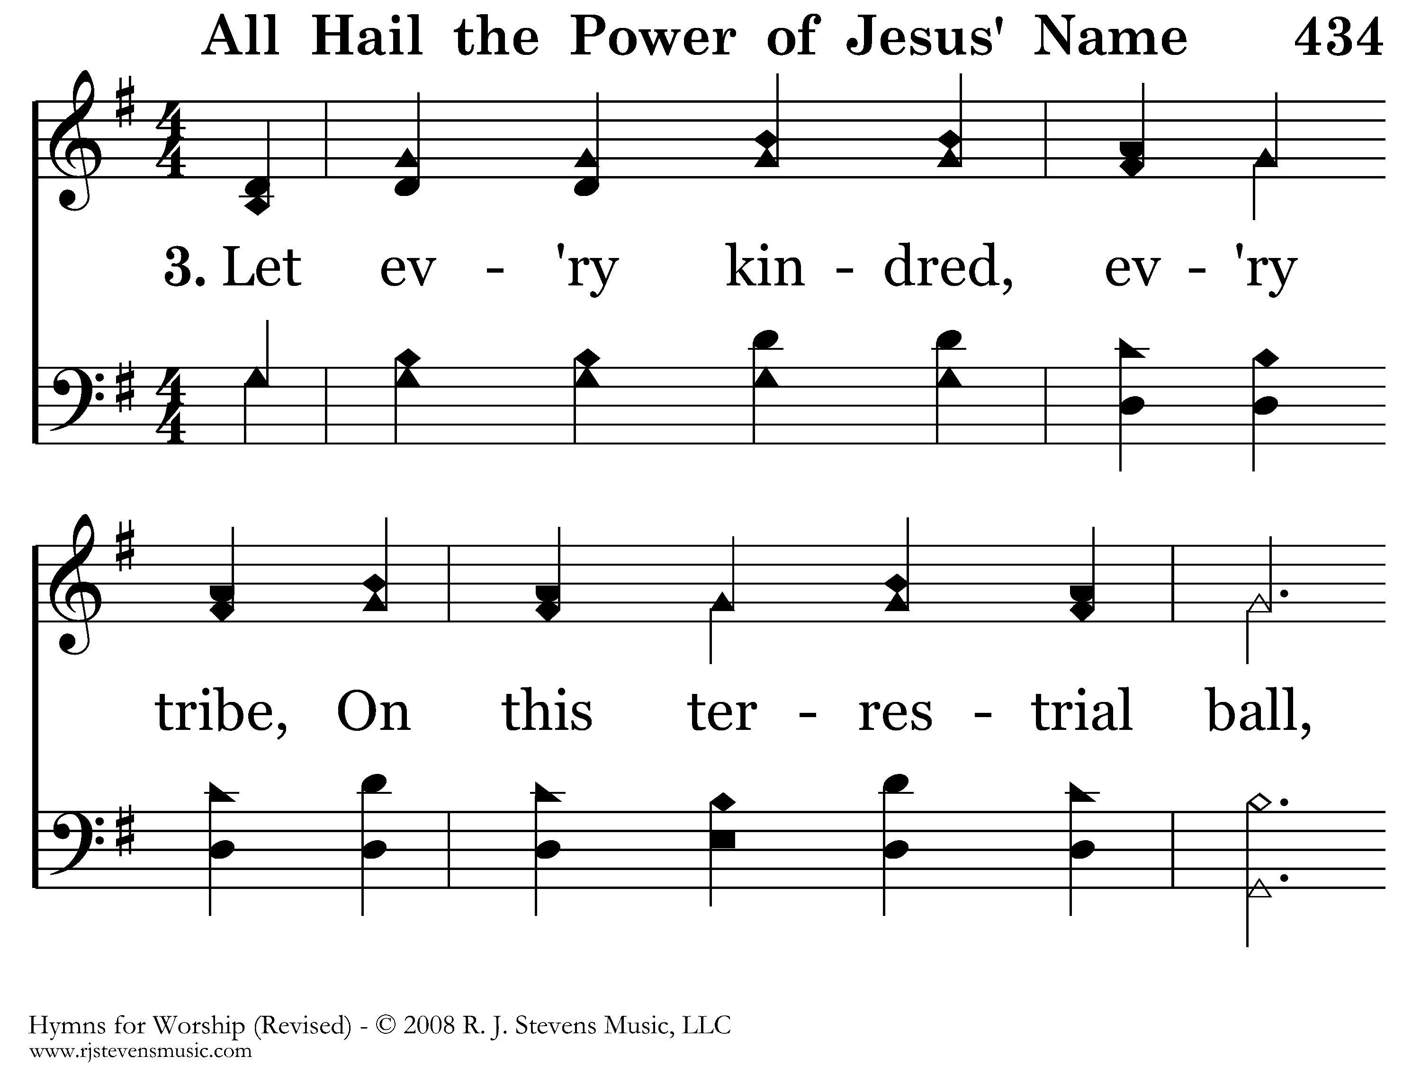
434 - All Hail The Power Of Jesus' Name - 3.1

Slide 9

434 - All Hail The Power Of Jesus' Name - 3.2

Slide 10
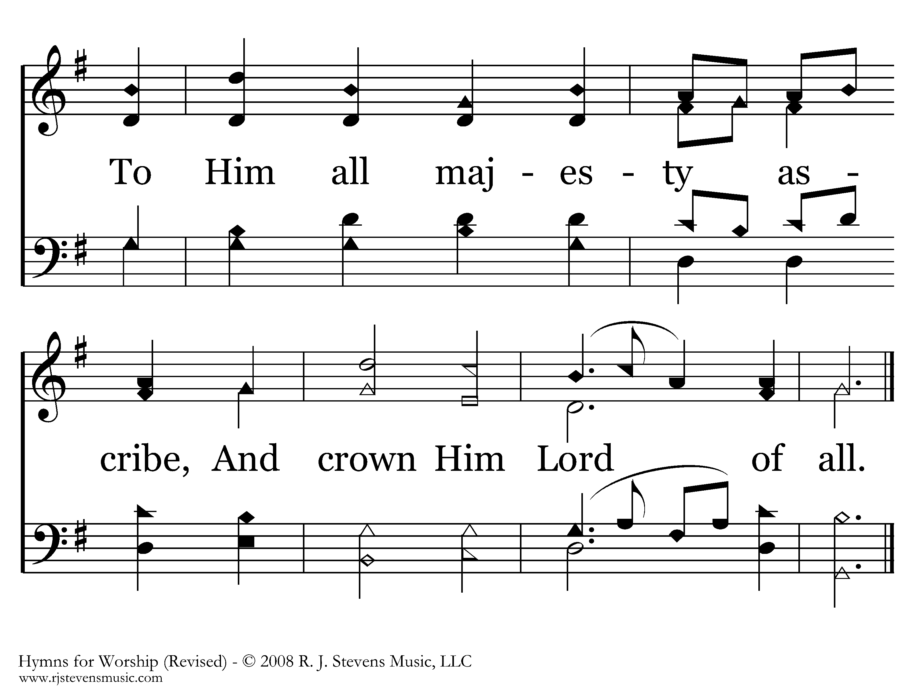
434 - All Hail The Power Of Jesus' Name - 3.3
End of Verse 3

Slide 11
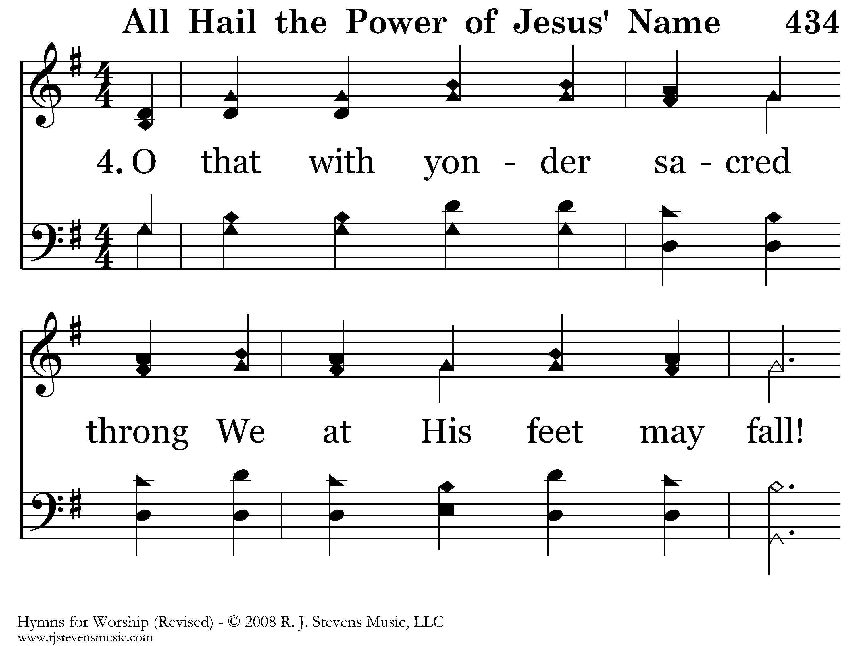
434 - All Hail The Power Of Jesus' Name - 4.1

Slide 12
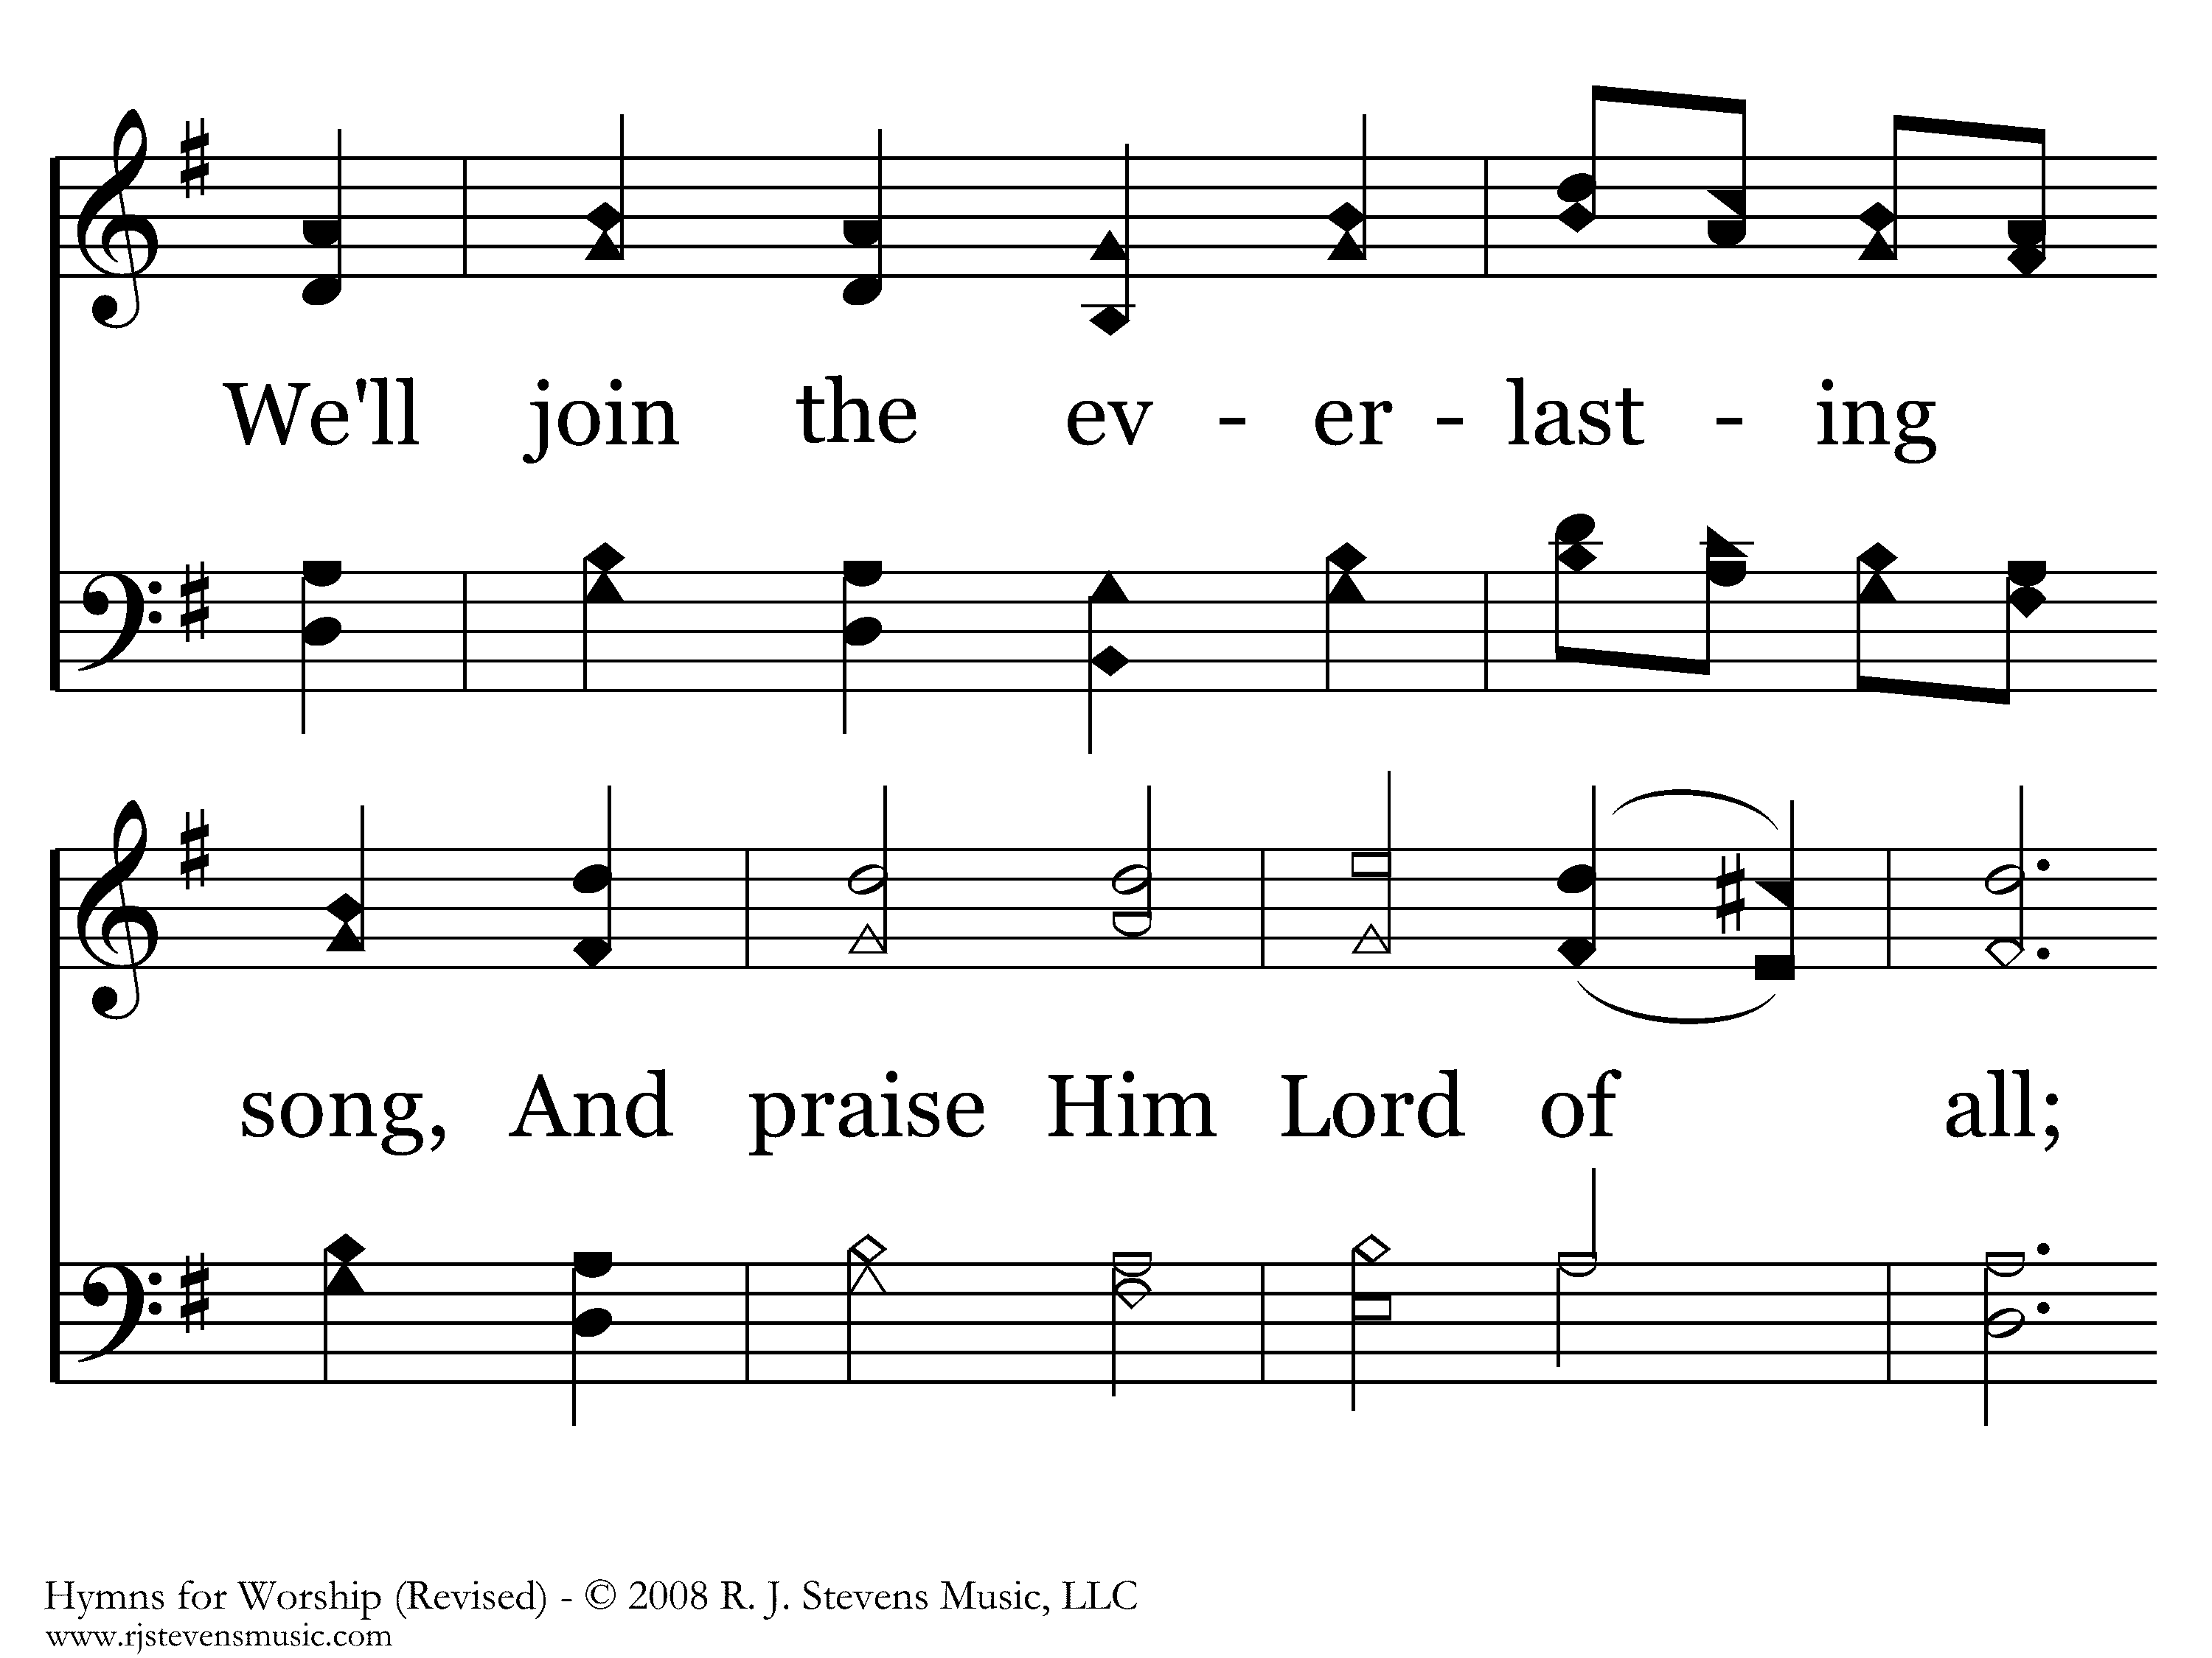
434 - All Hail The Power Of Jesus' Name - 4.2

Slide 13
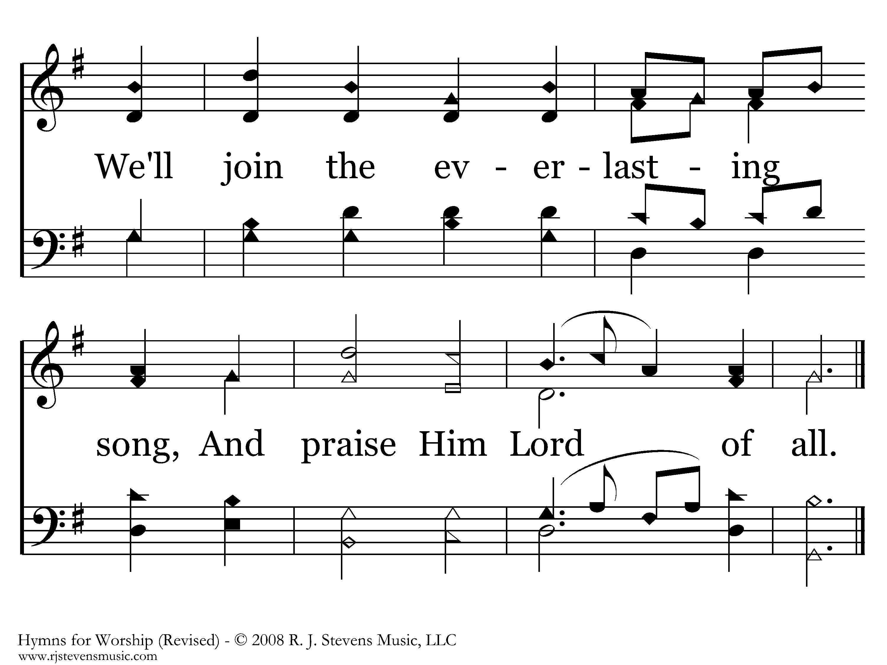
434 - All Hail The Power Of Jesus' Name - 4.3
End of Song

Slide 14
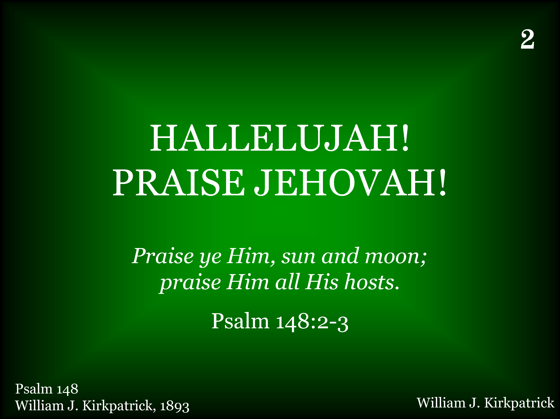
002 - Hallelujah! Praise Jehovah - Title

Slide 15
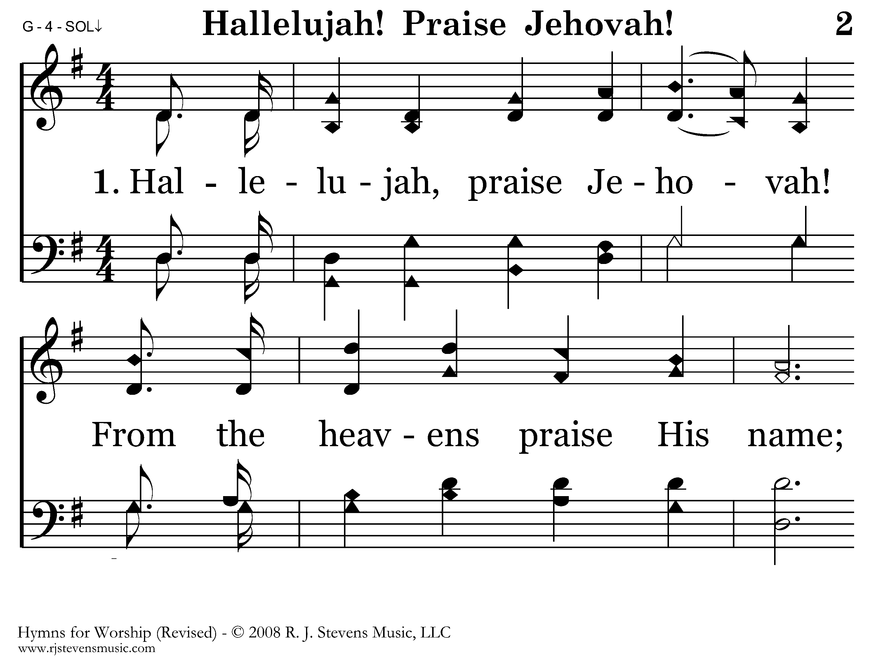
002 - Hallelujah! Praise Jehovah - 1.1

Slide 16
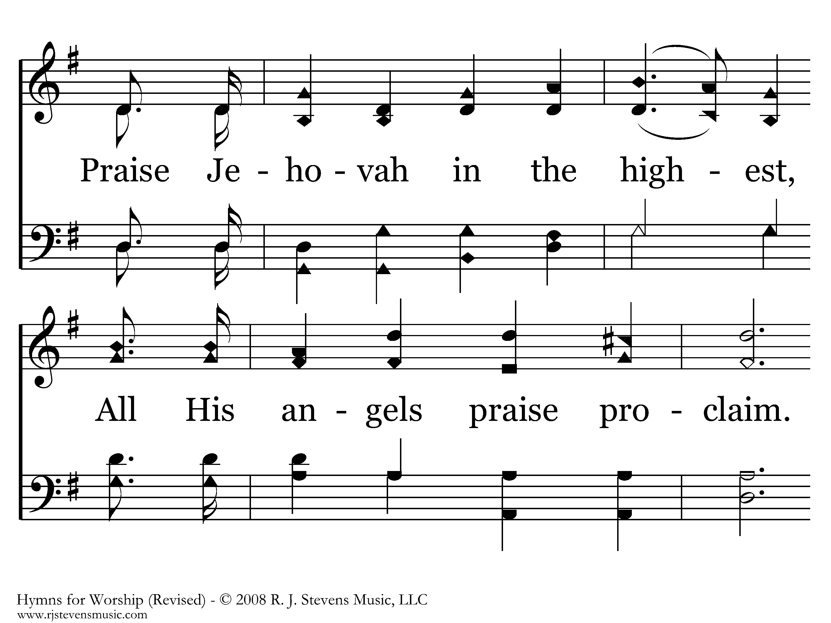
002 - Hallelujah! Praise Jehovah - 1.2

Slide 17
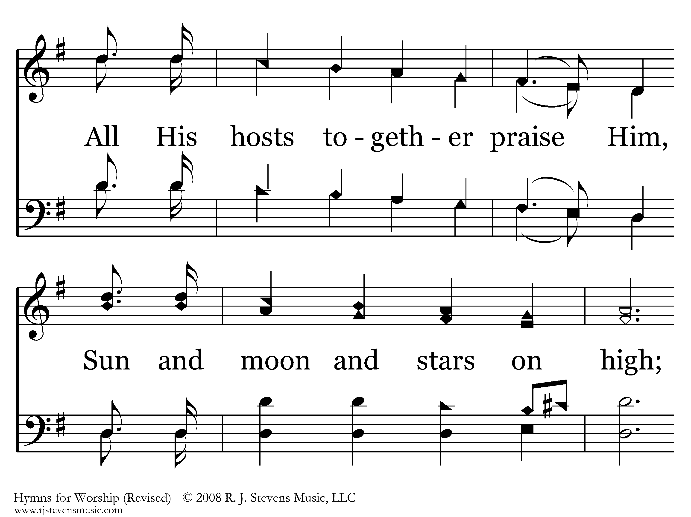
002 - Hallelujah! Praise Jehovah - 1.3

Slide 18
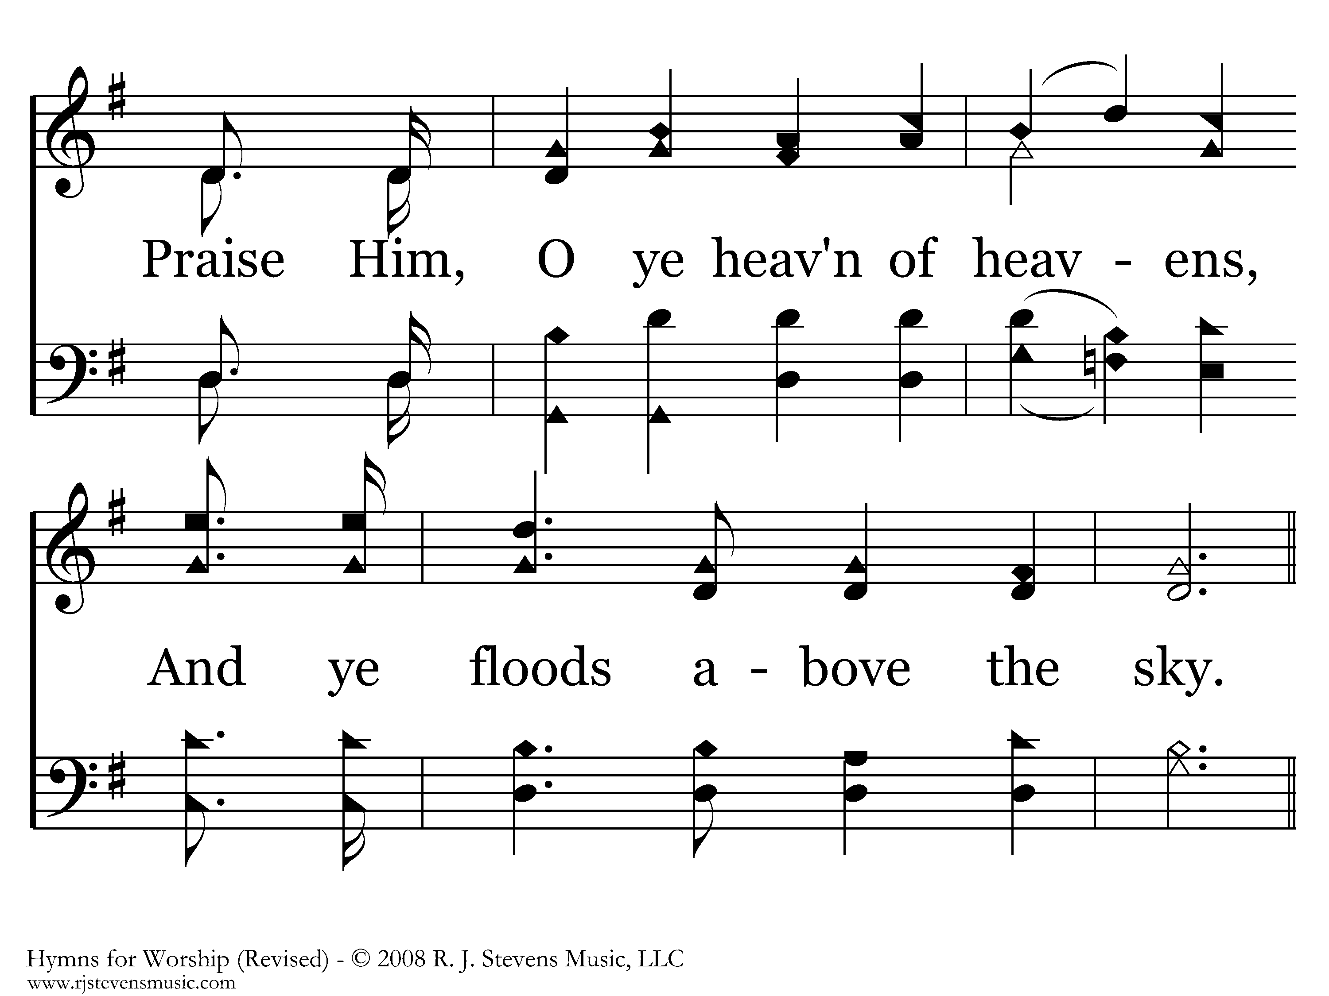
002 - Hallelujah! Praise Jehovah - 1.4

Slide 19
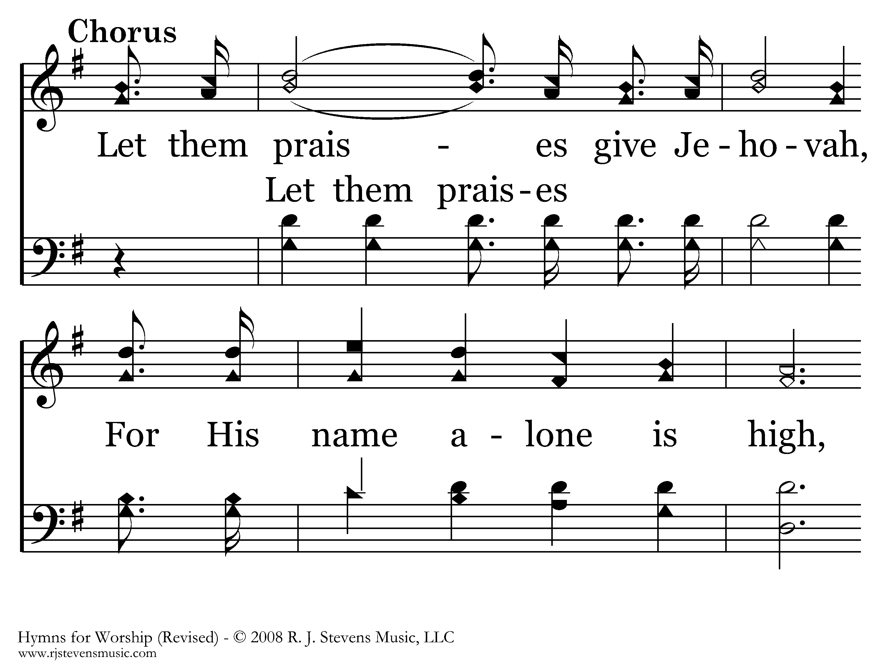
002 - Hallelujah! Praise Jehovah - C.1

Slide 20
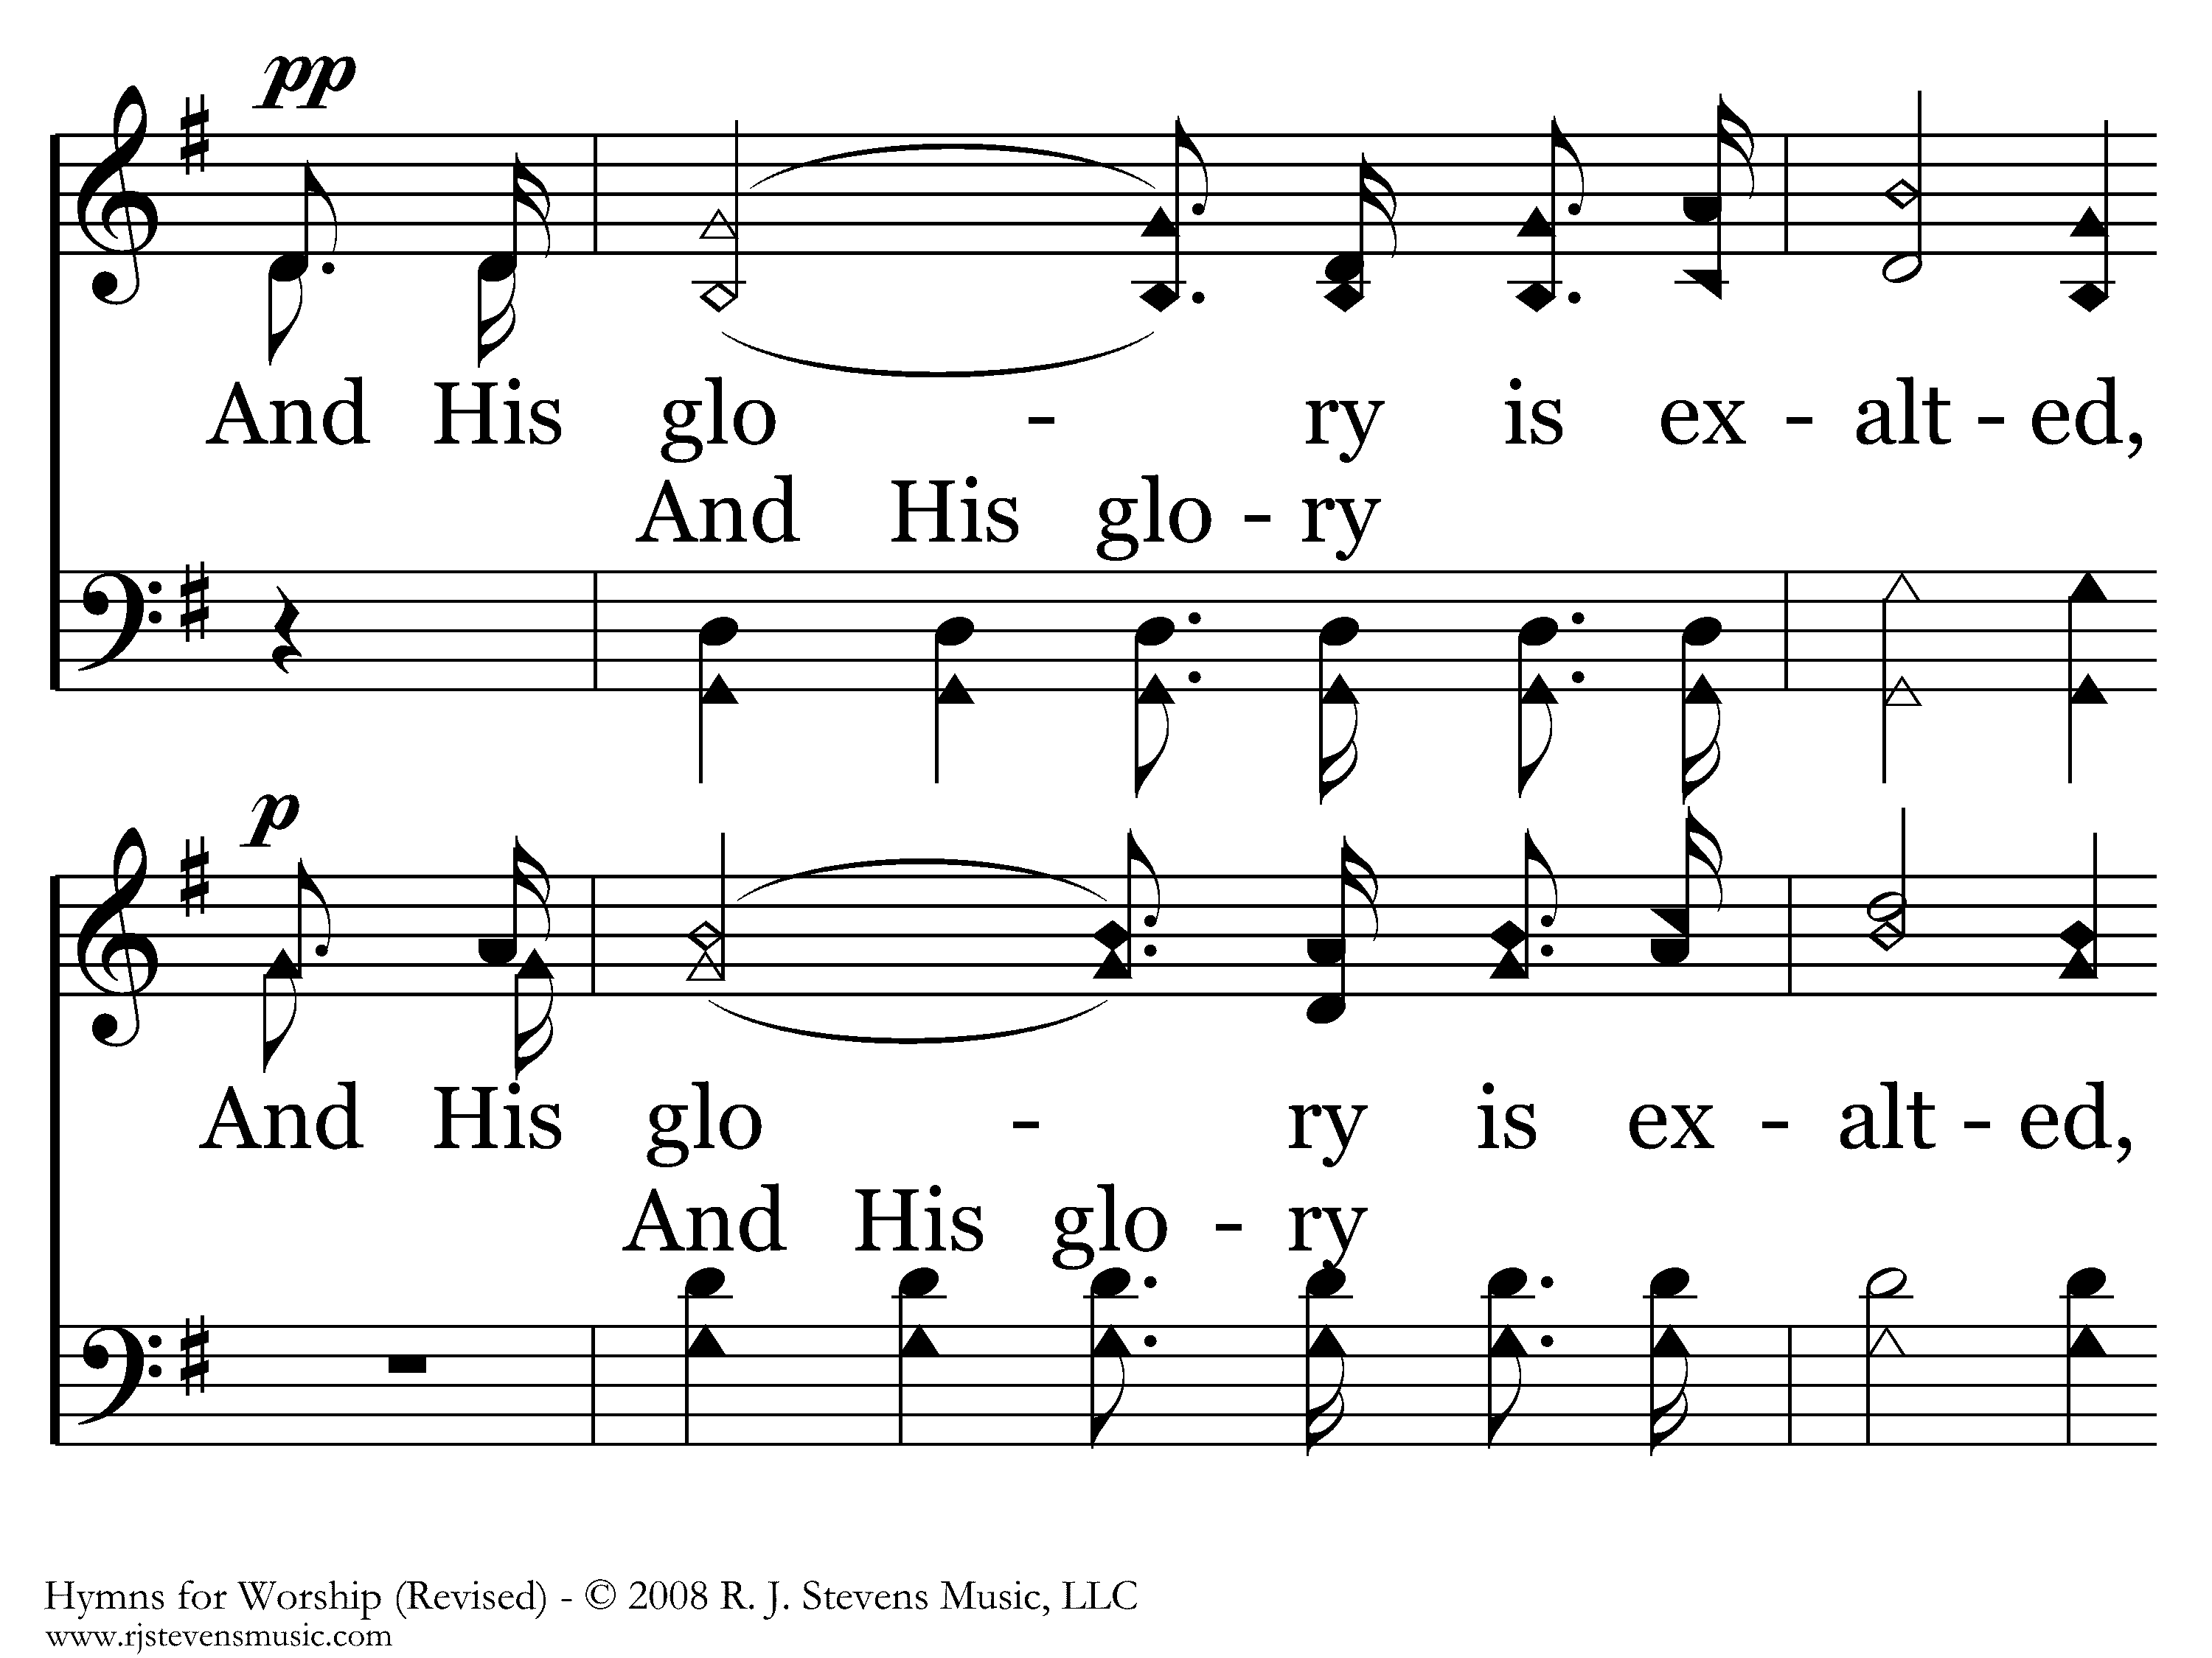
002 - Hallelujah! Praise Jehovah - C.2

Slide 21
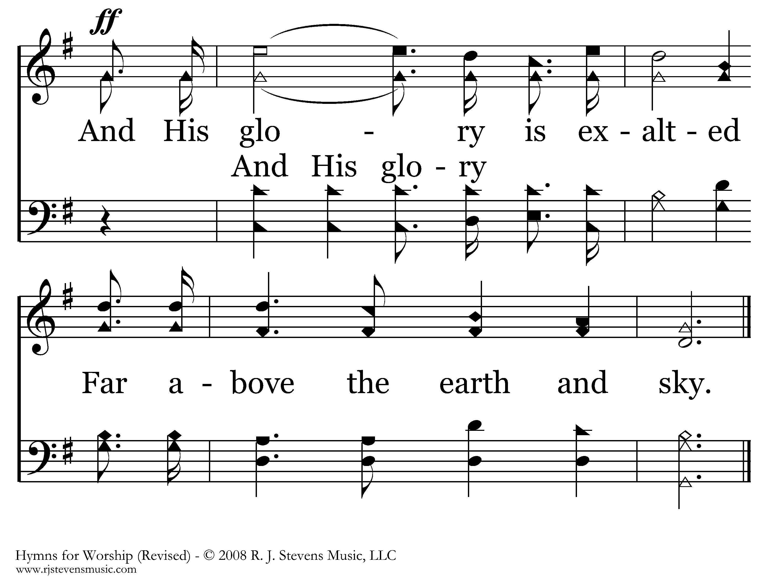
002 - Hallelujah! Praise Jehovah - C.3
End of Verse 1

Slide 22
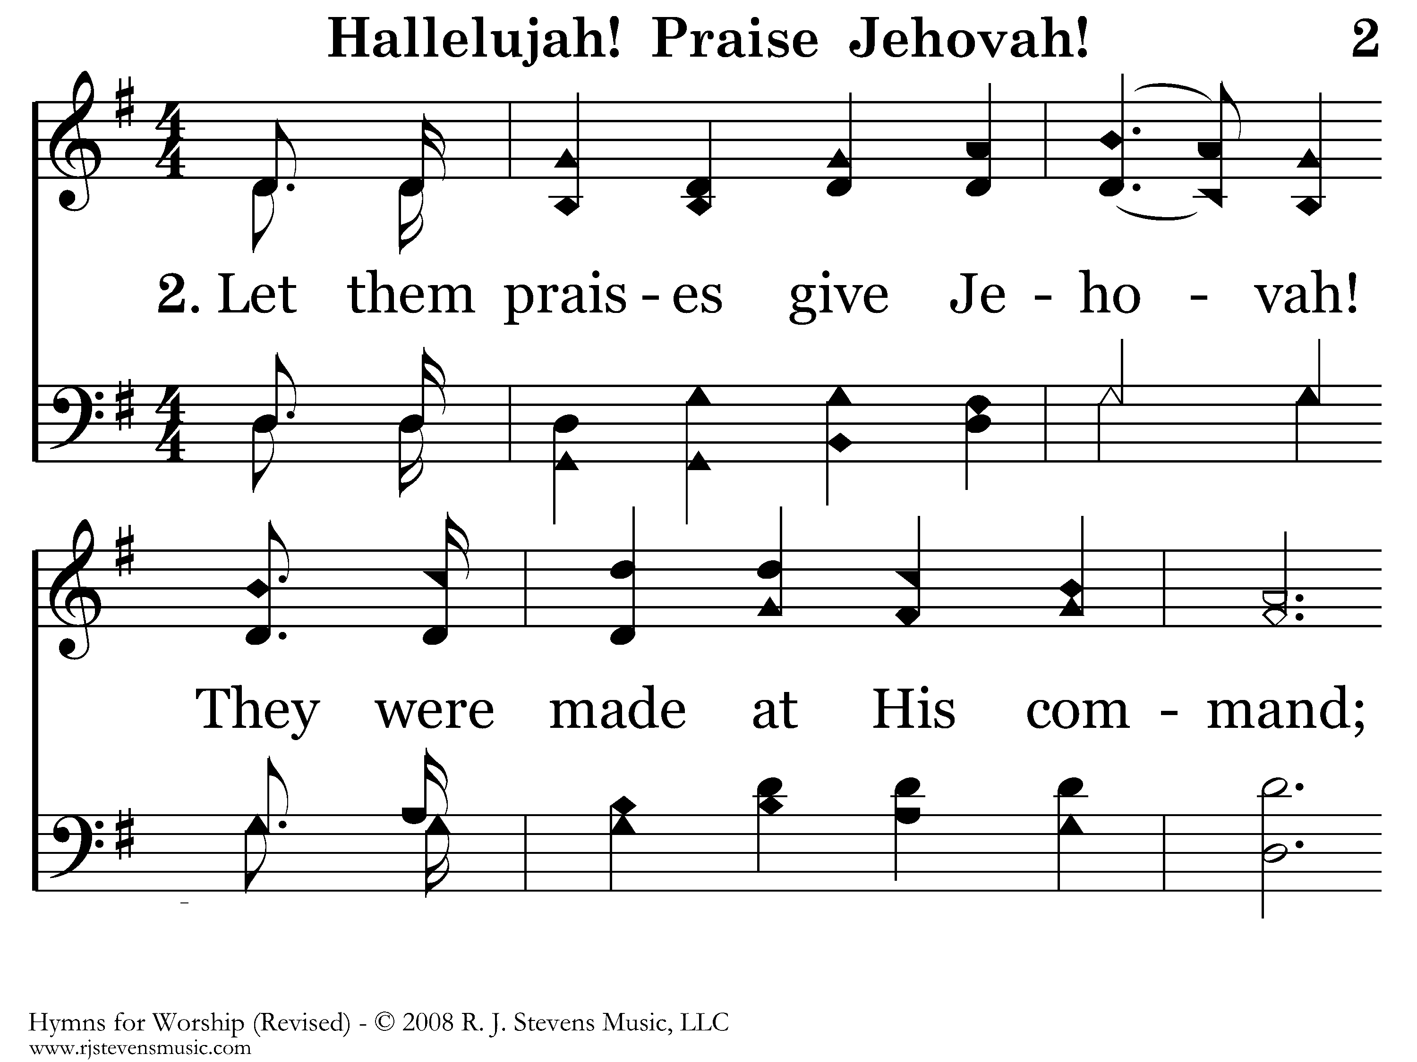
002 - Hallelujah! Praise Jehovah - 2.1

Slide 23
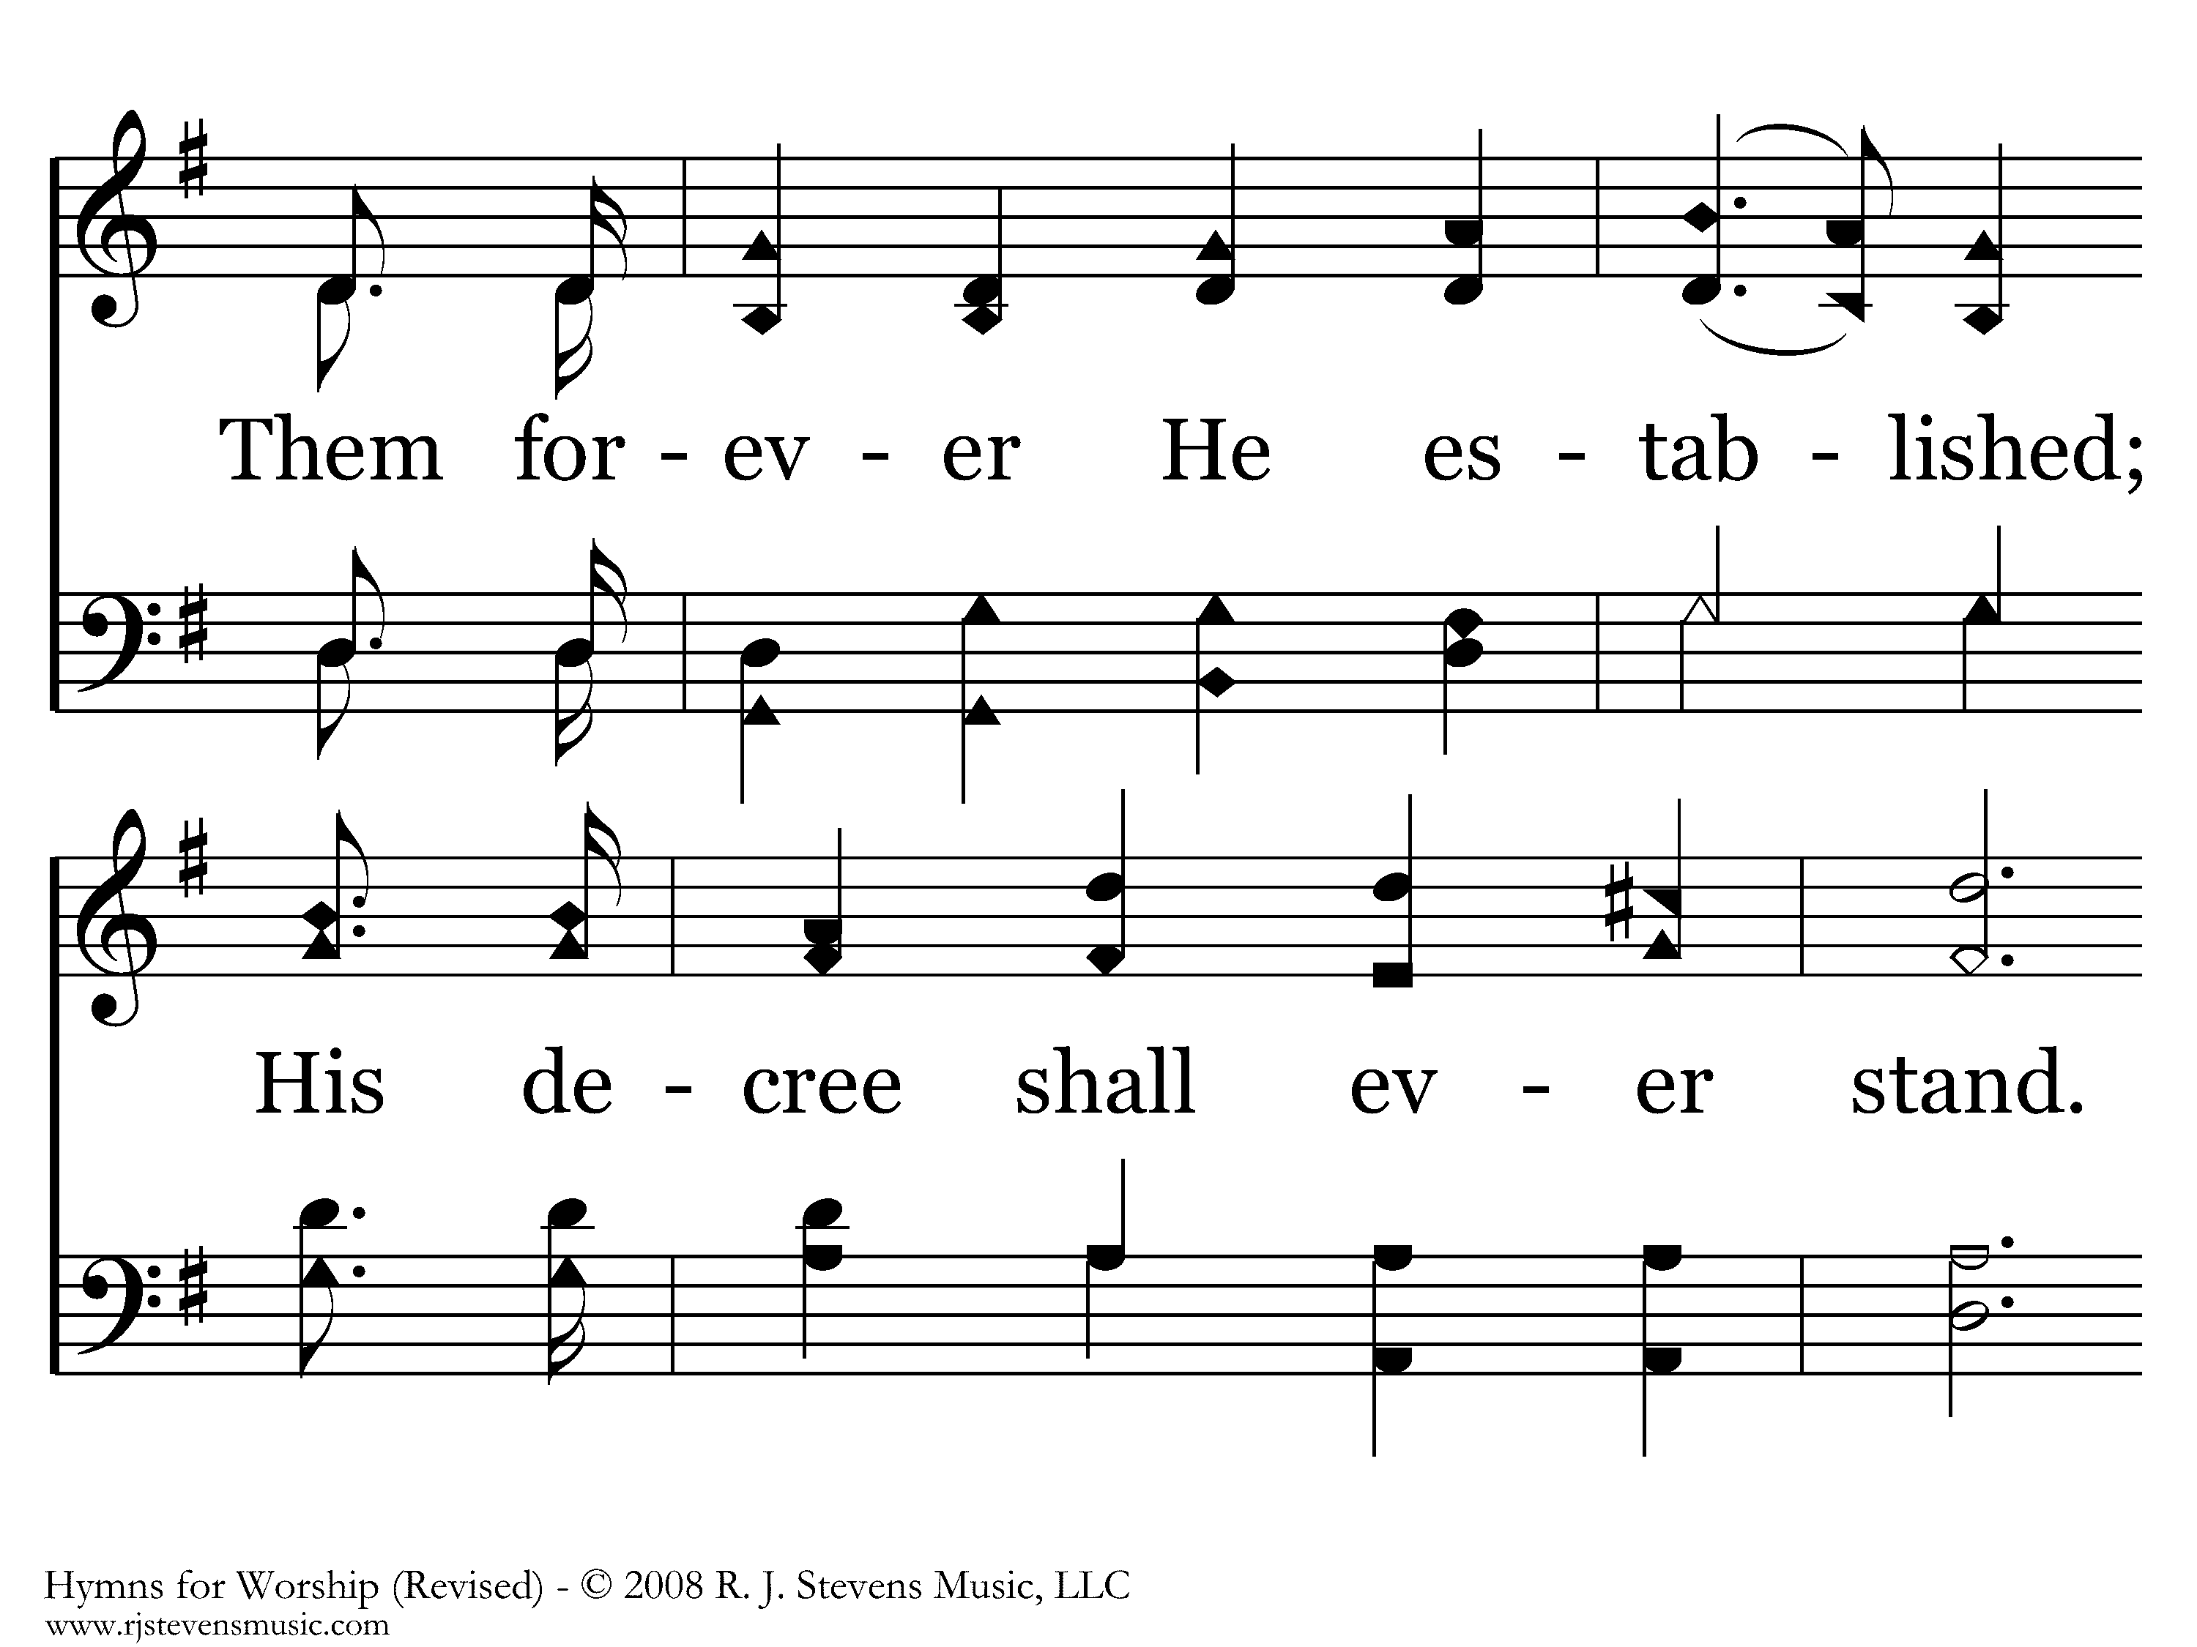
002 - Hallelujah! Praise Jehovah - 2.2

Slide 24
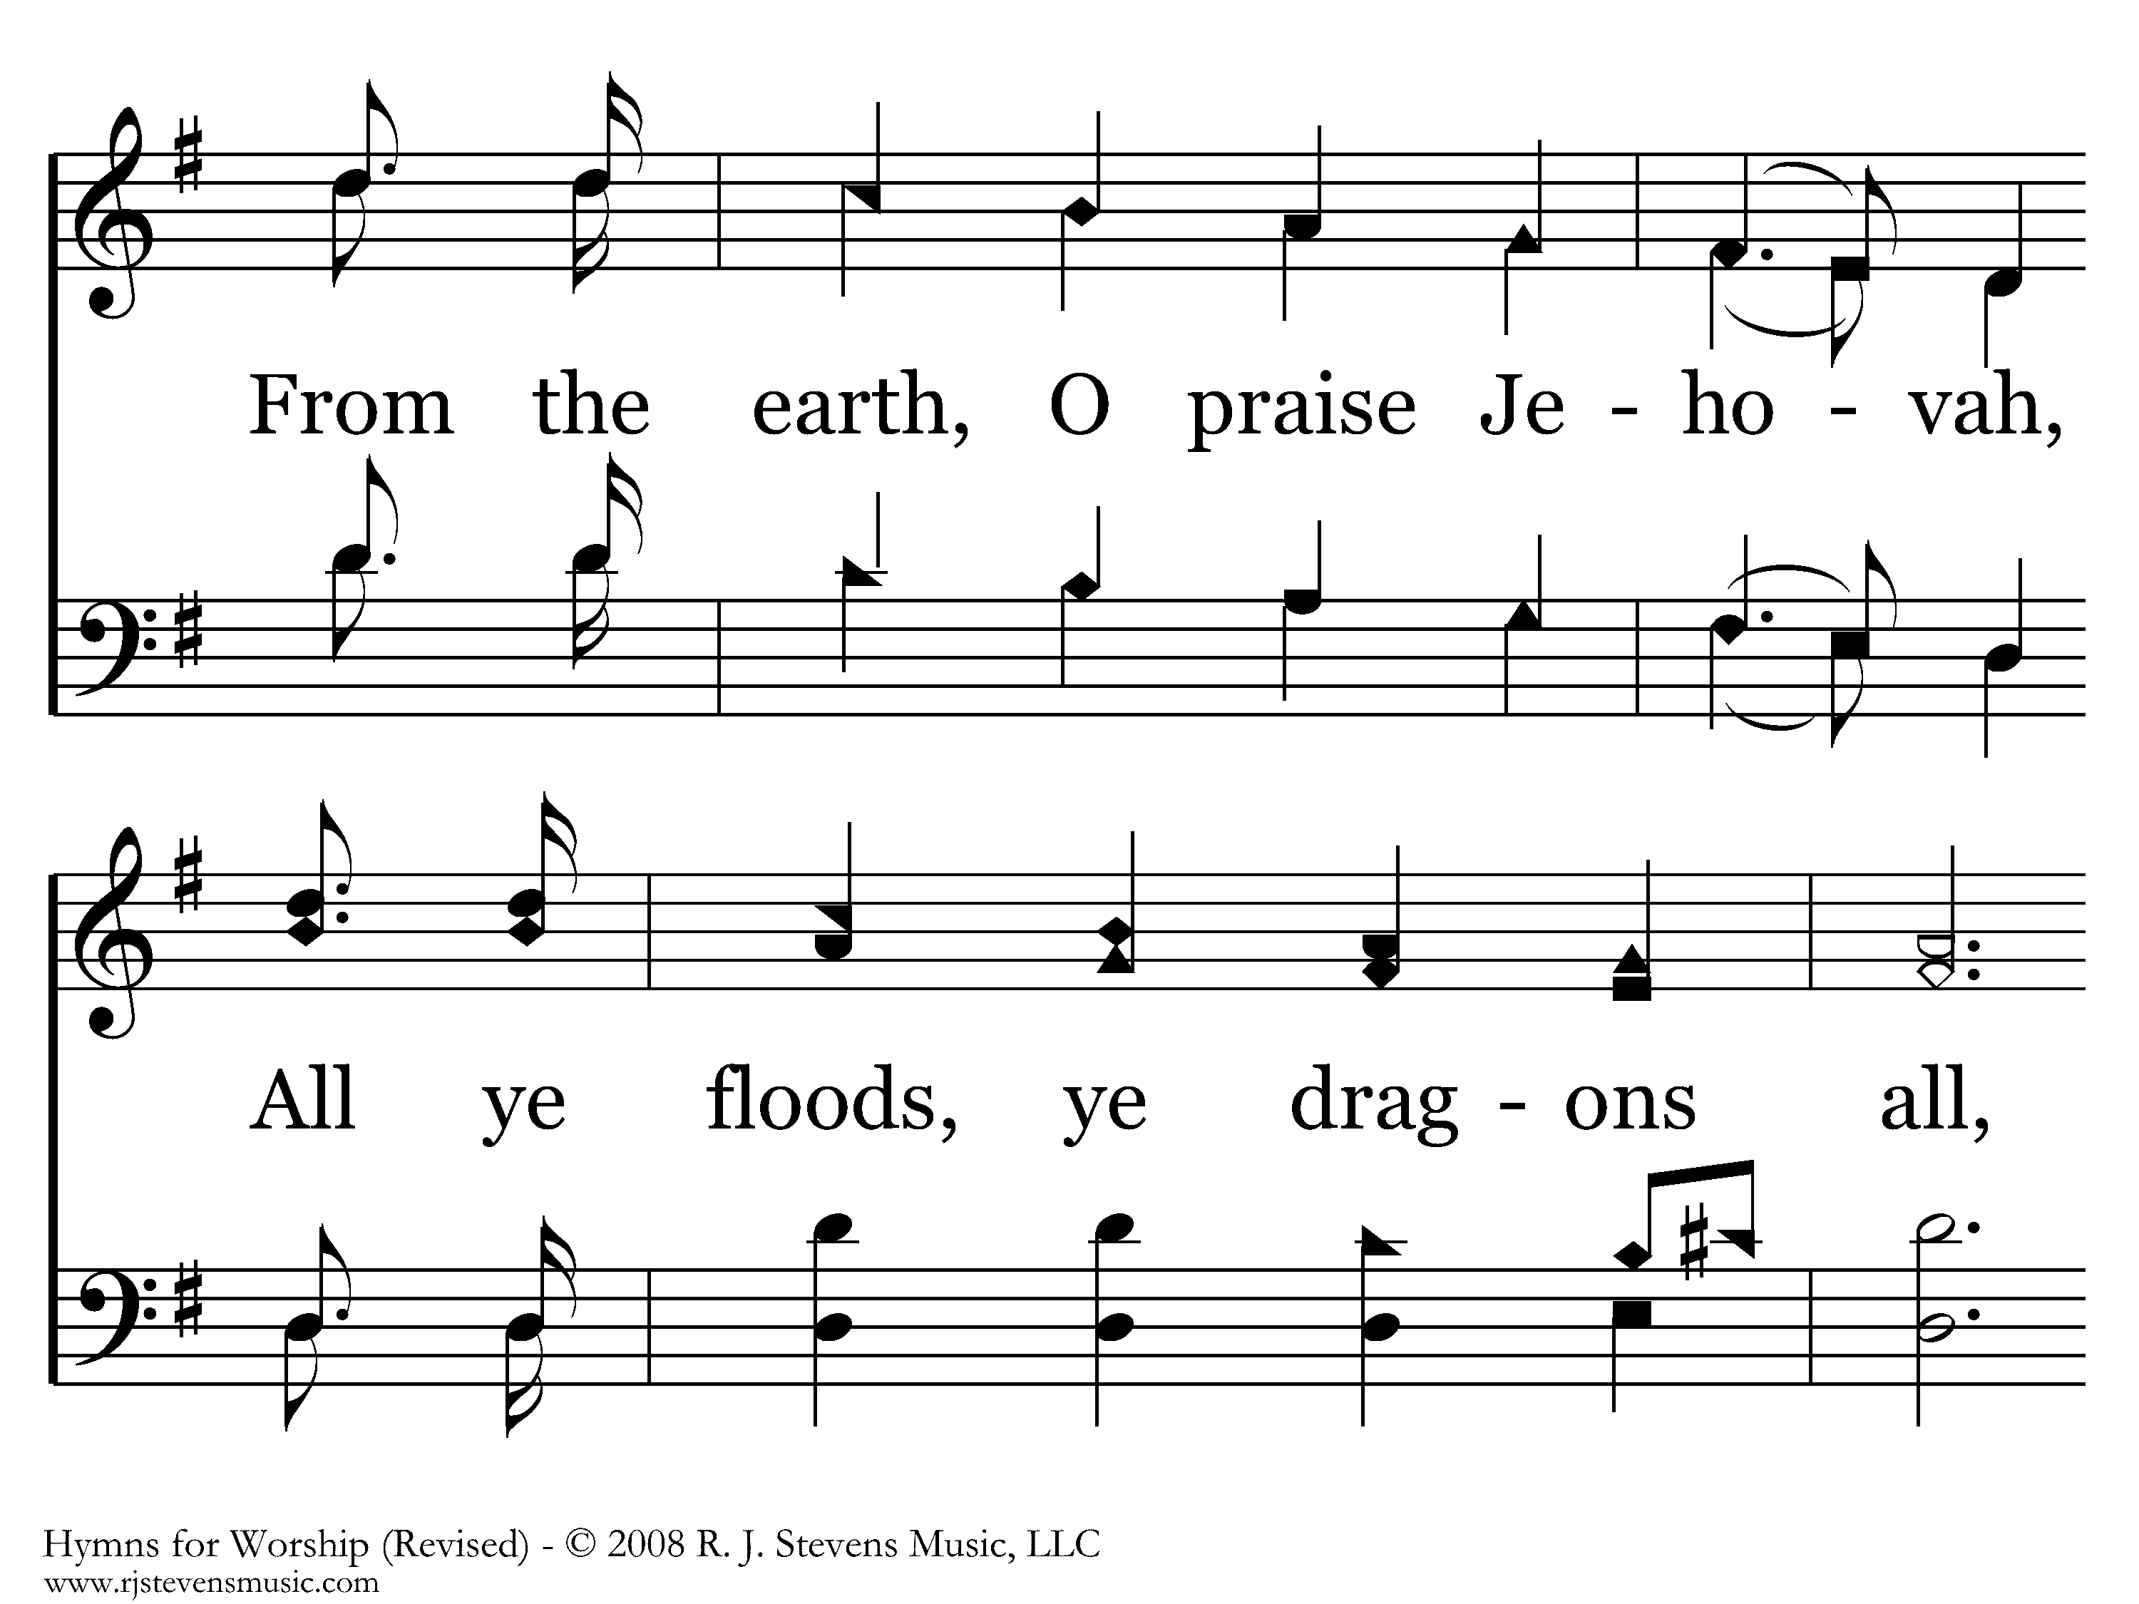
002 - Hallelujah! Praise Jehovah - 2.3

Slide 25
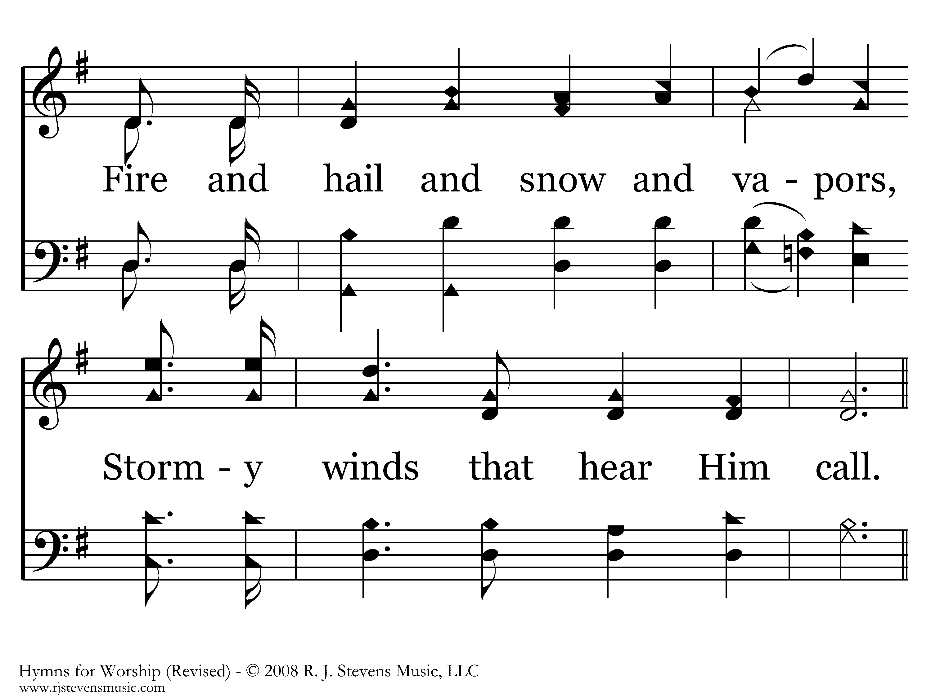
002 - Hallelujah! Praise Jehovah - 2.4

Slide 26
002 - Hallelujah! Praise Jehovah - C.1

Slide 27
002 - Hallelujah! Praise Jehovah - C.2

Slide 28
002 - Hallelujah! Praise Jehovah - C.3
End of Verse 2

Slide 29
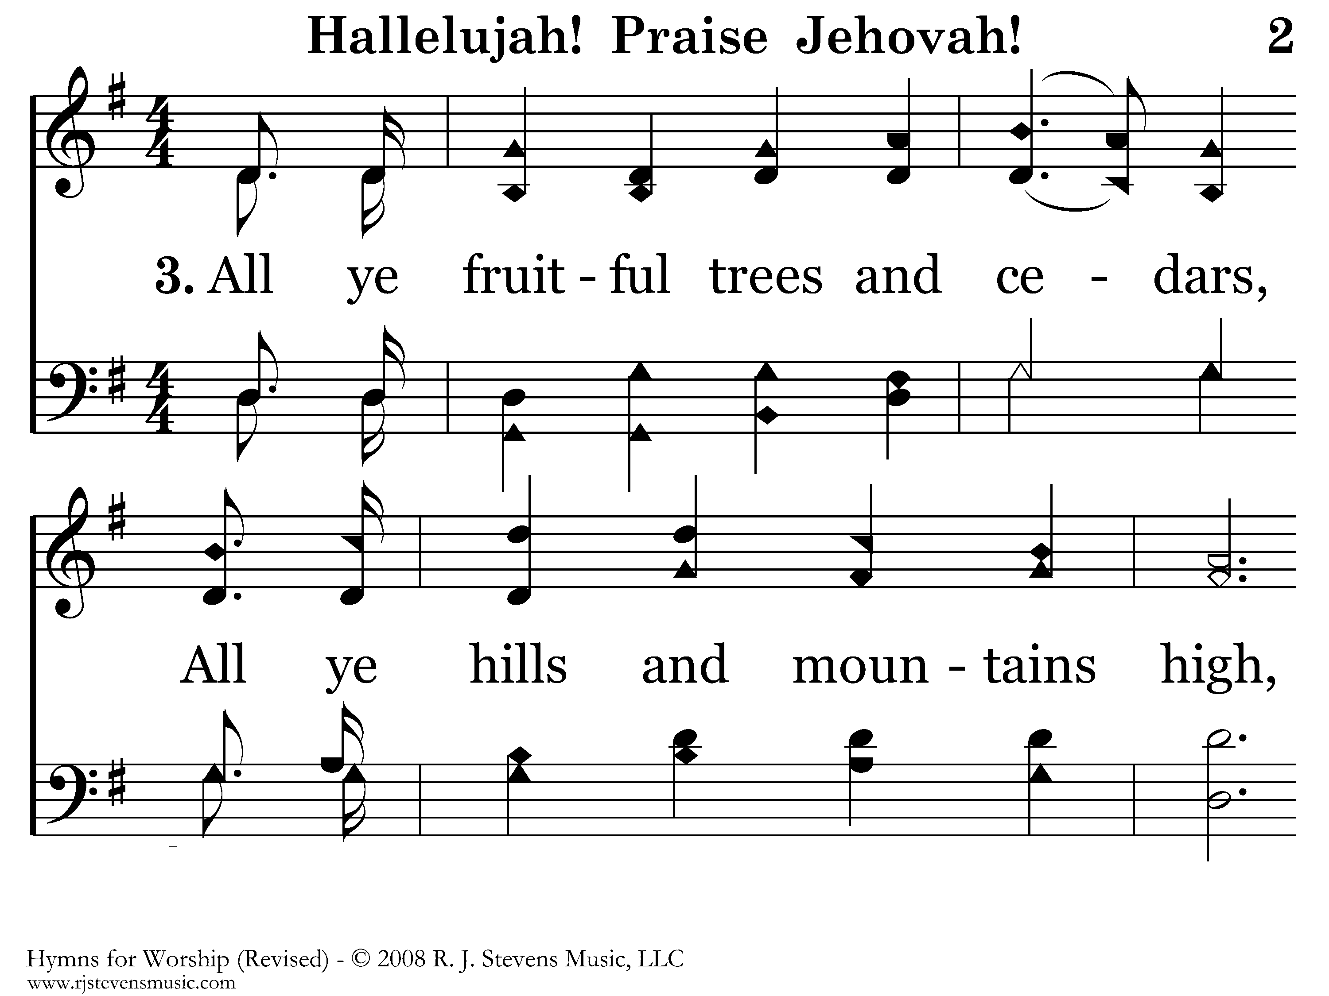
002 - Hallelujah! Praise Jehovah - 3.1

Slide 30
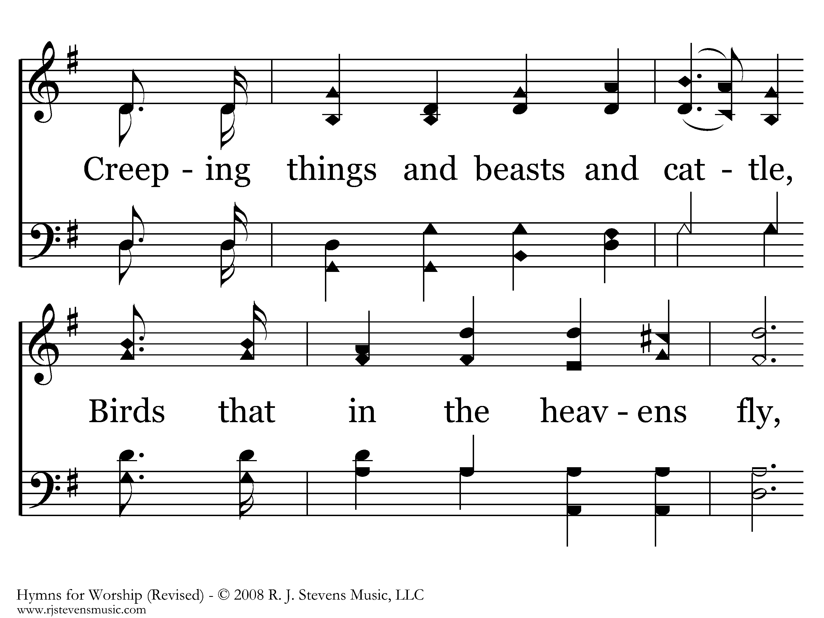
002 - Hallelujah! Praise Jehovah - 3.2

Slide 31
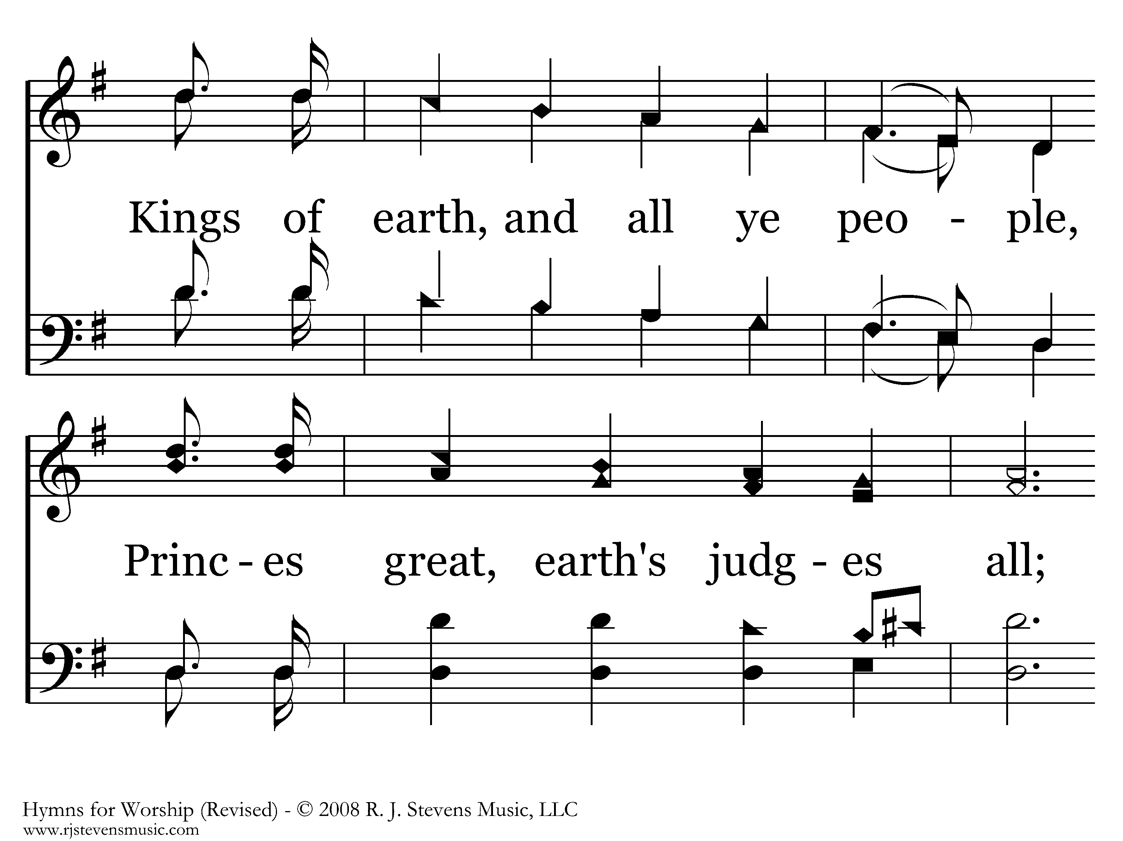
002 - Hallelujah! Praise Jehovah - 3.3

Slide 32
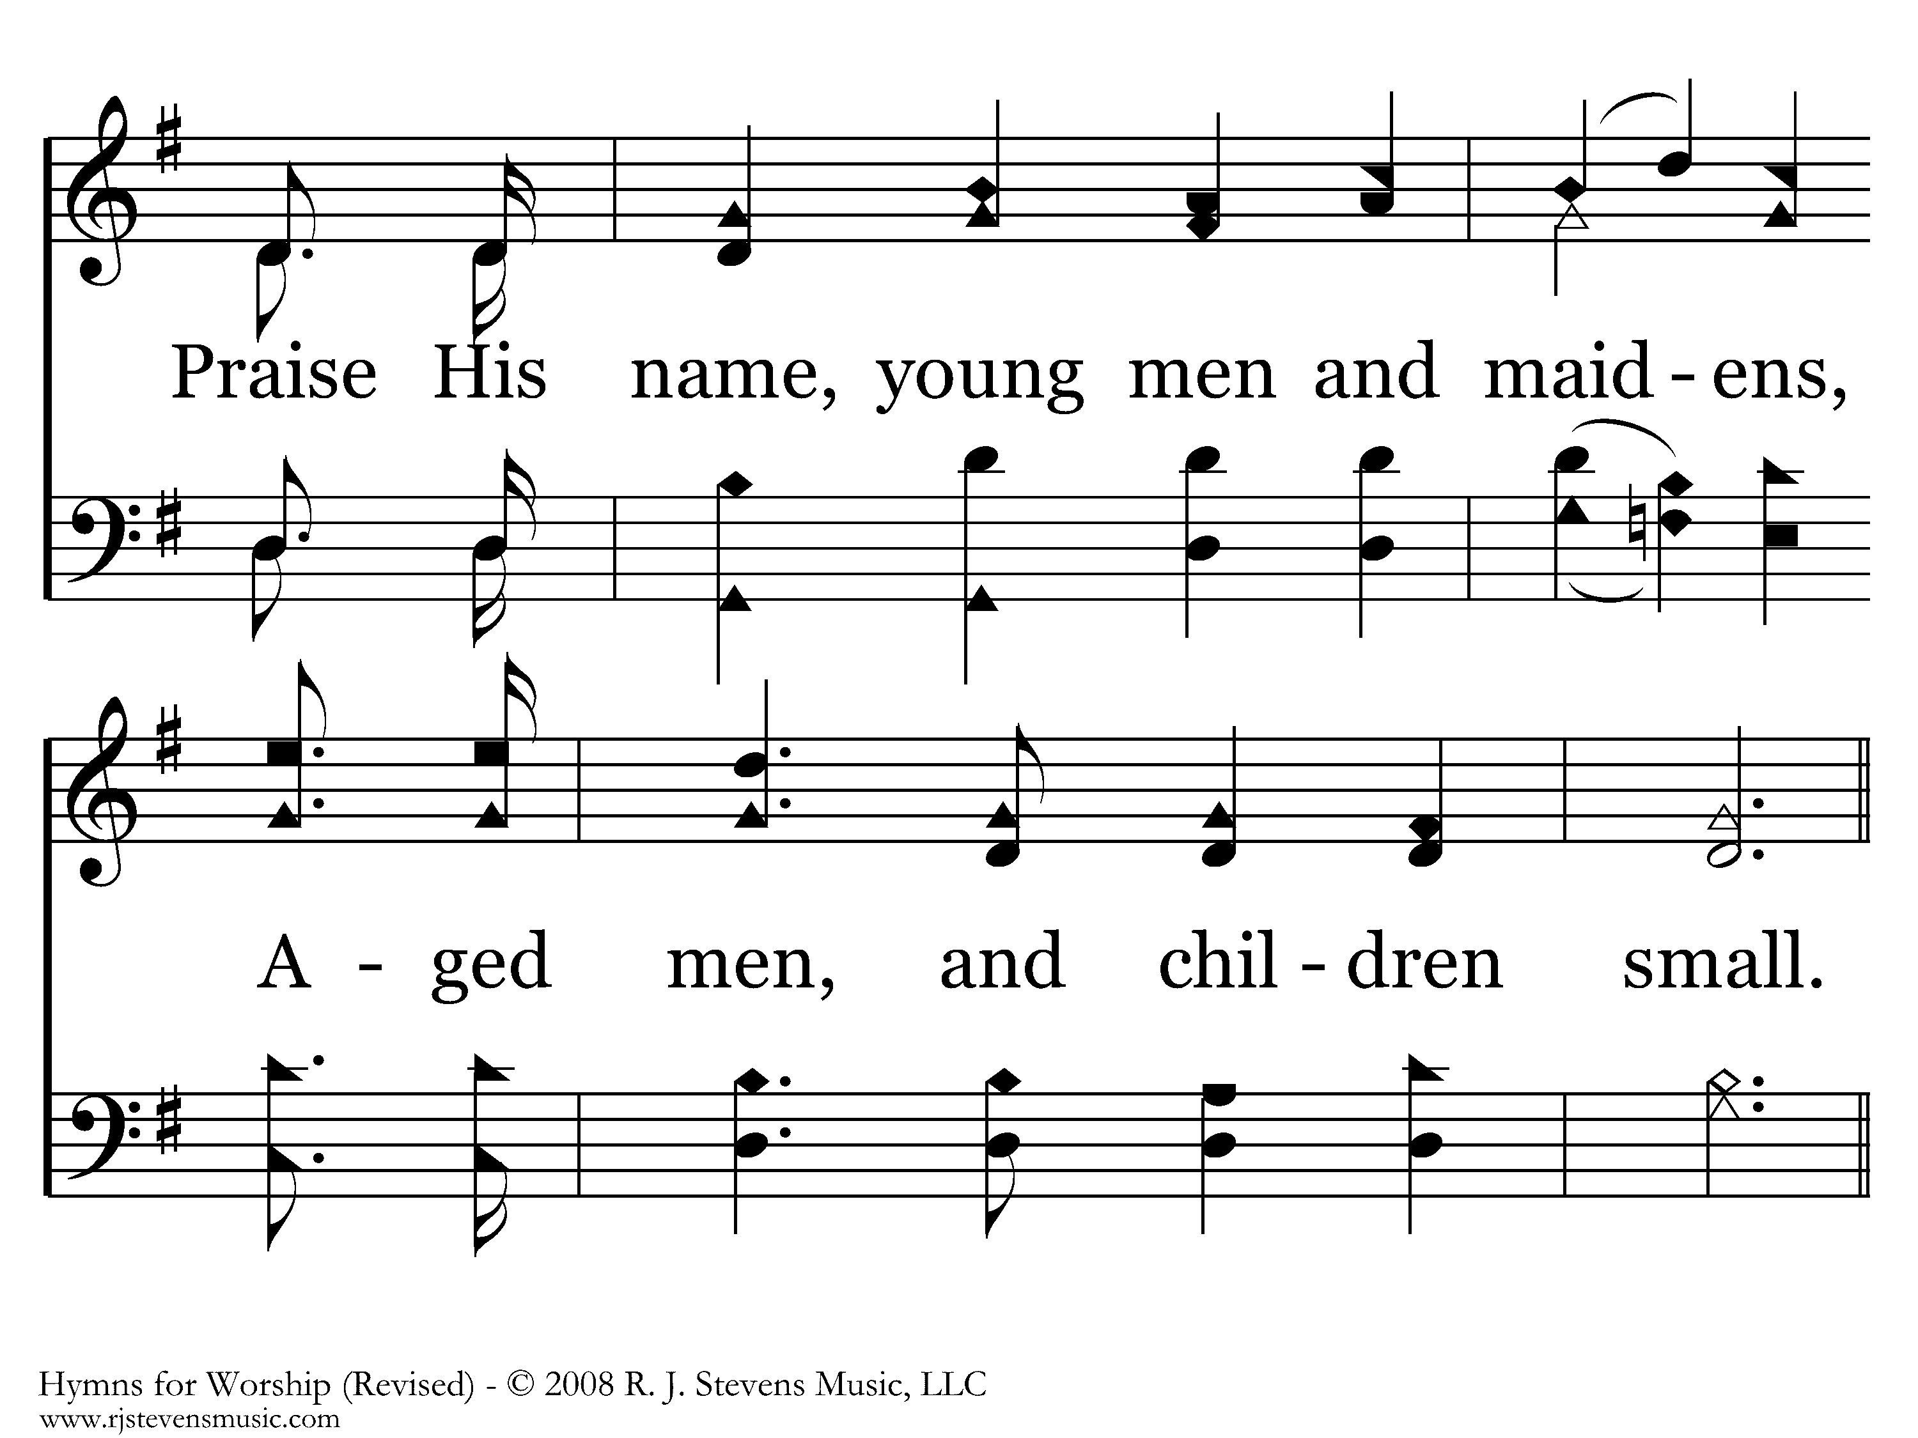
002 - Hallelujah! Praise Jehovah - 3.4

Slide 33
002 - Hallelujah! Praise Jehovah - C.1

Slide 34
002 - Hallelujah! Praise Jehovah - C.2

Slide 35
002 - Hallelujah! Praise Jehovah - C.3
End of Song

Slide 36
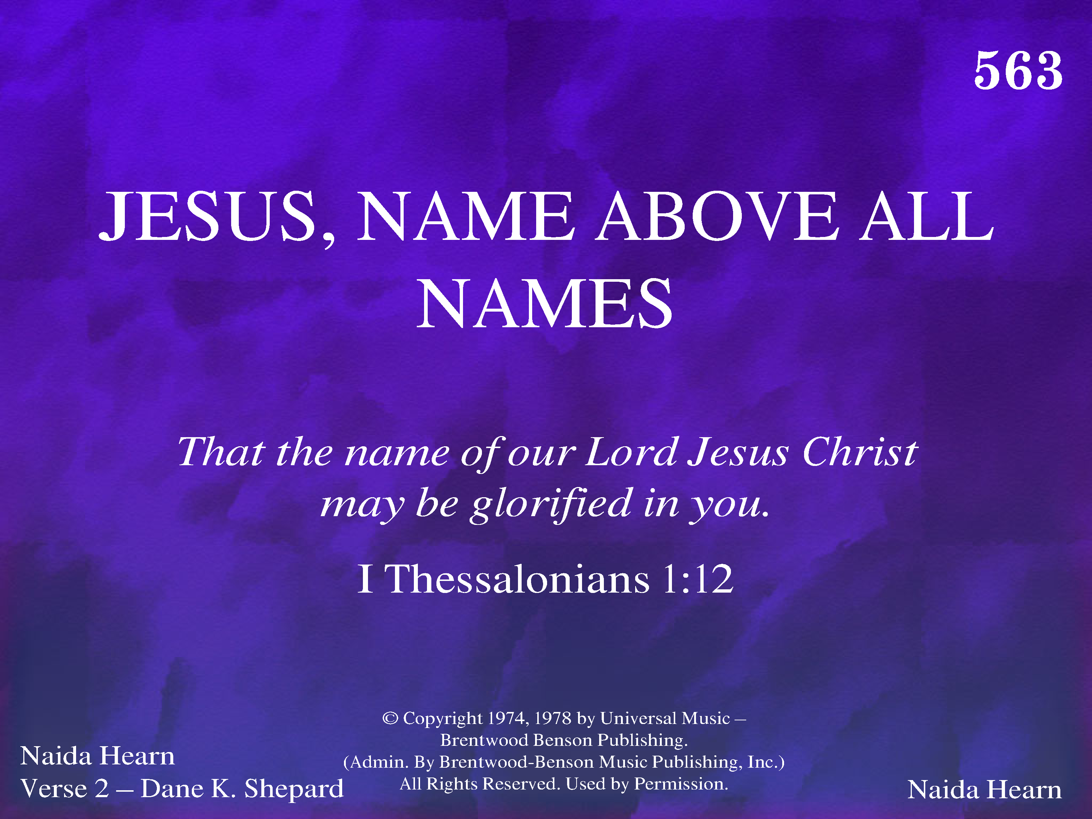
563 - Jesus, Name Above All Names - Title

Slide 37
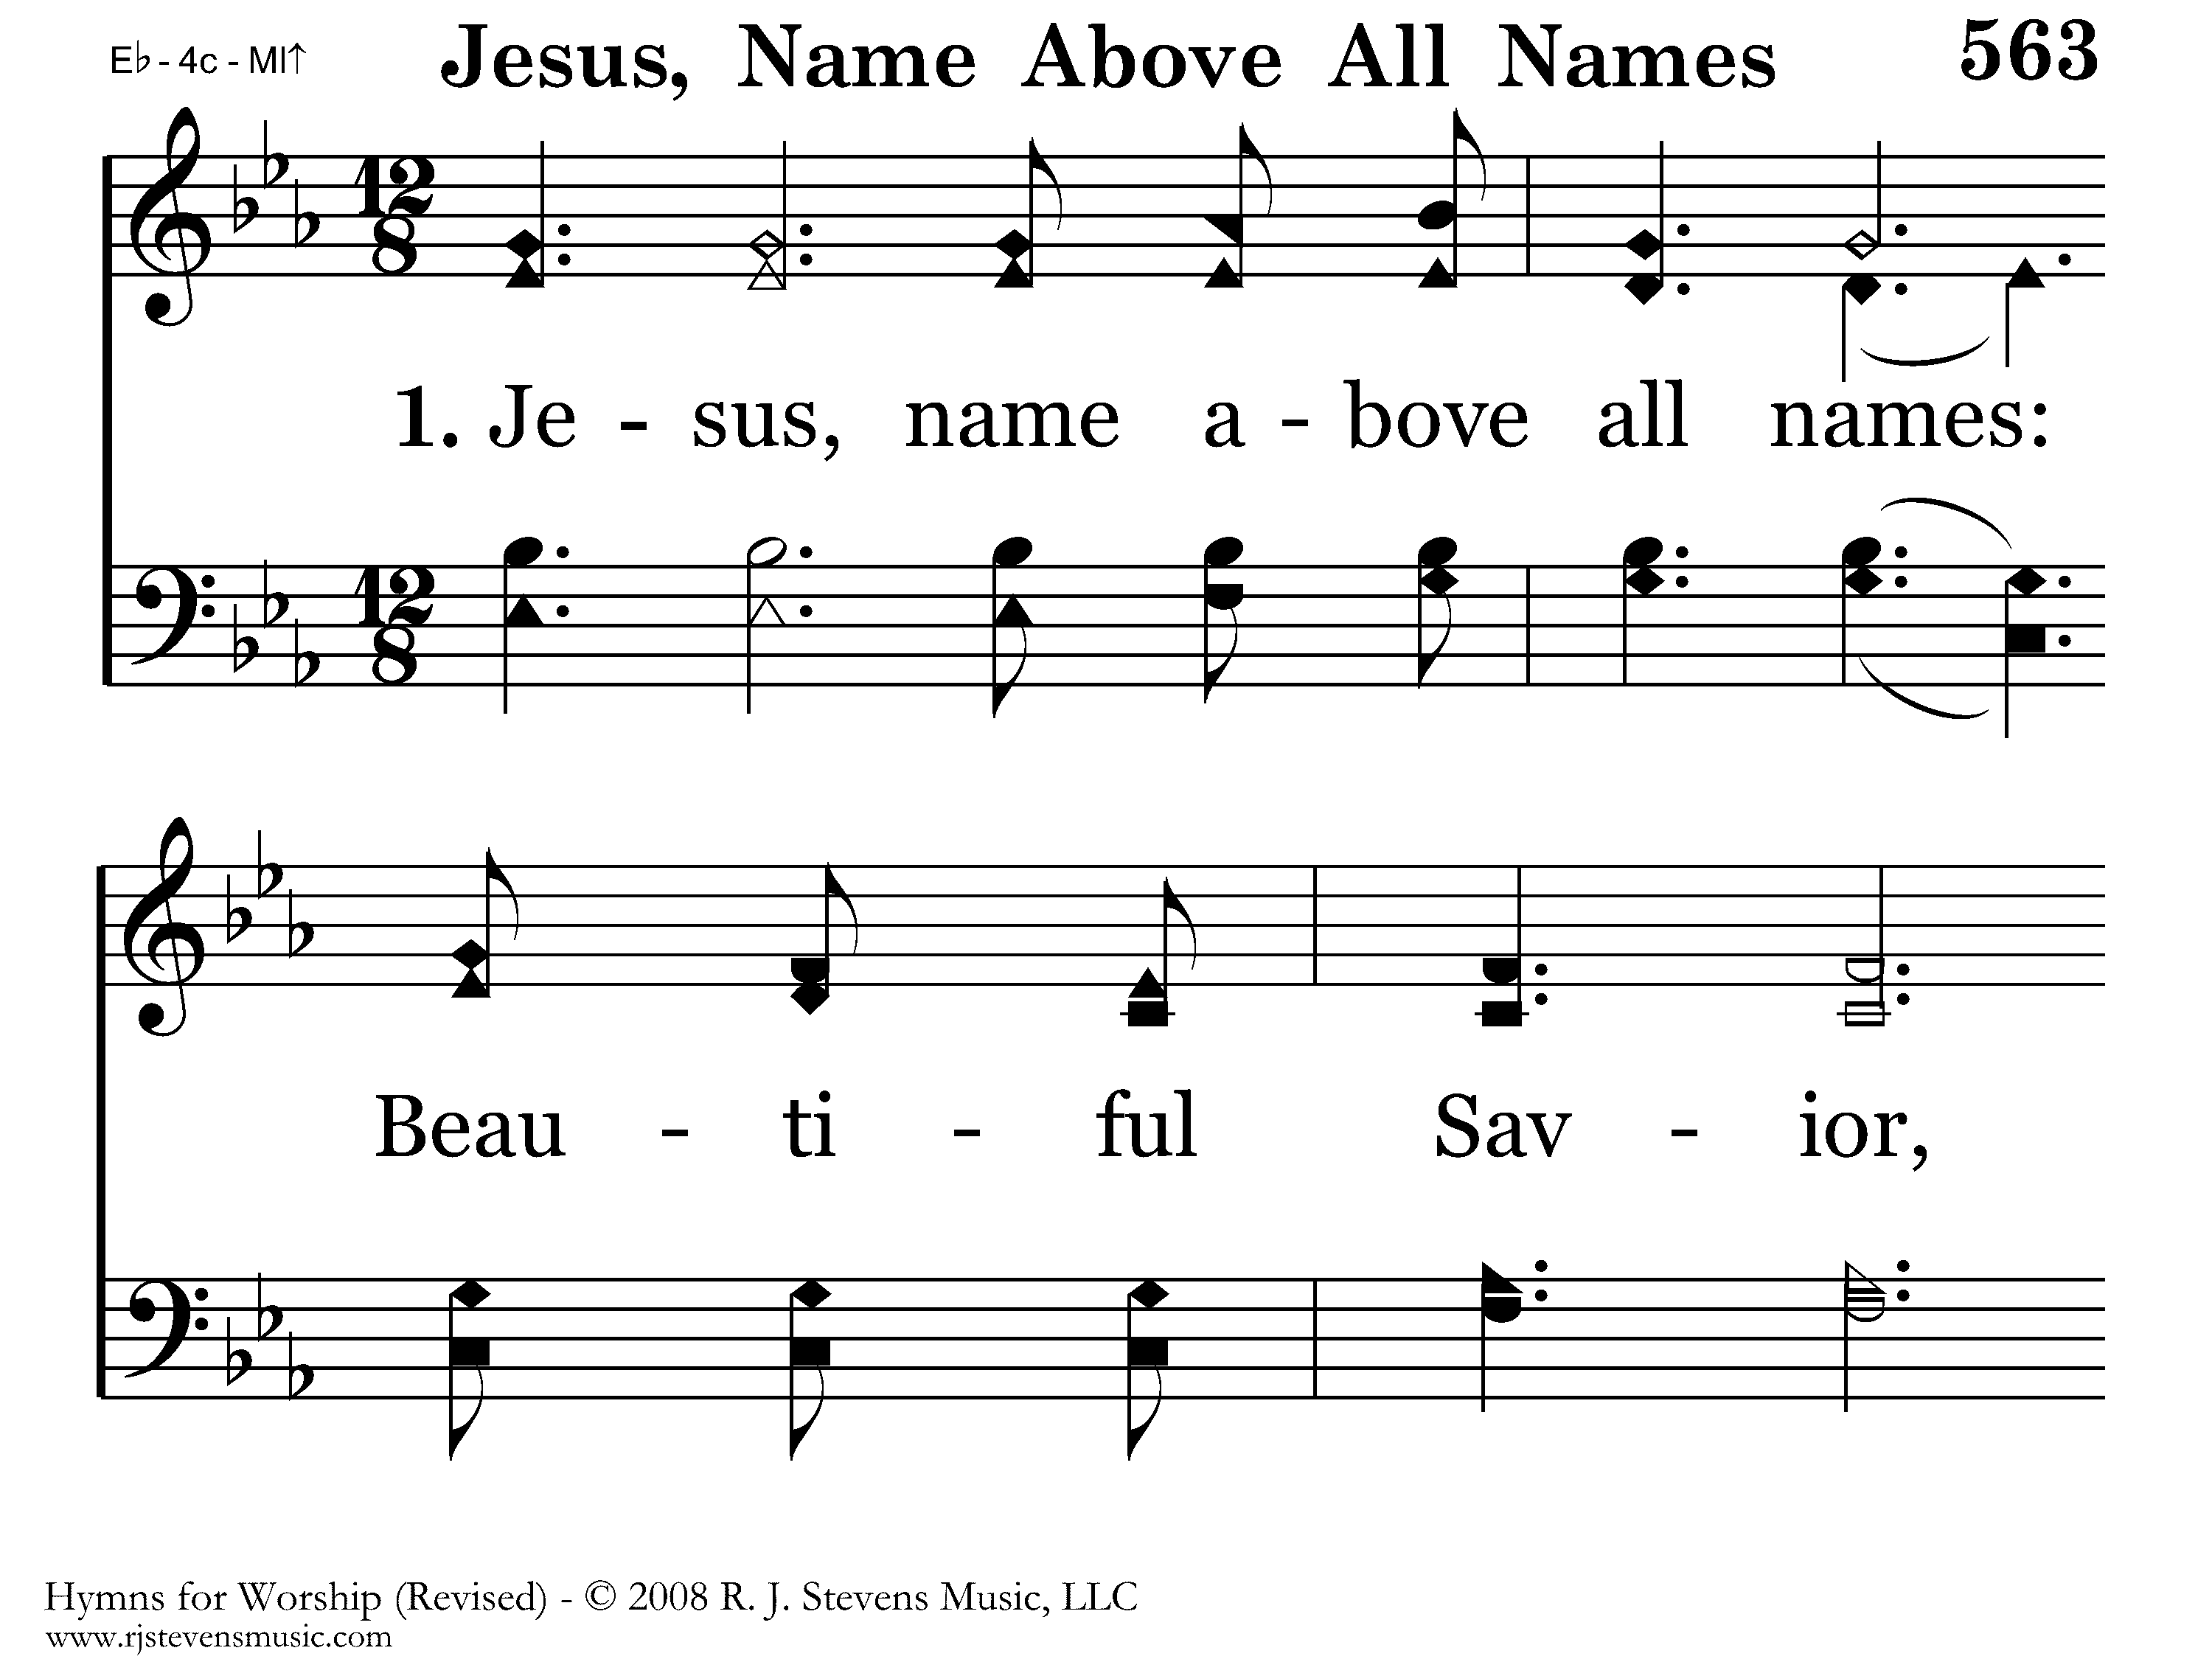
563 - Jesus, Name Above All Names - 1.1

Slide 38
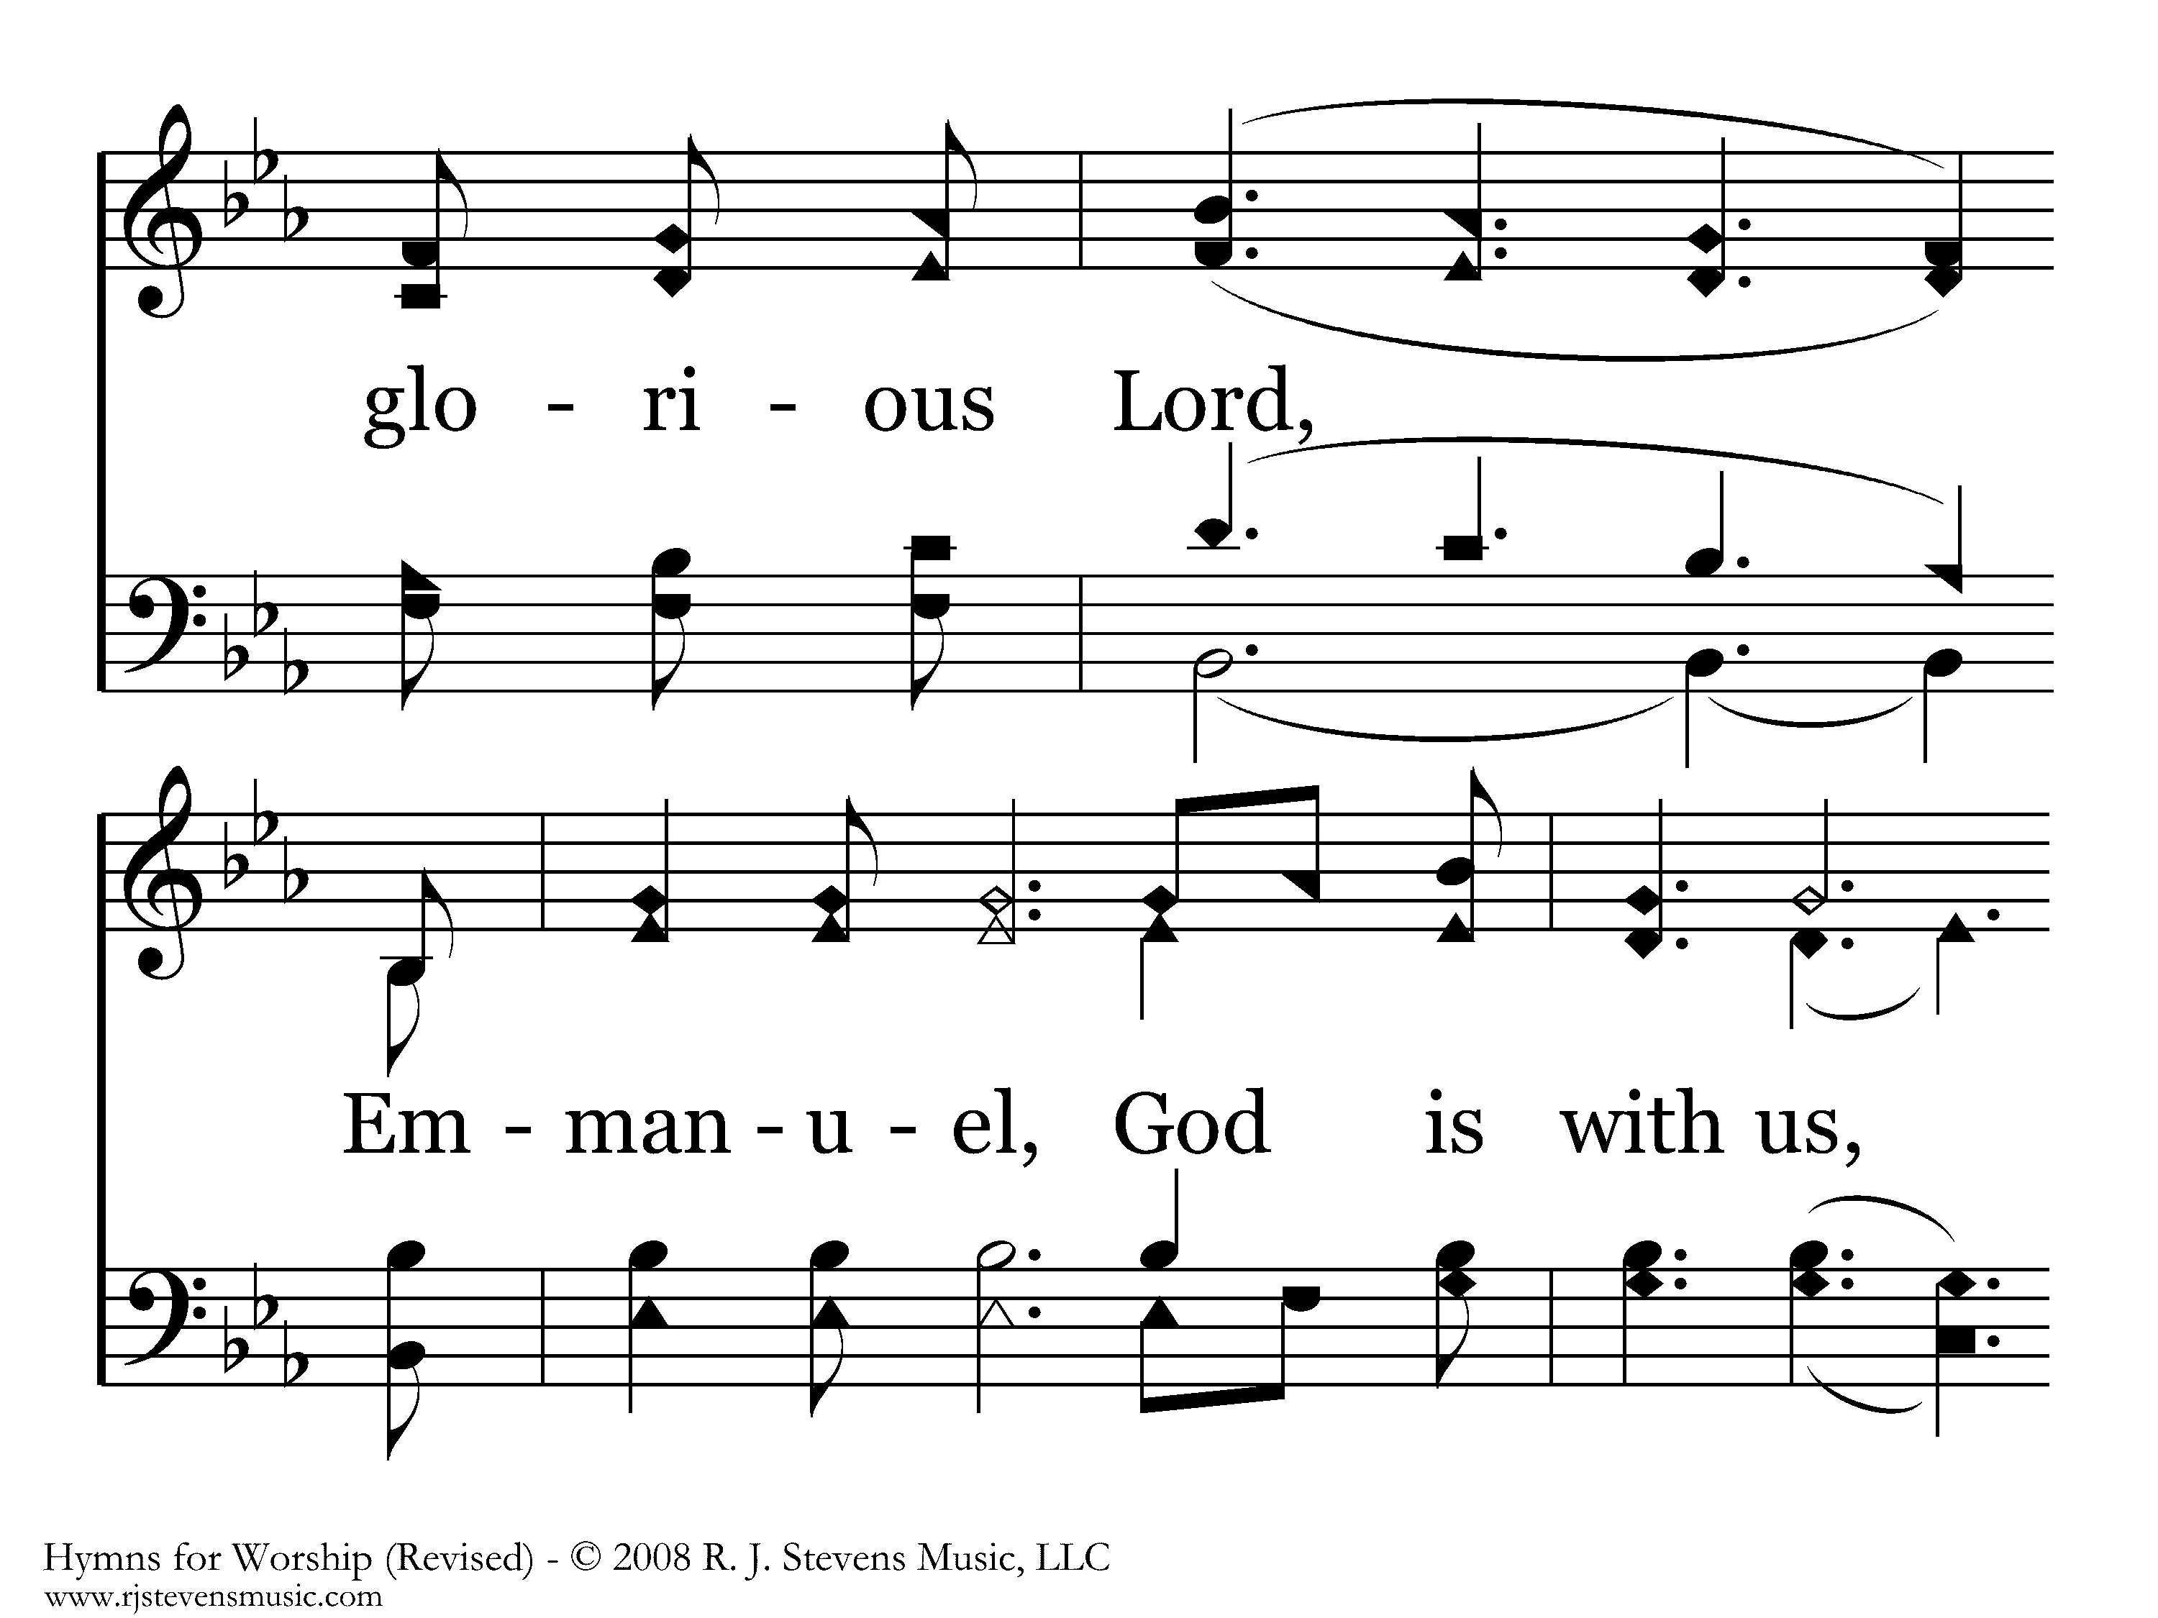
563 - Jesus, Name Above All Names - 1.2

Slide 39
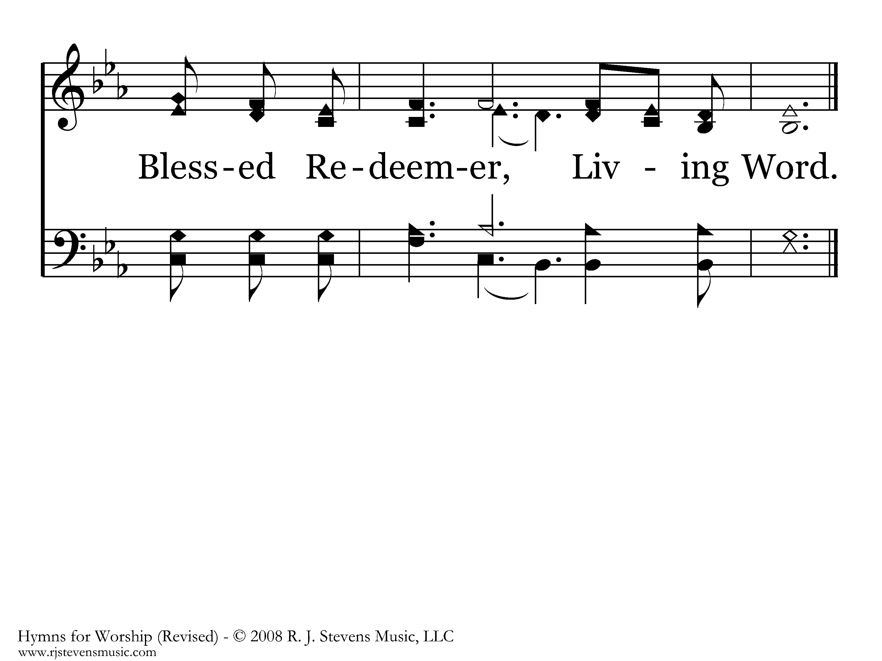
563 - Jesus, Name Above All Names - 1.3
End of Verse 1

Slide 40
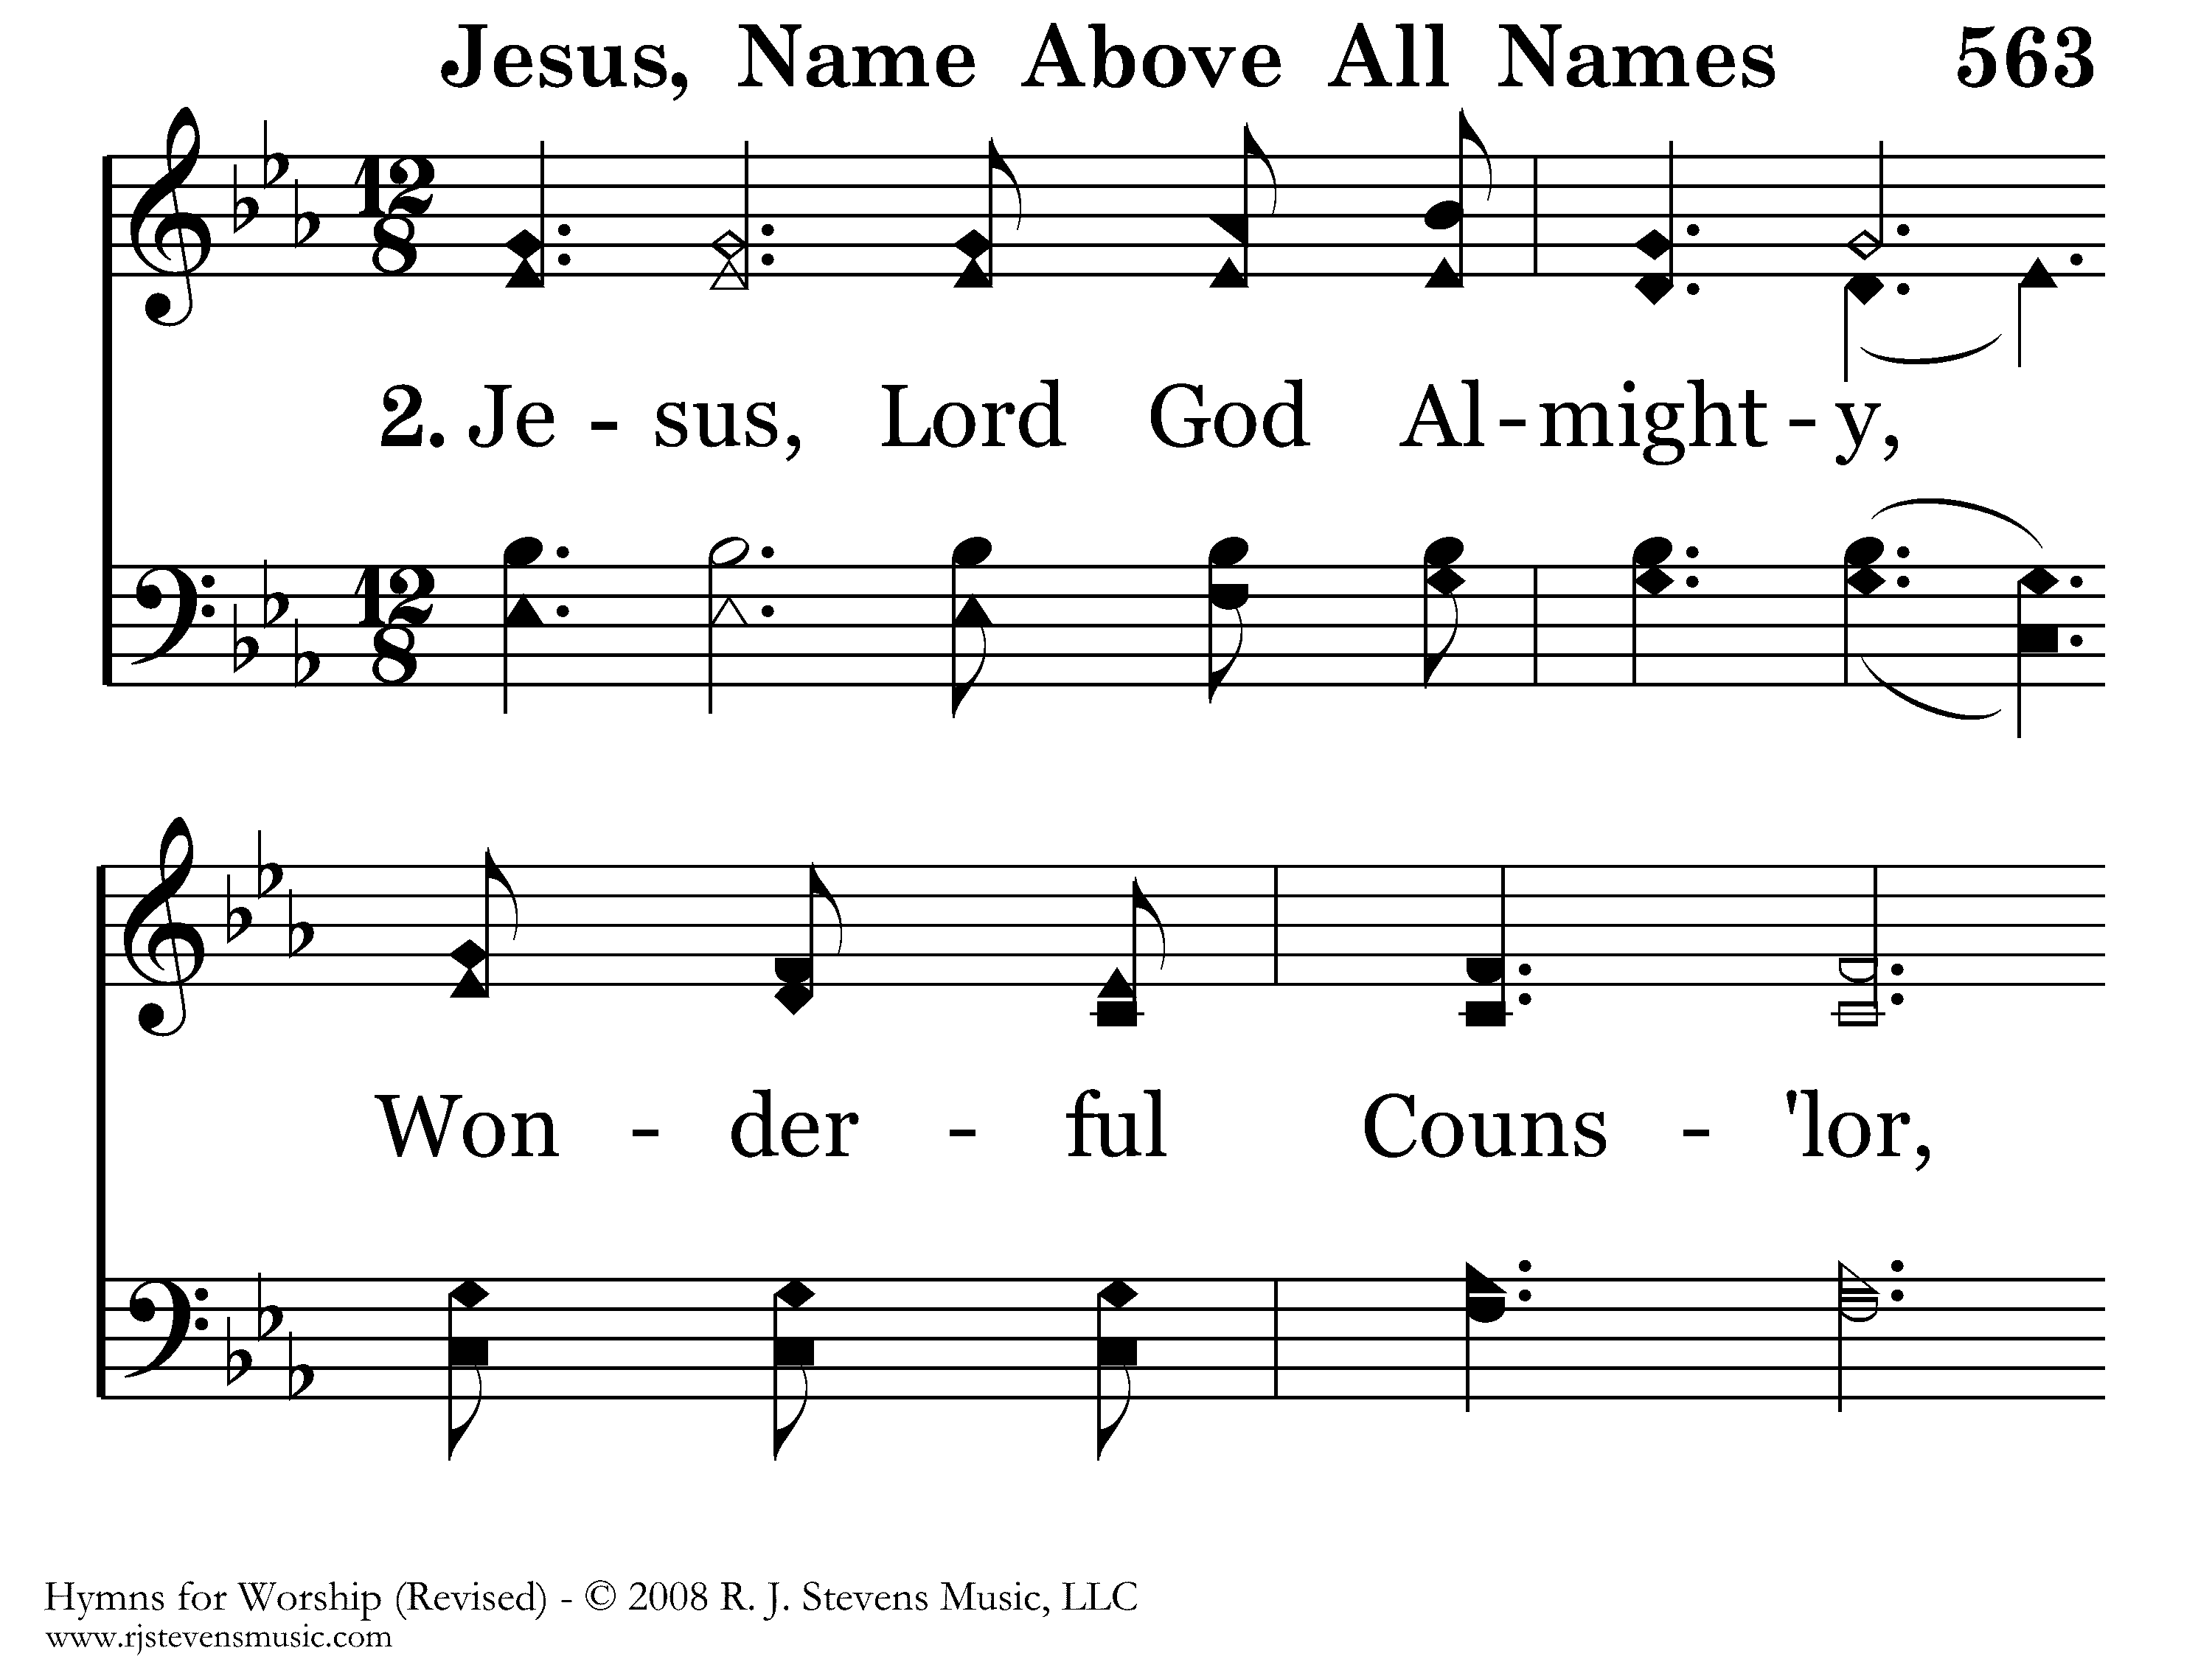
563 - Jesus, Name Above All Names - 2.1

Slide 41
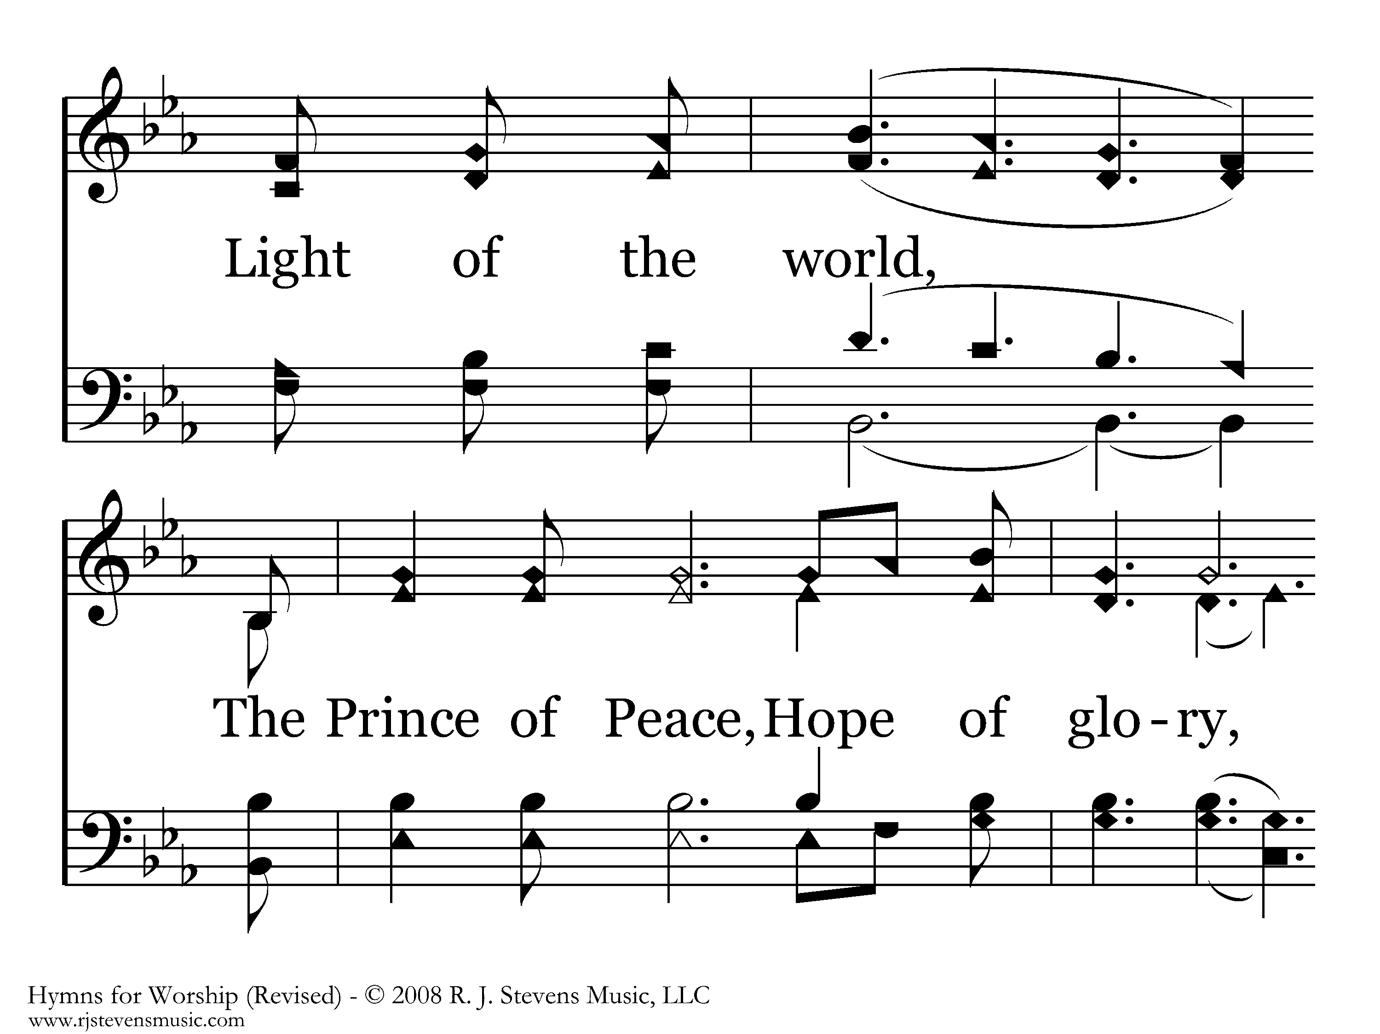
563 - Jesus, Name Above All Names - 2.2

Slide 42
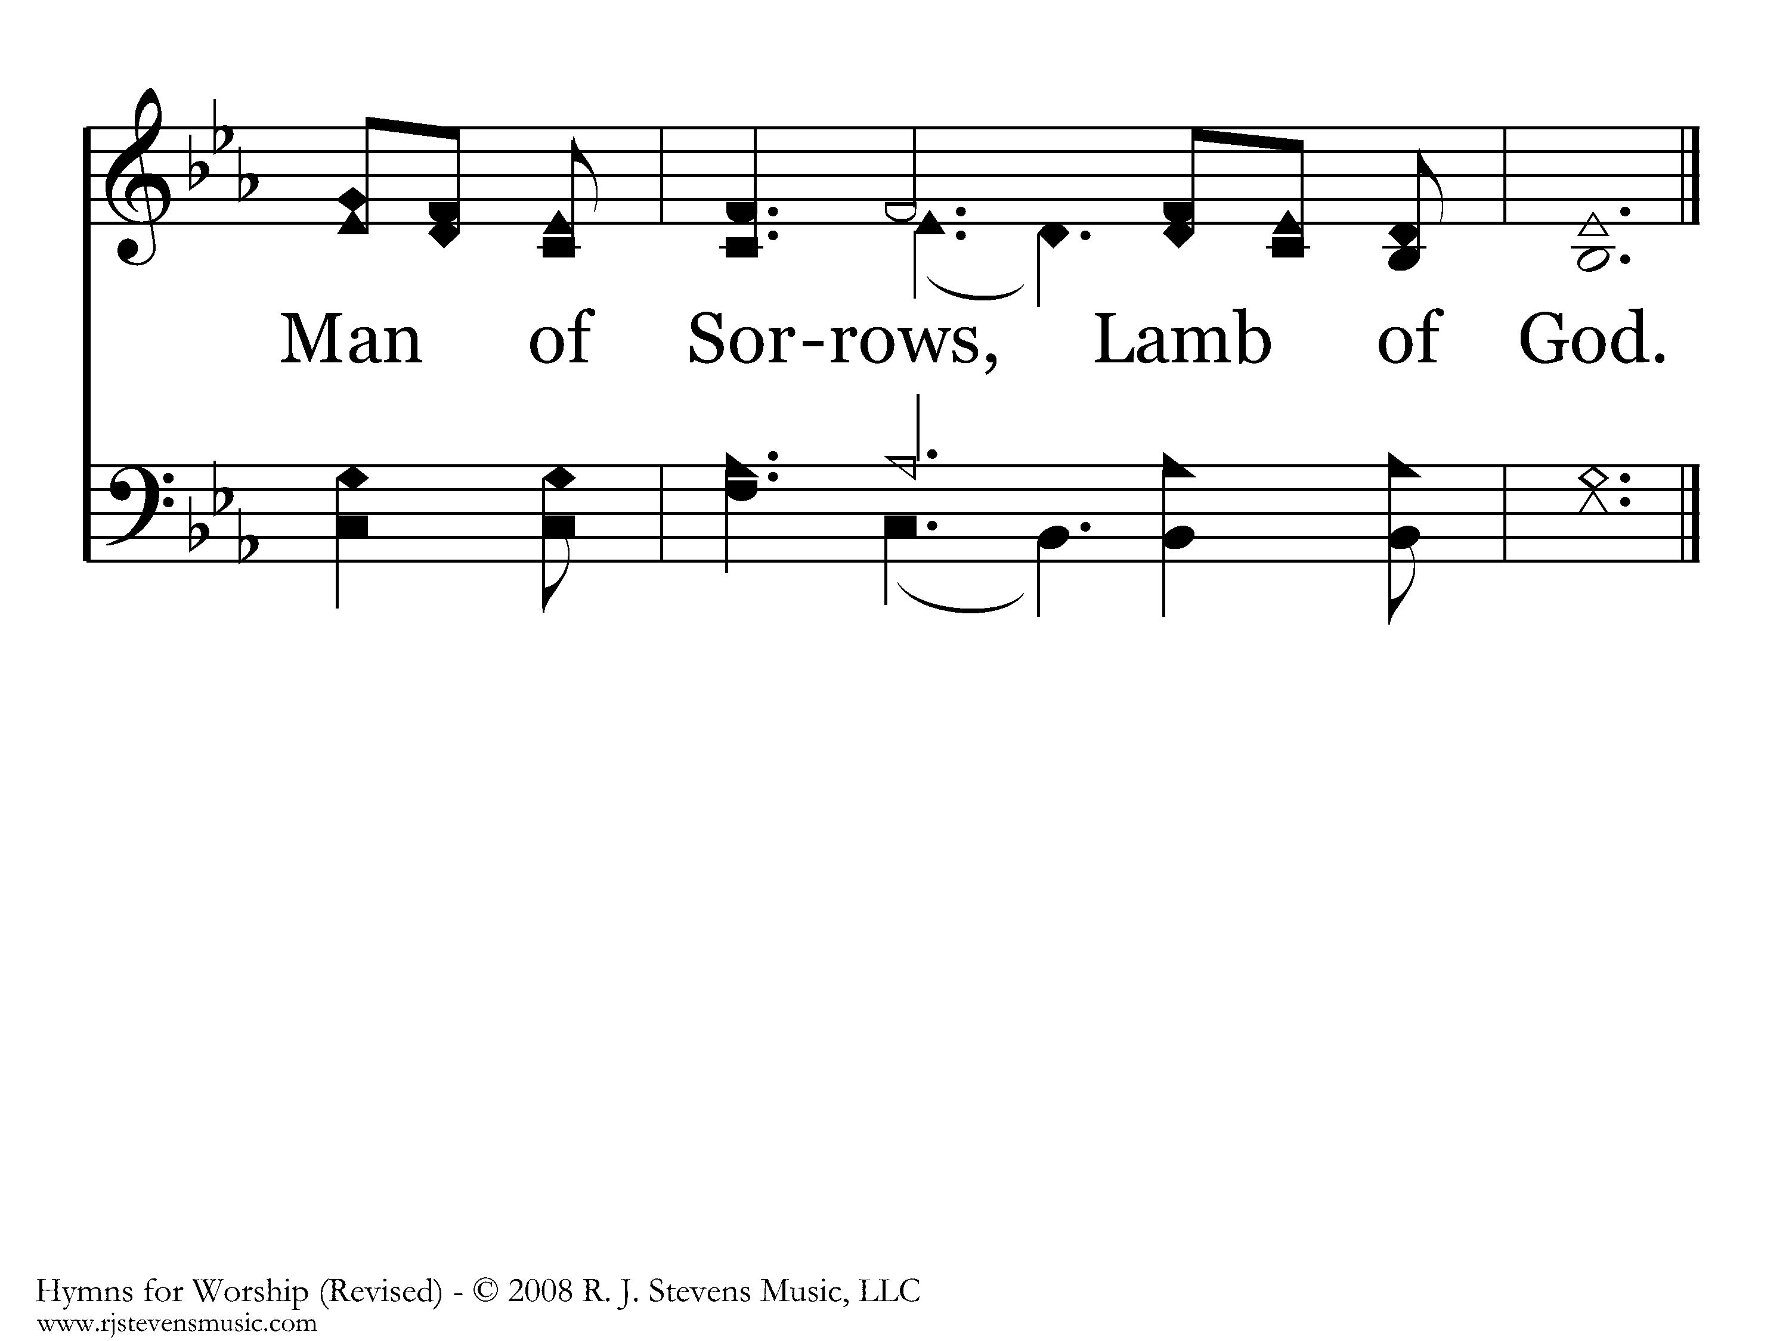
563 - Jesus, Name Above All Names - 2.3
End of Song

Slide 43
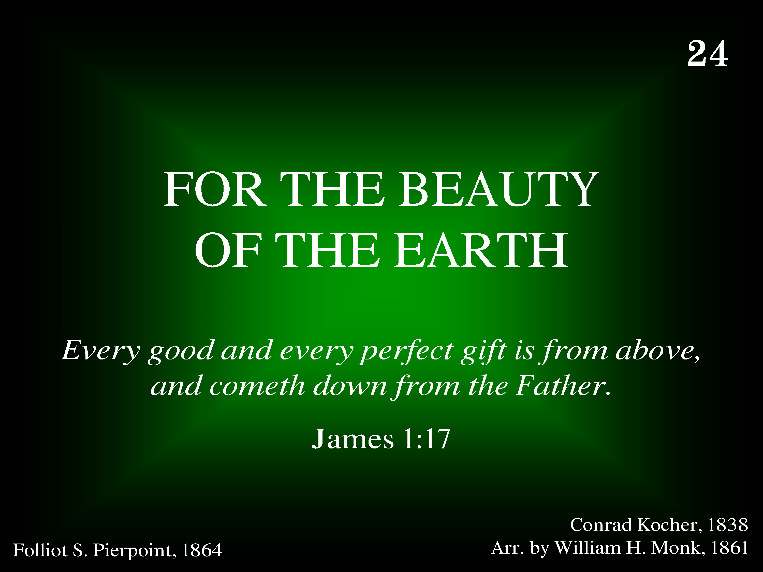
024 - For The Beauty Of The Earth - Title

Slide 44
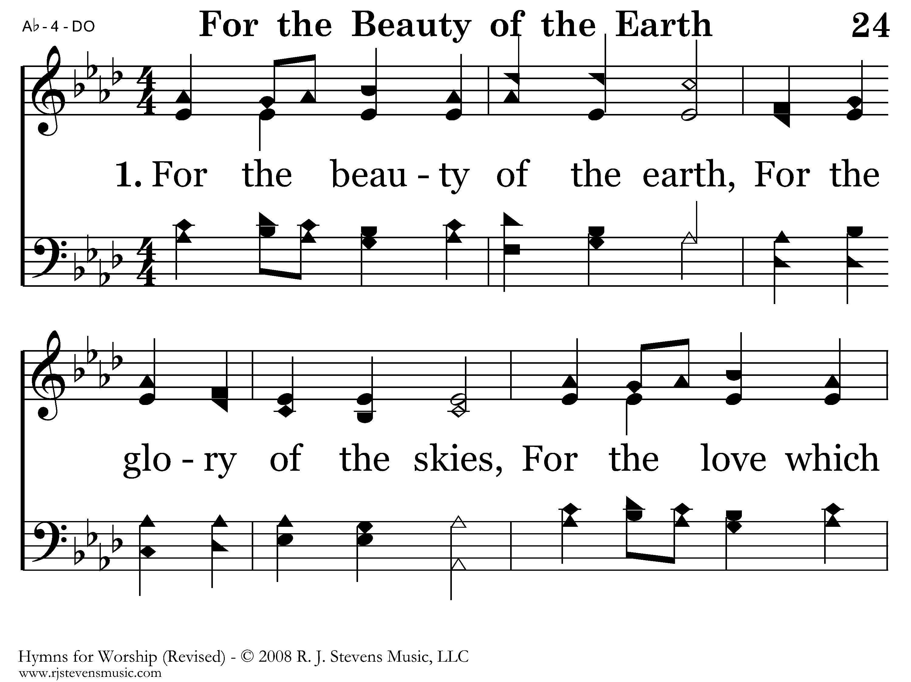
024 - For The Beauty Of The Earth - 1.1

Slide 45
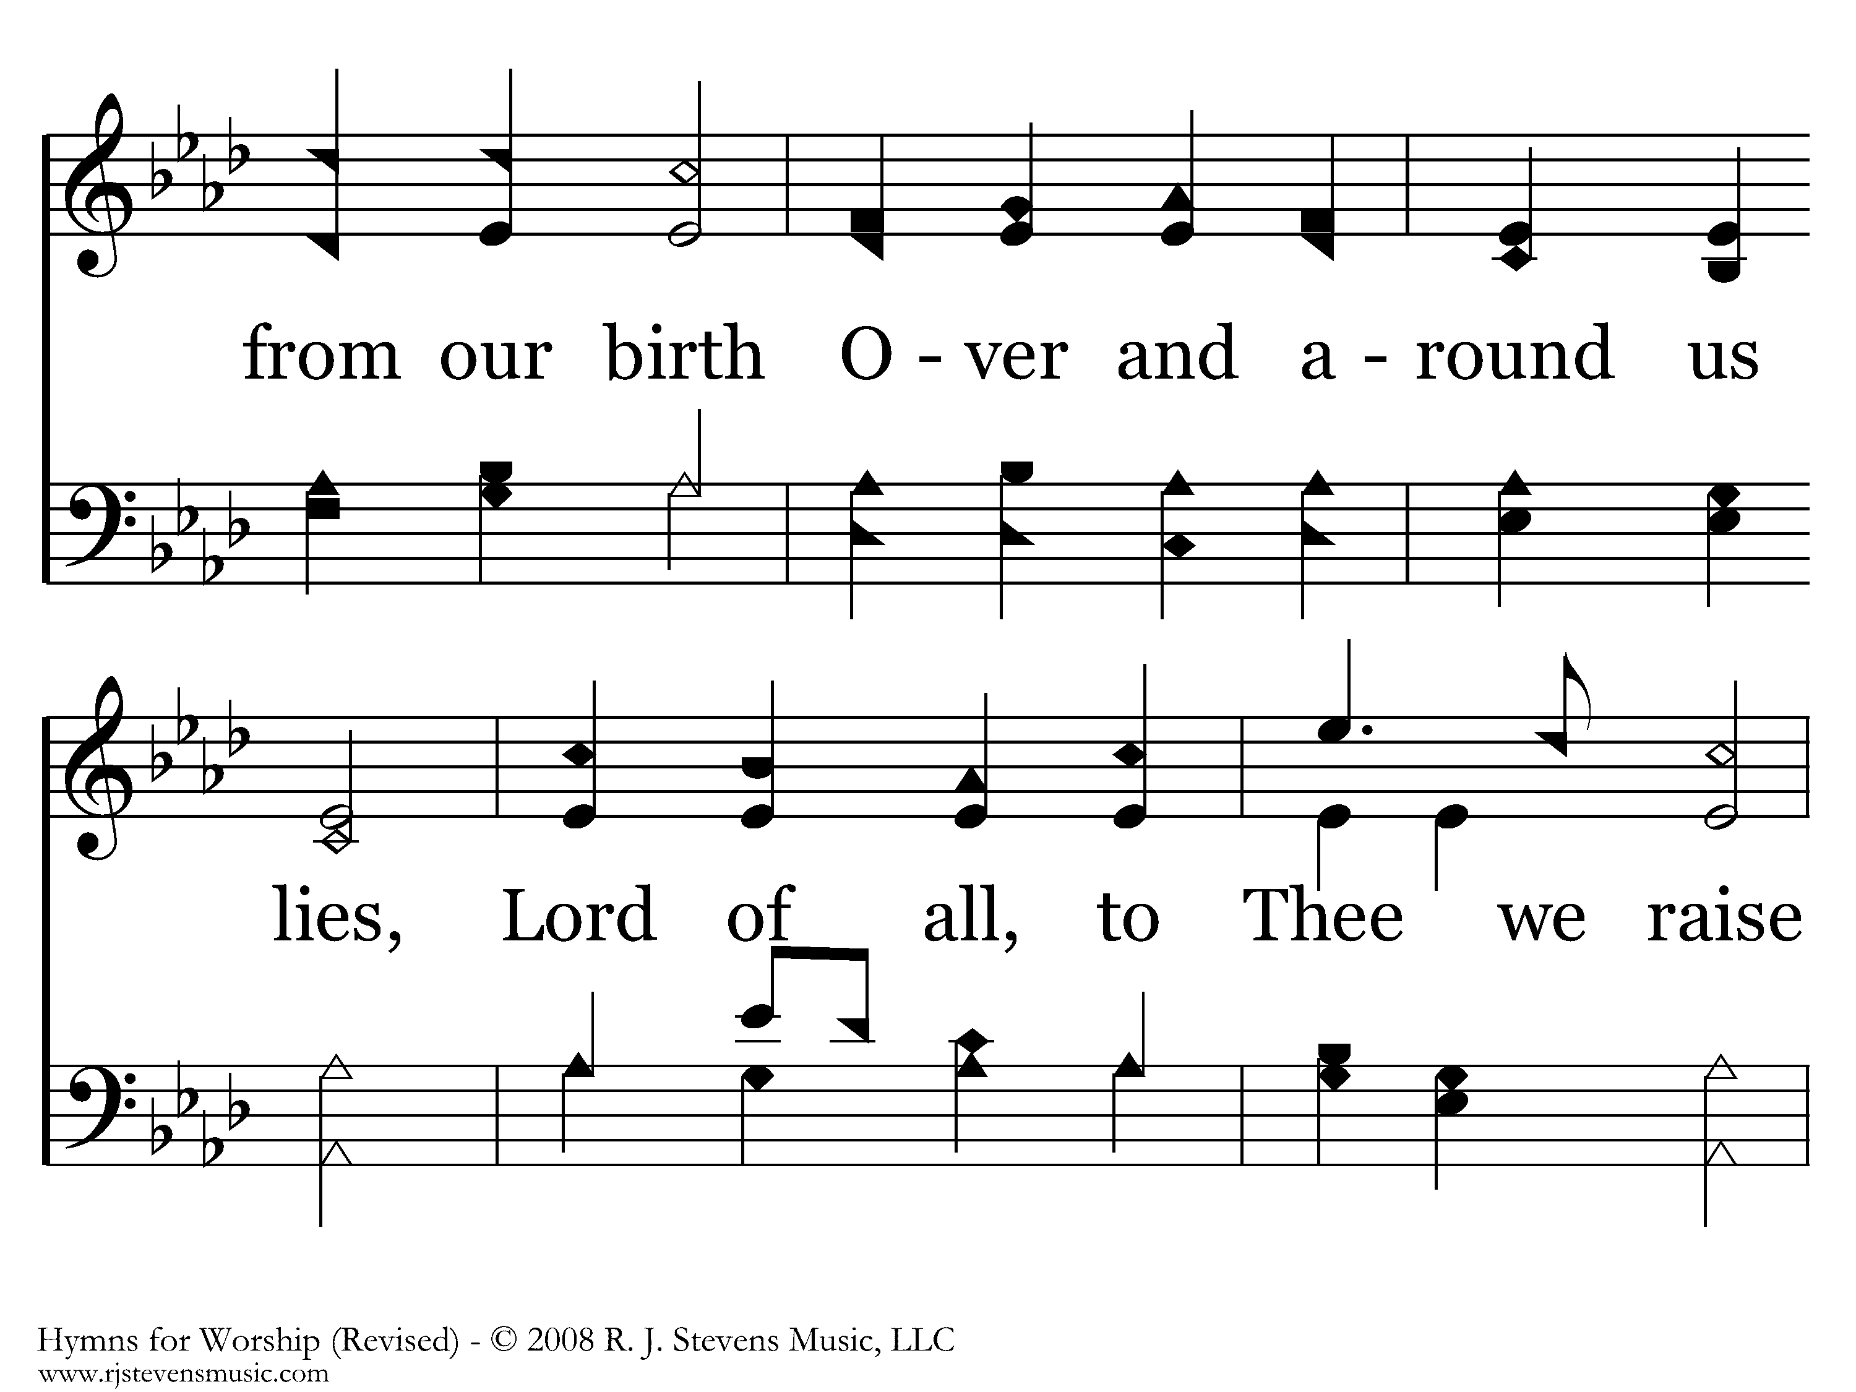
024 - For The Beauty Of The Earth - 1.2

Slide 46
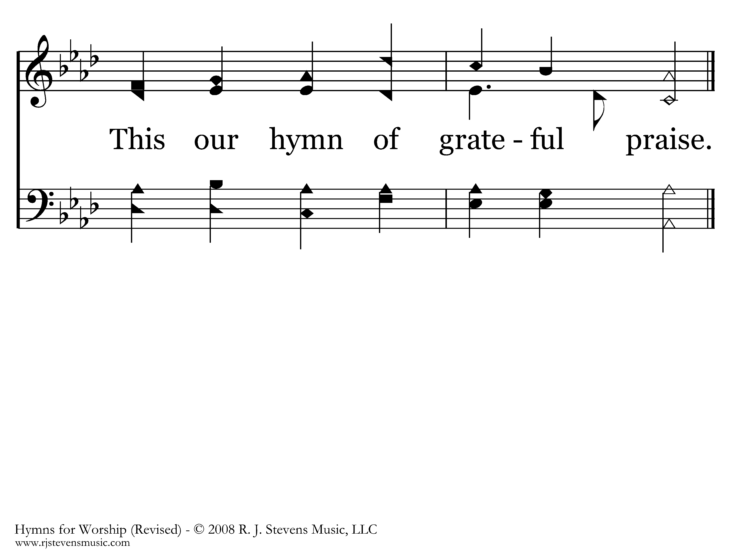
024 - For The Beauty Of The Earth - 1.3
End of Verse 1

Slide 47
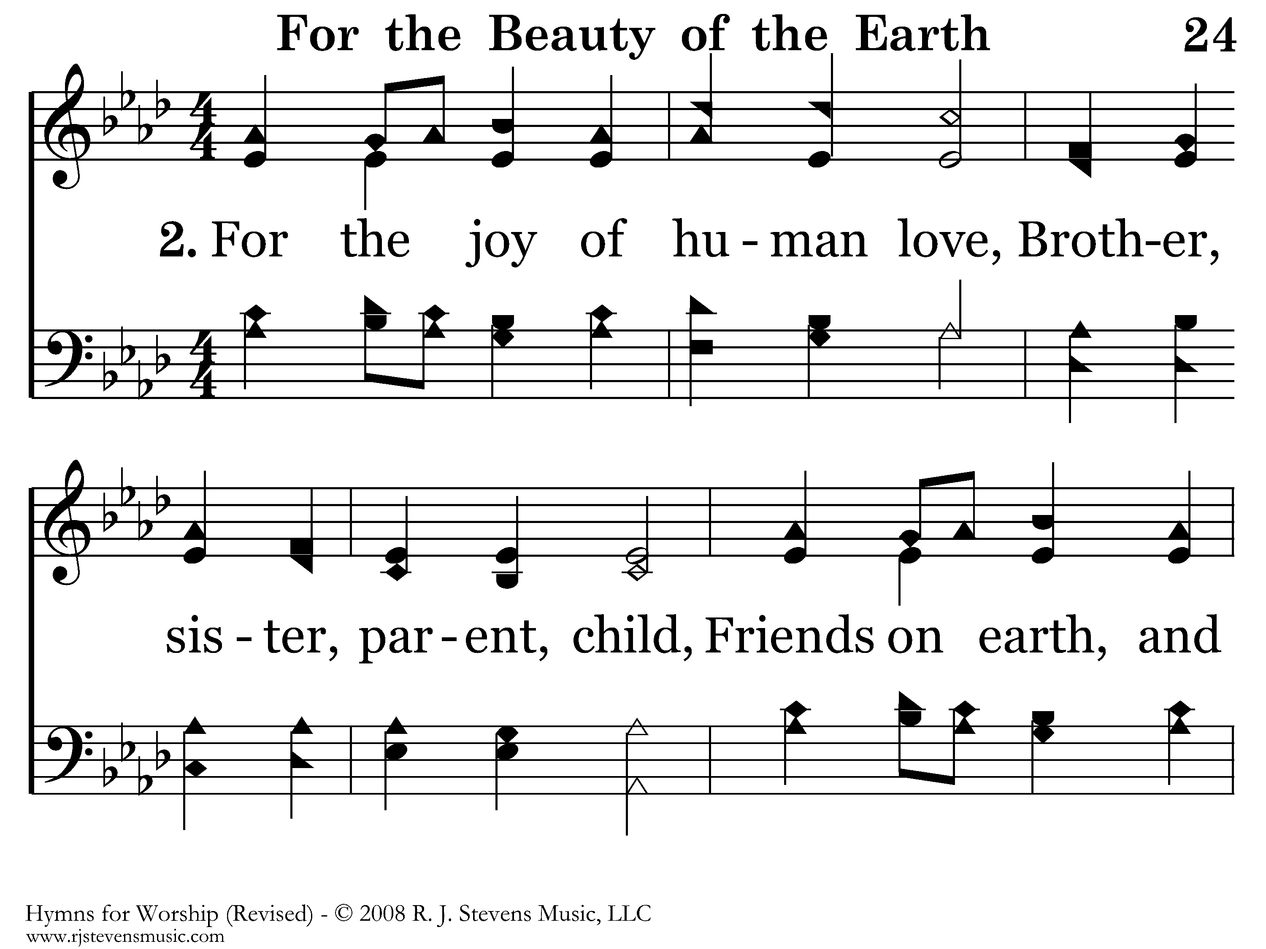
024 - For The Beauty Of The Earth - 2.1

Slide 48
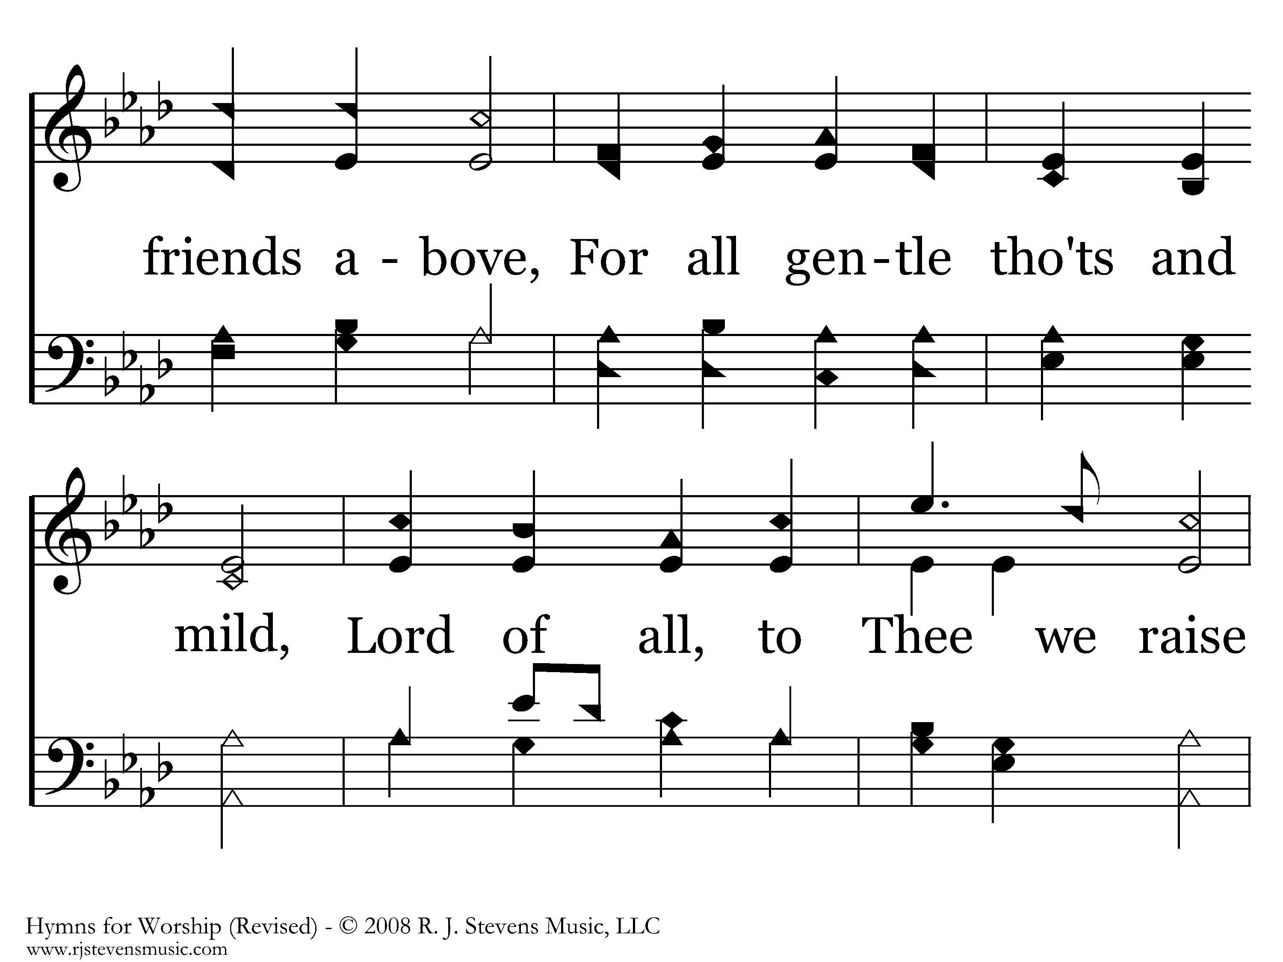
024 - For The Beauty Of The Earth - 2.2

Slide 49
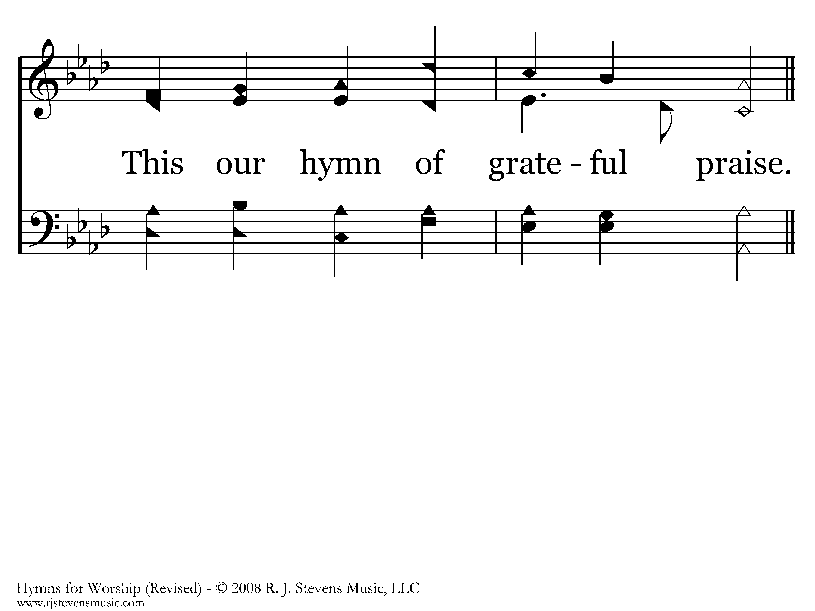
024 - For The Beauty Of The Earth - 2.3
End of Verse 2

Slide 50
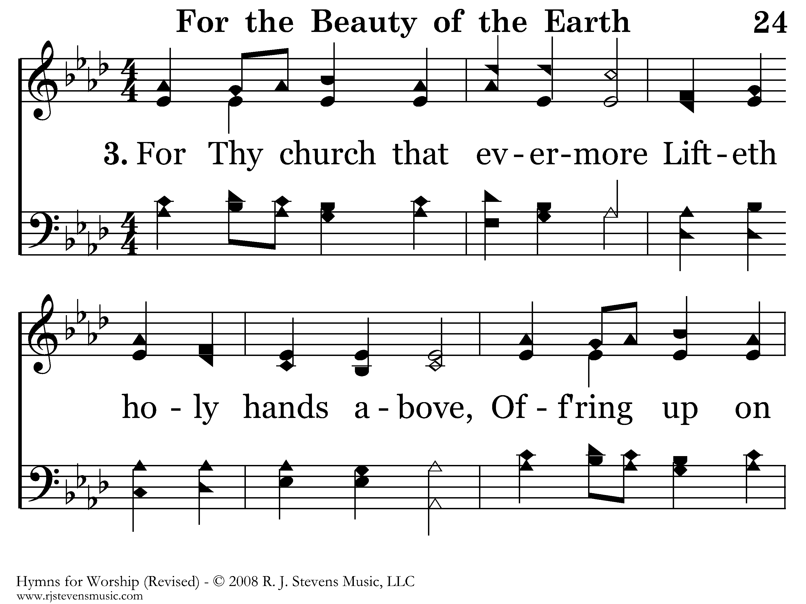
024 - For The Beauty Of The Earth - 3.1

Slide 51
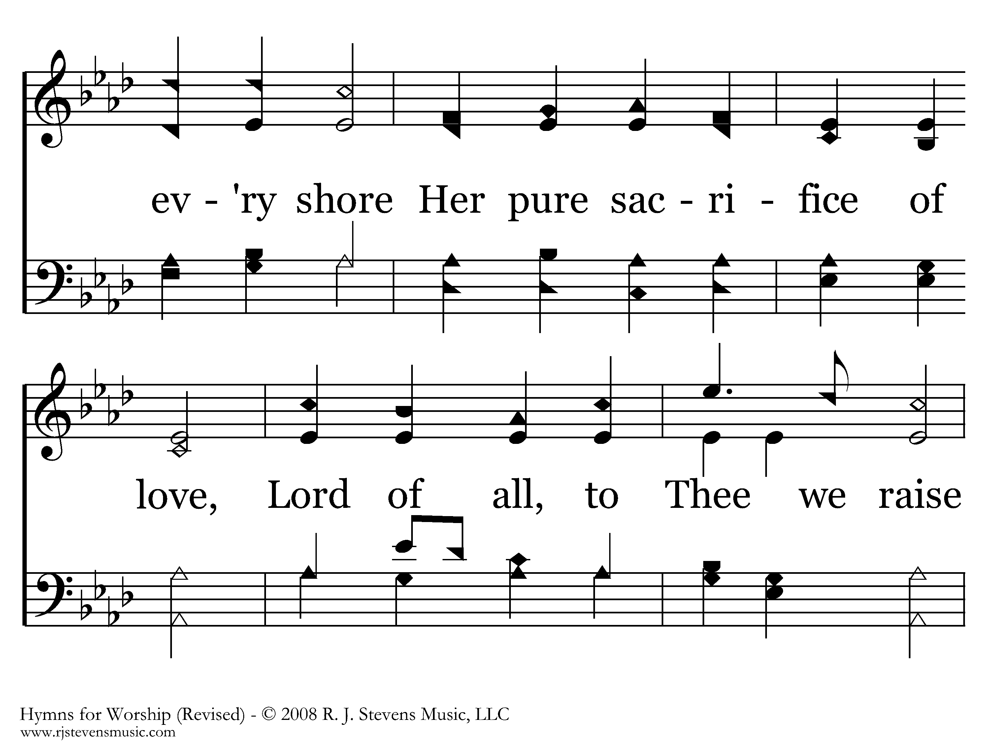
024 - For The Beauty Of The Earth - 3.2

Slide 52
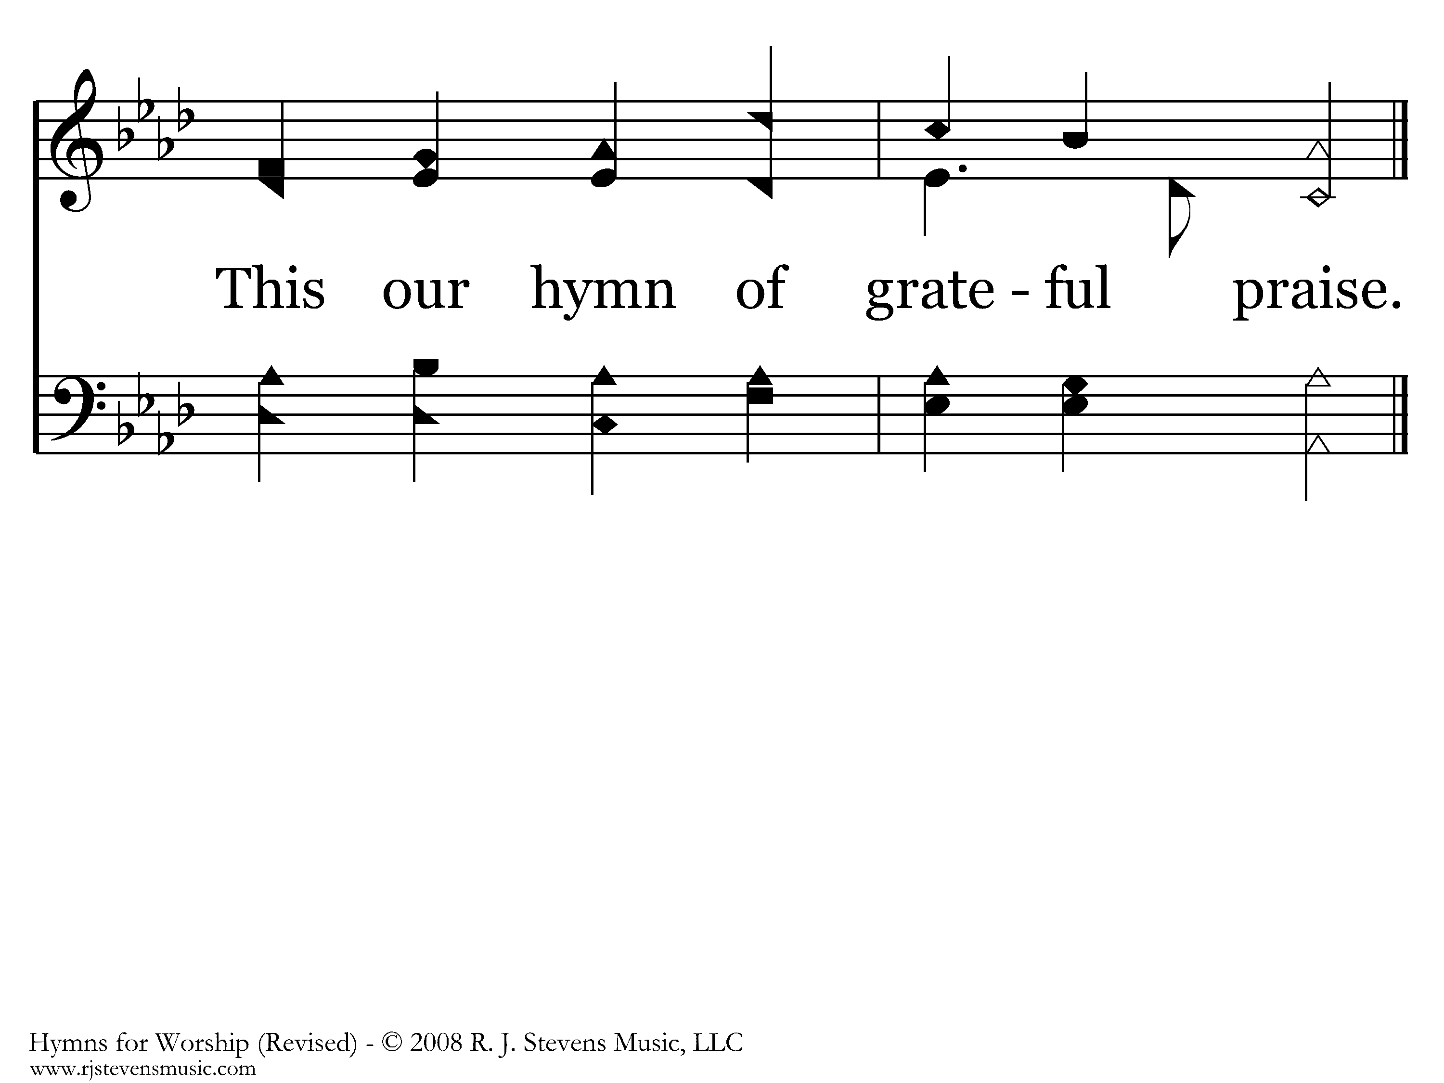
024 - For The Beauty Of The Earth - 3.3
End of Song

Slide 53
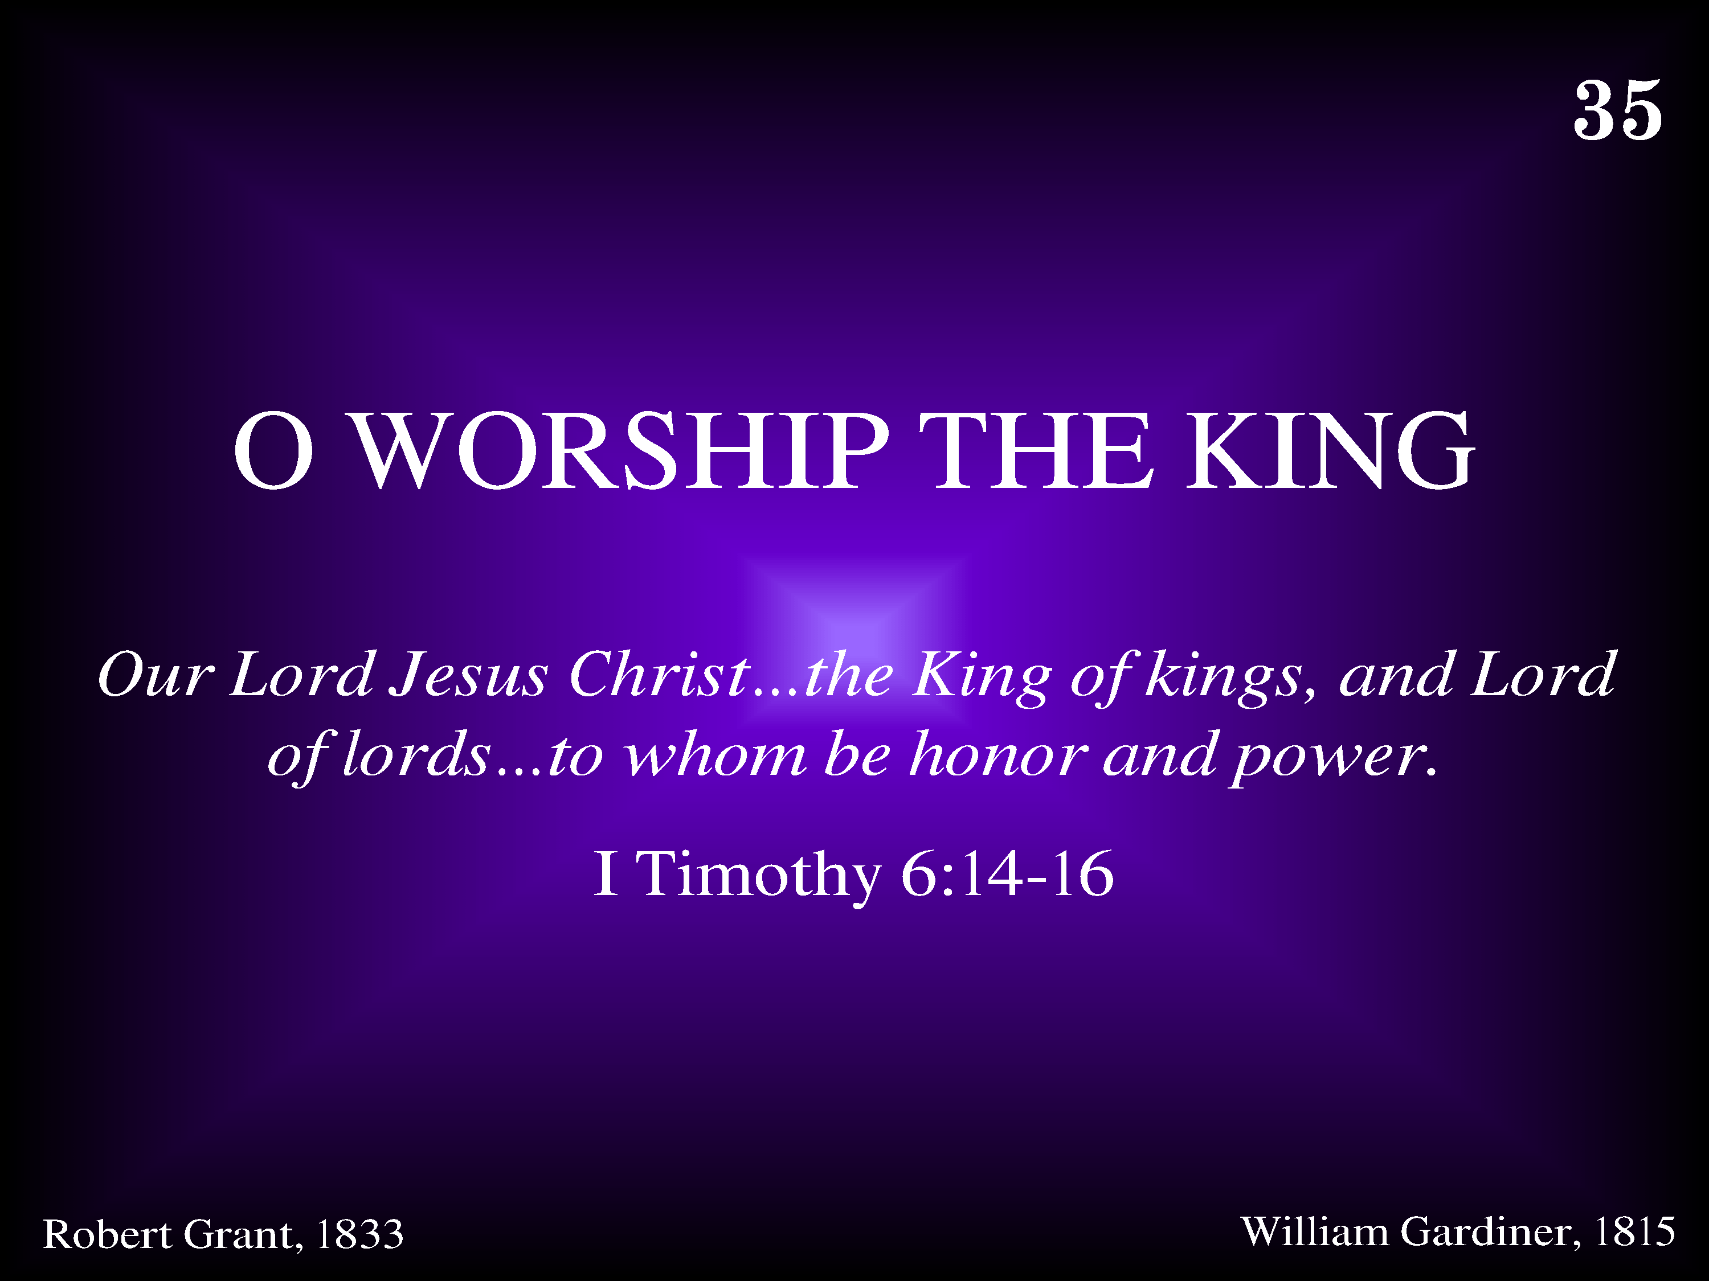
035 - O Worship The King - Title

Slide 54
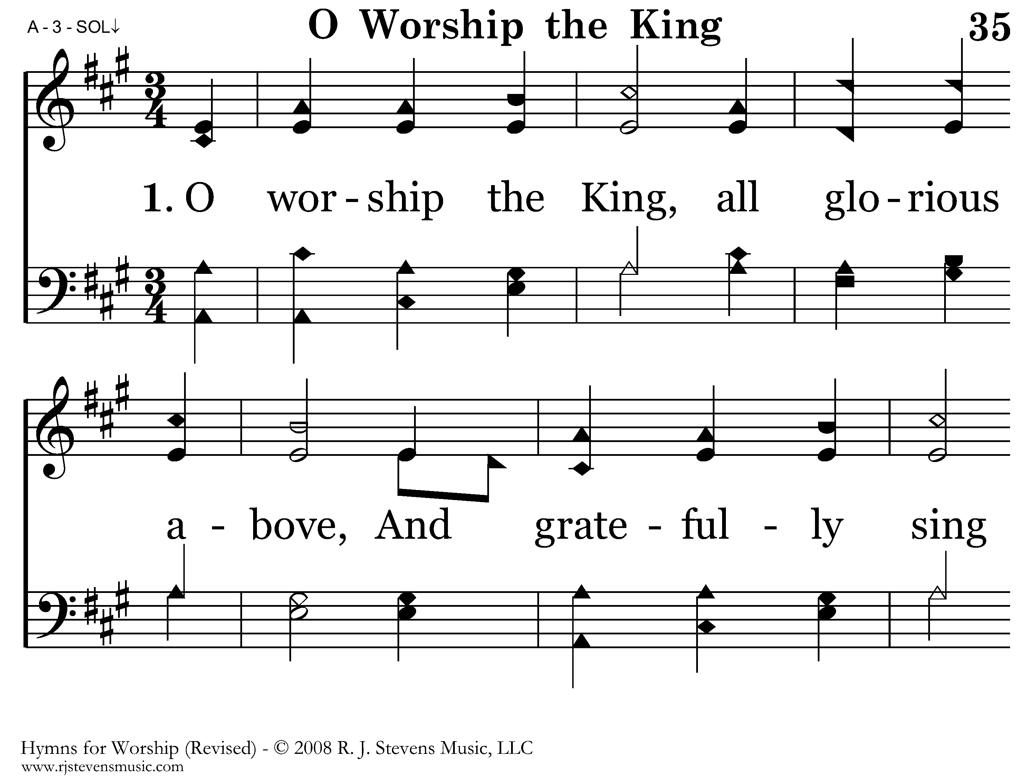
035 - O Worship The King - 1.1

Slide 55
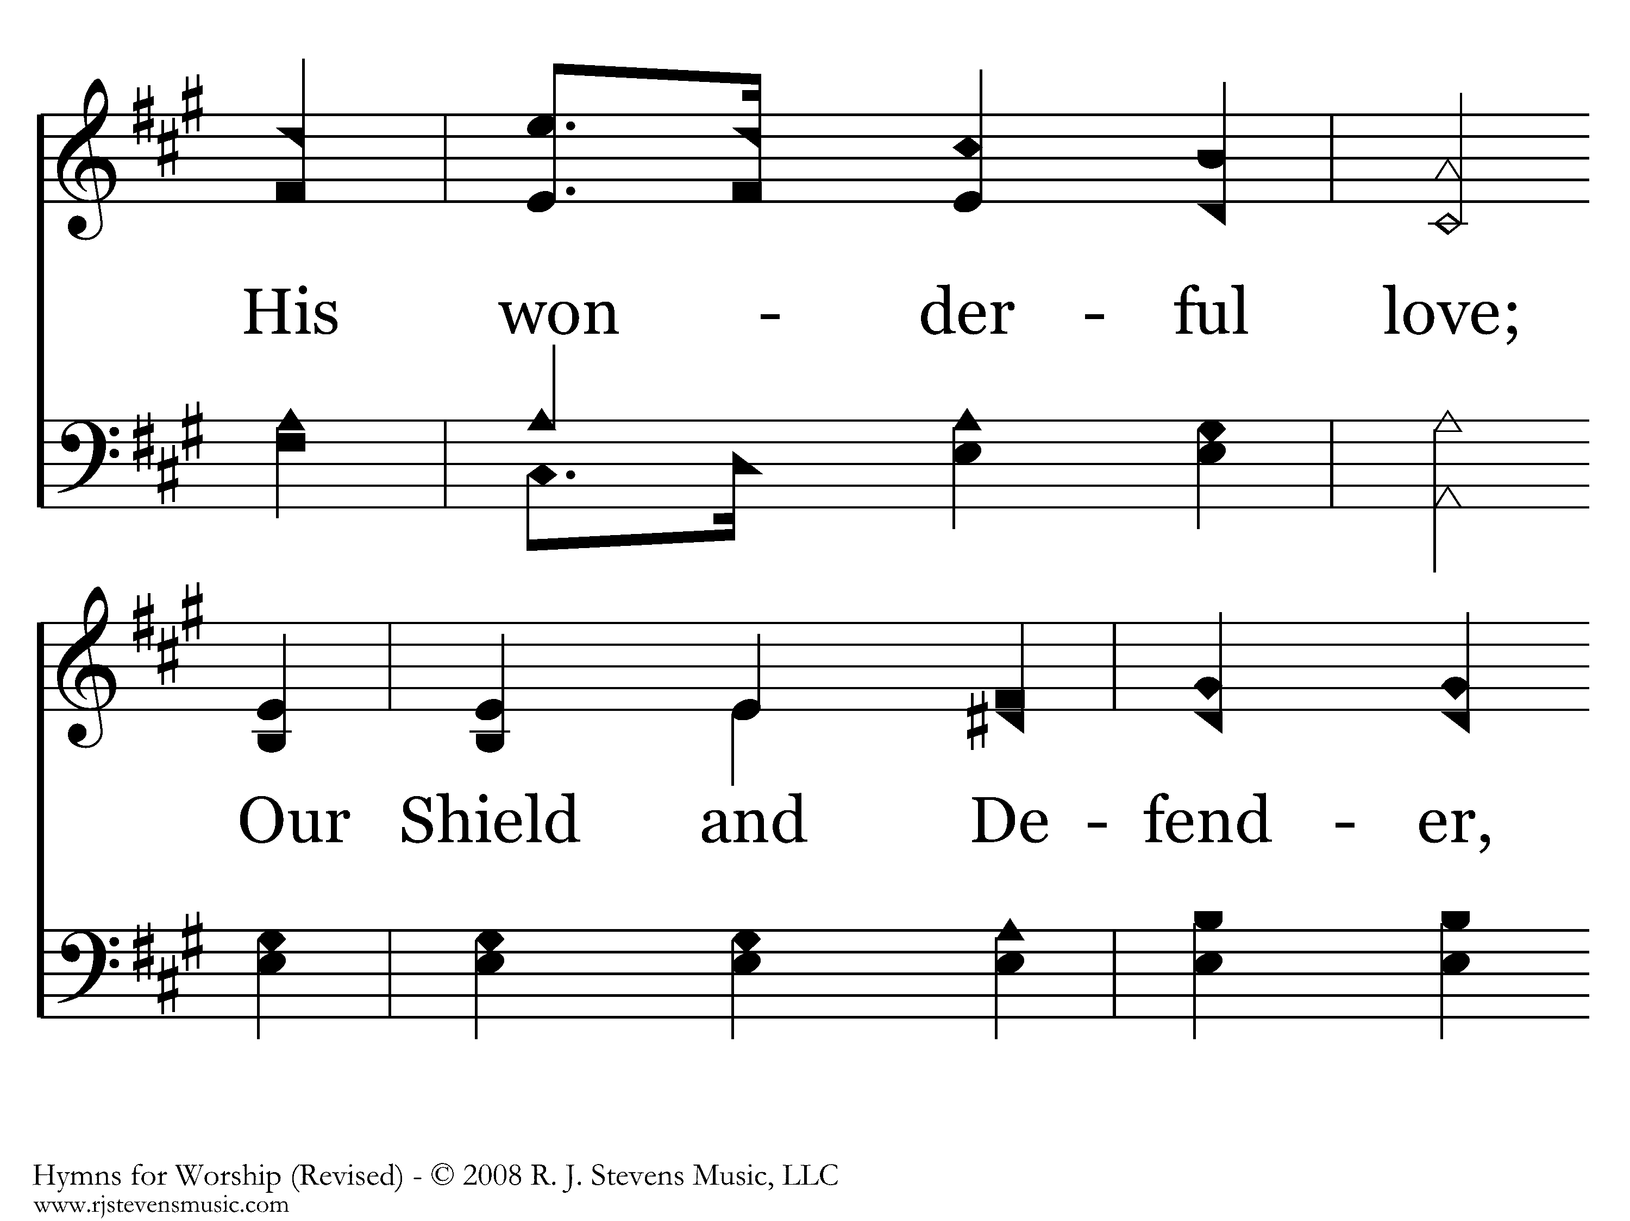
035 - O Worship The King - 1.2

Slide 56
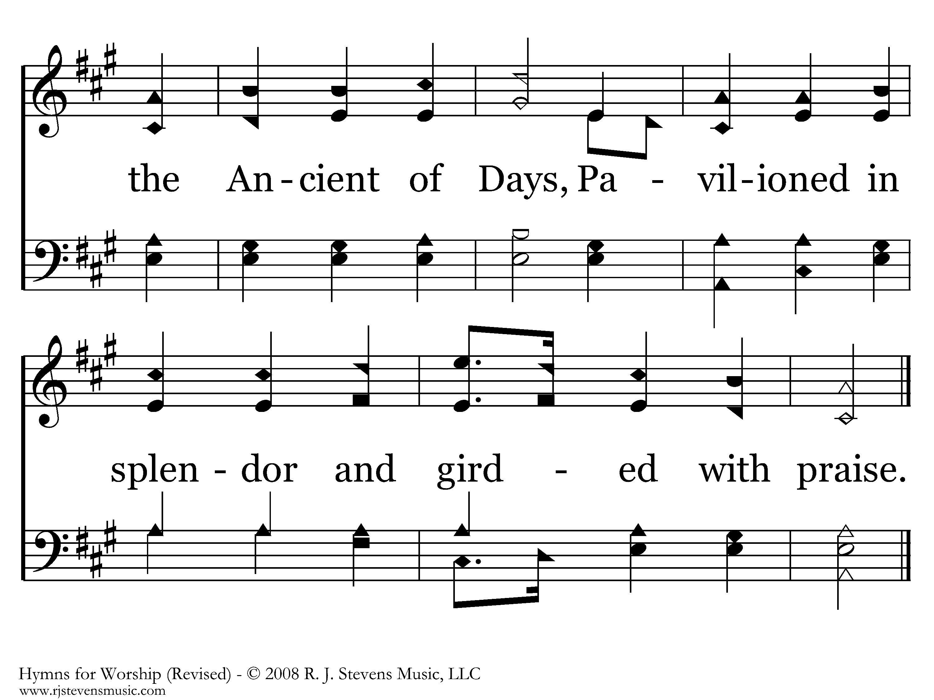
035 - O Worship The King - 1.3
End of Verse 1

Slide 57
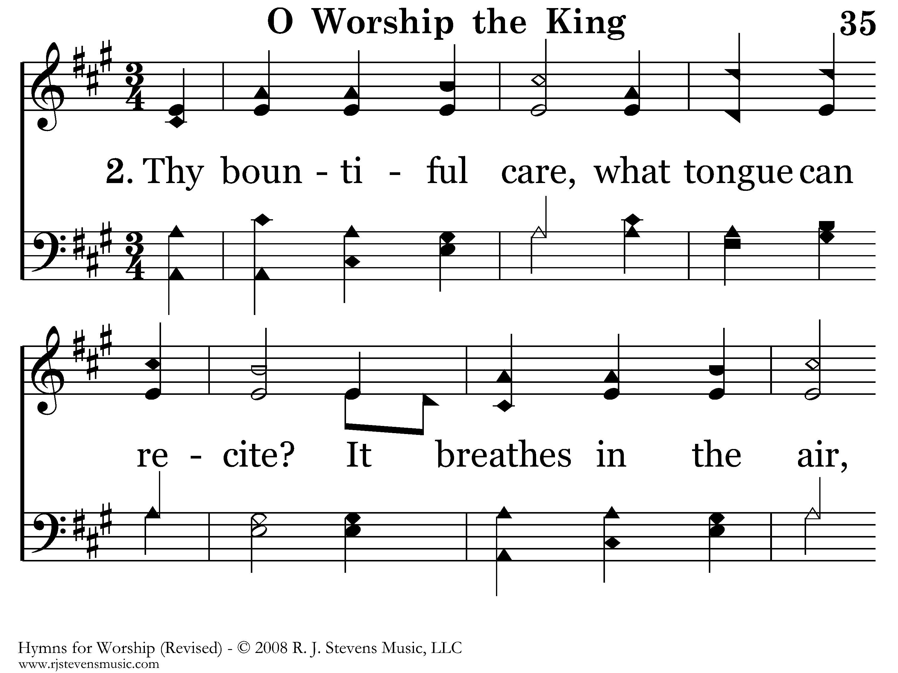
035 - O Worship The King - 2.1

Slide 58

035 - O Worship The King - 2.2

Slide 59

035 - O Worship The King - 2.3
End of Verse 2

Slide 60

035 - O Worship The King - 3.1

Slide 61

035 - O Worship The King - 3.2

Slide 62

035 - O Worship The King - 3.3
End of Song

Slide 63

072 - Be With Me, Lord - Title

Slide 64

072 - Be With Me, Lord - 1.1

Slide 65

072 - Be With Me, Lord - 1.2
End of Verse 1

Slide 66

072 - Be With Me, Lord - 2.1

Slide 67

072 - Be With Me, Lord - 2.2
End of Verse 2

Slide 68

072 - Be With Me, Lord - 3.1

Slide 69

072 - Be With Me, Lord - 3.2
End of Verse 3

Slide 70

072 - Be With Me, Lord - 4.1

Slide 71

072 - Be With Me, Lord - 4.2
End of Song

Slide 72

402 - Leaning On The Everlasting Arms - Title

Slide 73

402 - Leaning On The Everlasting Arms - 1.1

Slide 74

402 - Leaning On The Everlasting Arms - 1.2

Slide 75

402 - Leaning On The Everlasting Arms - C.1

Slide 76

402 - Leaning On The Everlasting Arms - C.2
End of Verse 1

Slide 77

402 - Leaning On The Everlasting Arms - 2.1

Slide 78

402 - Leaning On The Everlasting Arms - 2.2

Slide 79
402 - Leaning On The Everlasting Arms - C.1

Slide 80
402 - Leaning On The Everlasting Arms - C.2
End of Verse 2

Slide 81

402 - Leaning On The Everlasting Arms - 3.1

Slide 82

402 - Leaning On The Everlasting Arms - 3.2

Slide 83
402 - Leaning On The Everlasting Arms - C.1

Slide 84
402 - Leaning On The Everlasting Arms - C.2
End of Song

Slide 85

626 - It Is Well - Title

Slide 86

626 - It Is Well - 1.1

Slide 87

626 - It Is Well - 1.2

Slide 88

626 - It Is Well - 1.3

Slide 89

626 - It Is Well - 1.4

Slide 90

626 - It Is Well - C.1

Slide 91

626 - It Is Well - C.2
End of Verse 1

Slide 92

626 - It Is Well - 2.1

Slide 93

626 - It Is Well - 2.2

Slide 94

626 - It Is Well - 2.3

Slide 95

626 - It Is Well - 2.4

Slide 96
626 - It Is Well - C.1

Slide 97
626 - It Is Well - C.2
End of Verse 2

Slide 98

626 - It Is Well - 3.1

Slide 99

626 - It Is Well - 3.2

Slide 100

626 - It Is Well - 3.3

Slide 101

626 - It Is Well - 3.4

Slide 102
626 - It Is Well - C.1

Slide 103
626 - It Is Well - C.2
End of Verse 3

Slide 104

626 - It Is Well - 4.1

Slide 105

626 - It Is Well - 4.2

Slide 106

626 - It Is Well - 4.3

Slide 107

626 - It Is Well - 4.4

Slide 108
626 - It Is Well - C.1

Slide 109
626 - It Is Well - C.2
End of Song

Slide 110

063 - I Need Thee Every Hour - Title

Slide 111

063 - I Need Thee Every Hour - 1.1

Slide 112

063 - I Need Thee Every Hour - 1.2

Slide 113

063 - I Need Thee Every Hour - 1.3

Slide 114

063 - I Need Thee Every Hour - 1.4
End of Verse 1

Slide 115

063 - I Need Thee Every Hour - 2.1

Slide 116

063 - I Need Thee Every Hour - 2.2

Slide 117
063 - I Need Thee Every Hour - 2.3

Slide 118

063 - I Need Thee Every Hour - 2.4
End of Verse 2

Slide 119

063 - I Need Thee Every Hour - 3.1

Slide 120

063 - I Need Thee Every Hour - 3.2

Slide 121
063 - I Need Thee Every Hour - 3.3

Slide 122

063 - I Need Thee Every Hour - 3.4
End of Verse 3

Slide 123

063 - I Need Thee Every Hour - 4.1

Slide 124

063 - I Need Thee Every Hour - 4.2

Slide 125

063 - I Need Thee Every Hour - 4.3

Slide 126

063 - I Need Thee Every Hour - 4.4
End of Song

Slide 127

191 - Heaven Holds All To Me - Title

Slide 128

191 - Heaven Holds All To Me - 1.1

Slide 129

191 - Heaven Holds All To Me - 1.2

Slide 130

191 - Heaven Holds All To Me - C.1

Slide 131

191 - Heaven Holds All To Me - C.2
End of Verse 1

Slide 132

191 - Heaven Holds All To Me - 2.1

Slide 133

191 - Heaven Holds All To Me - 2.2

Slide 134
191 - Heaven Holds All To Me - C.1

Slide 135
191 - Heaven Holds All To Me - C.2
End of Verse 2

Slide 136

191 - Heaven Holds All To Me - 3.1

Slide 137

191 - Heaven Holds All To Me - 3.2

Slide 138
191 - Heaven Holds All To Me - C.1

Slide 139
191 - Heaven Holds All To Me - C.2
End of Song

Slide 140

204 - Never Grow Old - Title

Slide 141

204 - Never Grow Old - 1.1

Slide 142

204 - Never Grow Old - 1.2

Slide 143

204 - Never Grow Old - 1.3

Slide 144

204 - Never Grow Old - C.1

Slide 145

204 - Never Grow Old - C.2
End of Verse 1

Slide 146

204 - Never Grow Old - 2.1

Slide 147

204 - Never Grow Old - 2.2

Slide 148

204 - Never Grow Old - 2.3

Slide 149
204 - Never Grow Old - C.1

Slide 150
204 - Never Grow Old - C.2
End of Verse 2

Slide 151

204 - Never Grow Old - 3.1

Slide 152

204 - Never Grow Old - 3.2

Slide 153

204 - Never Grow Old - 3.3

Slide 154
204 - Never Grow Old - C.1

Slide 155
204 - Never Grow Old - C.2
End of Song

Slide 156

194 - When We All Get To Heaven - Title

Slide 157

194 - When We All Get To Heaven - 1.1

Slide 158

194 - When We All Get To Heaven - 1.2

Slide 159

194 - When We All Get To Heaven - C.1

Slide 160

194 - When We All Get To Heaven - C.2

Slide 161

194 - When We All Get To Heaven - C.3
End of Verse 1

Slide 162

194 - When We All Get To Heaven - 2.1

Slide 163

194 - When We All Get To Heaven - 2.2

Slide 164
194 - When We All Get To Heaven - C.1

Slide 165
194 - When We All Get To Heaven - C.2

Slide 166
194 - When We All Get To Heaven - C.3
End of Verse 2

Slide 167

194 - When We All Get To Heaven - 3.1

Slide 168

194 - When We All Get To Heaven - 3.2

Slide 169
194 - When We All Get To Heaven - C.1

Slide 170
194 - When We All Get To Heaven - C.2

Slide 171
194 - When We All Get To Heaven - C.3
End of Song

Slide 172

273 - I'm Not Ashamed - Title

Slide 173

273 - I'm Not Ashamed - 1.1

Slide 174

273 - I'm Not Ashamed - 1.2
End of Verse 1

Slide 175

273 - I'm Not Ashamed - 2.1

Slide 176

273 - I'm Not Ashamed - 2.2
End of Verse 2

Slide 177

273 - I'm Not Ashamed - 3.1

Slide 178

273 - I'm Not Ashamed - 3.2
End of Song

